Slide 1


Connected Systems = Healthier Lifestyle
How Regional Health Connectors
Can Help Your Organization
April 21, 2021
Presenters:
Gillian Grant, Trailhead Institute
Cristina Gair, WMRHA
Mary Burt, Tri-County Health Network
Krystal Baker, NCCHP
Jackie Sievers, QHN

Slide 2
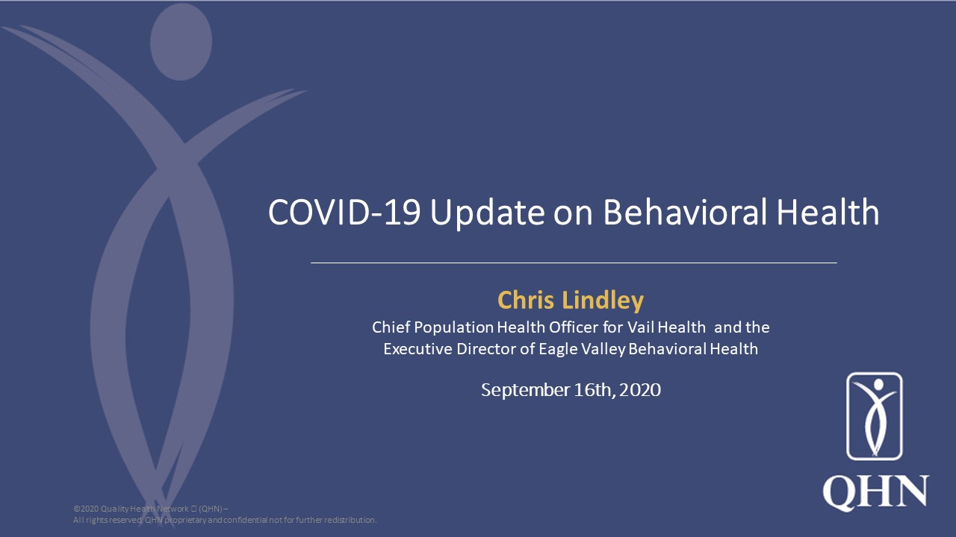
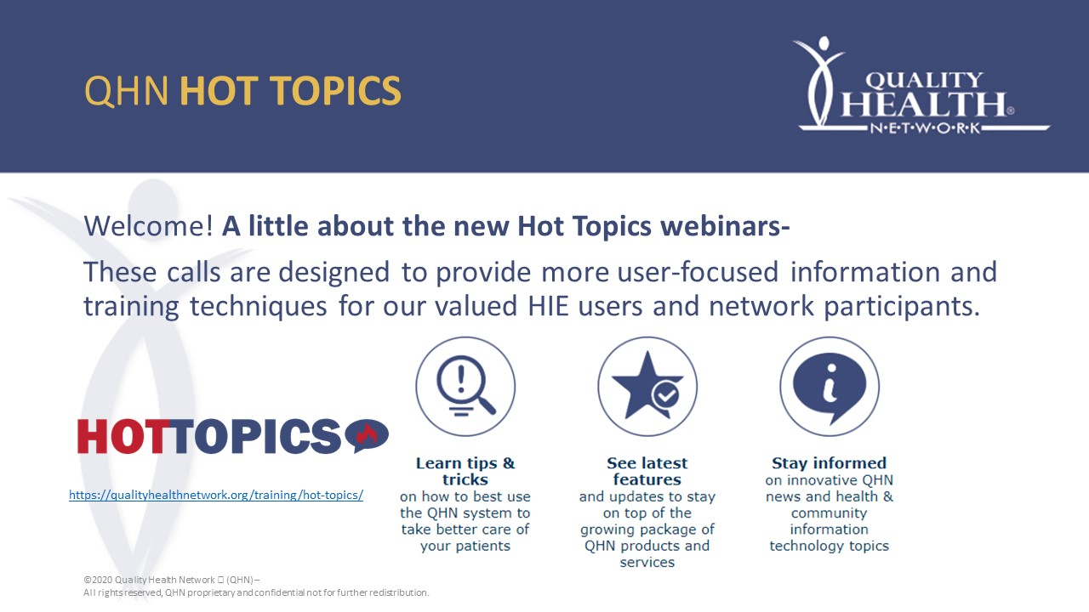

Slide 3
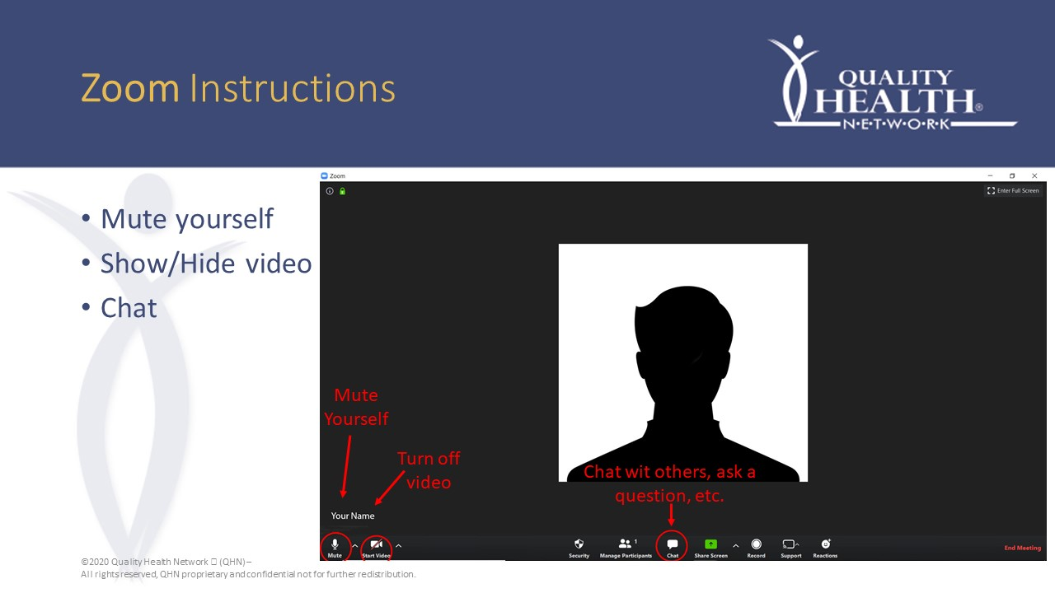
h others, ask a

Slide 4
Agenda
Welcome – Introductions
RHC Background
RHC updates
Questions

Slide 5
Bio- Gillian Grant
Cross Sector Workforce Manager, Trailhead
Gillian Grant, M.P.H., is a program manager for the Regional Health Connectors (RHCs). Working with a variety of partners in public health, she contributes to the implementation, coordination and evaluation of the program. Gillian provides technical assistance for the RHCs through monthly trainings, annual retreats, weekly newsletters, and 1:1 calls, tailored to the RHCs’ needs. In addition to maintaining regular connection to the RHCs and their host organizations, Gillian builds and sustains relationships with many partners in the RHC program including Colorado Health Institute, University of Colorado Department of Family Medicine, Area Health Education Centers, the Regional Accountable Entities (RAEs), and public health agencies. Gillian has more than 10 years of public health experience in health education, training, program and budget management. She is a natural connector and strongly values relationships across individuals and organizations, as well as is invested in health equity for all to thrive in the environments where they live, work, and play. She loves hiking with her golden retriever, her family, coffee, French fries, hugs, and texting with emojis or gifs.

Slide 6
Bio- Namrata Shrestha
Regional Health Connector, Region 12
Namrata joined WMRHA as the regional health connector for Region 12 (Eagle, Garfield, Pitkin, and Summit counties) in 2017 to identify the priority physical and behavioral issues facing the region, create connections with healthcare providers and other community organizations, and finally develop projects to address these issues and the region’s social determinants of health. Namrata has a Bachelor of Science in Biology from Wichita State in Kansas. Namrata is a native of Nepal, and she worked with Water, Sanitation, and Hygiene (WASH) in the international platform with a variety of partners including Governments, INGO ( UNICEF, World bank, WSSCC), and NGO (Red Cross Nepal, CODEF).

Slide 7
Bio- Cristina Gair
Executive Director
Cristina joined WMRHA as the Alliance's first executive director in 2017 with a focus on developing organizational leadership, strategy, innovation and sustainability. Cristina brings more than 16 years’ experience working with health and human service non-profit organizations in the West Mountain region. Cristina has a Master of Science in Organizational Leadership from Colorado State University and a Bachelor of Journalism from the University of Missouri. Cristina is passionate about creating a community healthcare system that serves all people and believes that this requires a focus on health equity and determinants of health

Slide 8
Bio- Mary Burt
Regional Health Connector
Mary joined Tri-County Health Network in 2020 as the RHC for Gunnison, Hinsdale, Montrose, Delta, Ouray and San Miguel Counties. She supports local community health improvement efforts by building linkages among the various components of the healthcare system, including primary care, behavioral health, governmental agencies, and organizations that build health equity. Before taking this position, Mary worked for 20 years with organizations in Western Colorado develop and sustain programming for food security, immigrant integration, adult and family literacy, health policy, and transportation. Originally from the San Luis Valley, Mary was raised in Gunnison and has a BA in Spanish from Western Colorado University. For Mary, Gunnison never lost its allure, and it is where she currently resides with her husband and teenage son.

Slide 9
Bio- Krystal Baker
Regional Health Connector
Krystal has worked throughout the region building relationships for several years. She recently began work at The Health Partnership working to build and strengthen coordination between primary care, public health, human services, and community organizations in Grand, Jackson, Moffat, Rio Blanco, and Routt counties.

Slide 10
Bio- Jackie Sievers
Director of Implementation
Jackie Sievers is the Director of Implementation for Quality Health Network’s (QHN) Community Resource Network (CRN). She leads the effort onboarding organizations that join CRN, enabling their teams to provide critical resources to individuals more efficiently. Under Jackie’s leadership, CRN grew from 13 first adopters to 50 full-time network partners and it is still growing. With extensive relationship building skills and an inspiring collaborative spirit, Jackie’s passion for community-level change stands out.
Prior to joining QHN, Jackie led the a variety of programs at Hilltop Community Resources including domestic violence services, child and family services, and a residential program for traumatically brain-injured adults. She then led the Quality Assurance/Quality Improvement and Informatics Departments at River Valley Family Health Centers, a Federally Qualified Health Center.

Slide 11

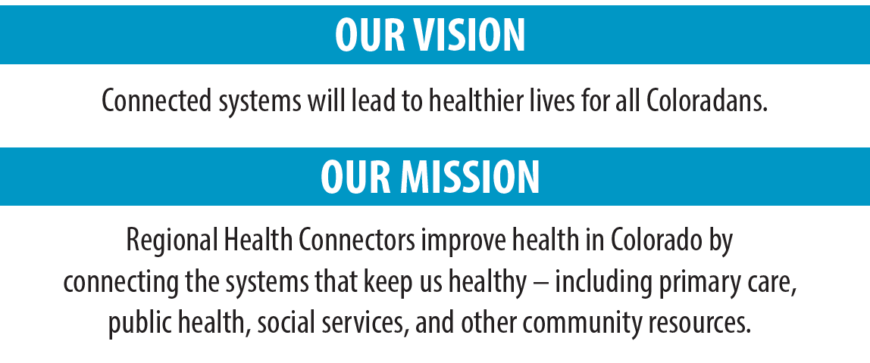
Notes:
Key components –
Local Priority projects
QI ISP support/marketing
Meeting with clinics, practices, RAEs, etc

Slide 12
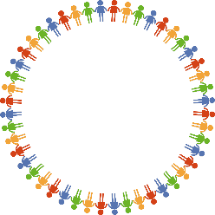


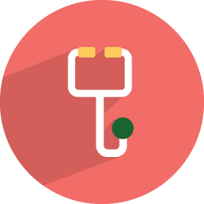
Our Working Definition of Clinical Community Linkages
Developing shared initiatives between clinics and community organizations
Better coordination across systems
Stronger and more effective networks to address SDoH
Stronger social capital
Healthier population, lower coats, happier patients and providers
Increasing awareness of local clinical and community assets
Community
Guiding the development of referral networks
RHCs are embedded in the community & employed by a local organization.
They serve community & clinical partners by…
Educating on best practices to impact SDoH
Clinical
Building & Deepening partnerships and capacity

Slide 13
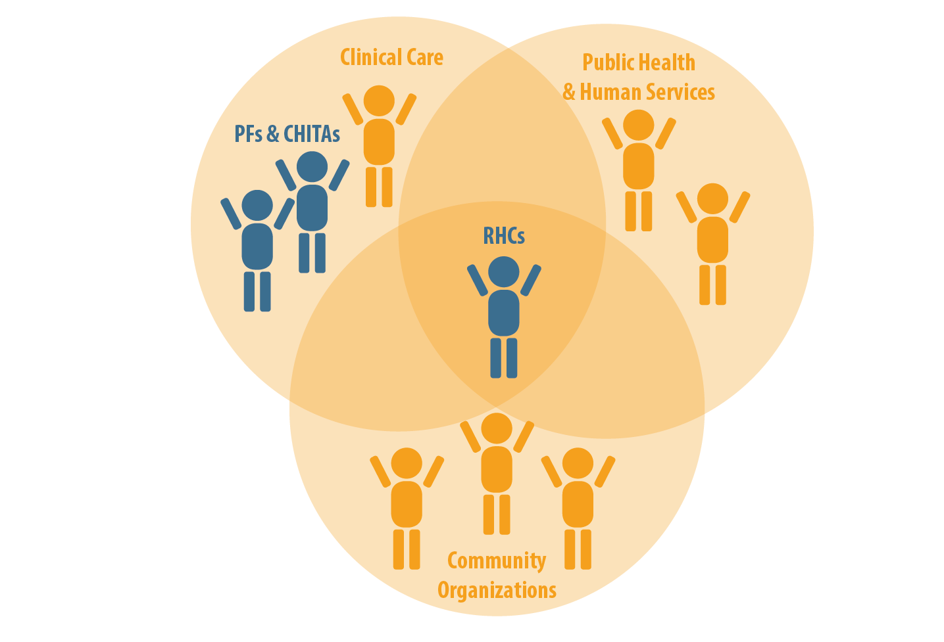
RHCs work across systems
PF – Practice Facilitator
CHITA – Clinical Health Information Technology Advisor
Notes:
Key components –
Local Priority projects
QI ISP support/marketing
Meeting with clinics, practices, RAEs, etc

Slide 14
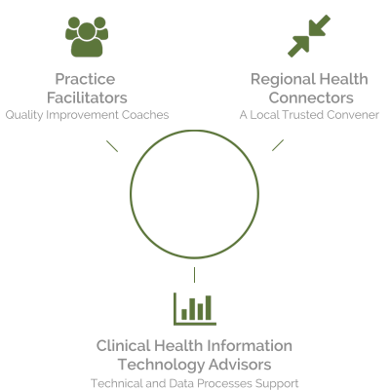
Practice Facilitators
Quality Improvement Coaches
Develop practice leaders that support a culture of improvement
Establish effective quality improvement teams
Identify and solve problems
Link to practices to transformation resources
Regional Health Connectors
A Local Trusted Convener
Live in communities
Link practices to community and statewide resources
Listen for needs and opportunities
Strengthen community capacity to address local health problems
Clinical Health Information Technology Advisors
Technical and Data Processes Support
Support practice data capacity
Analyze and identify ways to improve practice data systems
Optimize workflows for data collection, reporting, and analysis
Notes:
RHCs sit in the middle of these sectors – they connect the systems
Not to be holding up the network, but to build capacity for a network to become self sustaining
No organization can find the solution alone
Like raising a child – constant negotiation and adaptation
Complex issues do not currently have a best practice recipe
Evaluation the death of innovation
For those who love recipes, this is bad news
We need 360 degree intelligence on complex issues

Slide 15
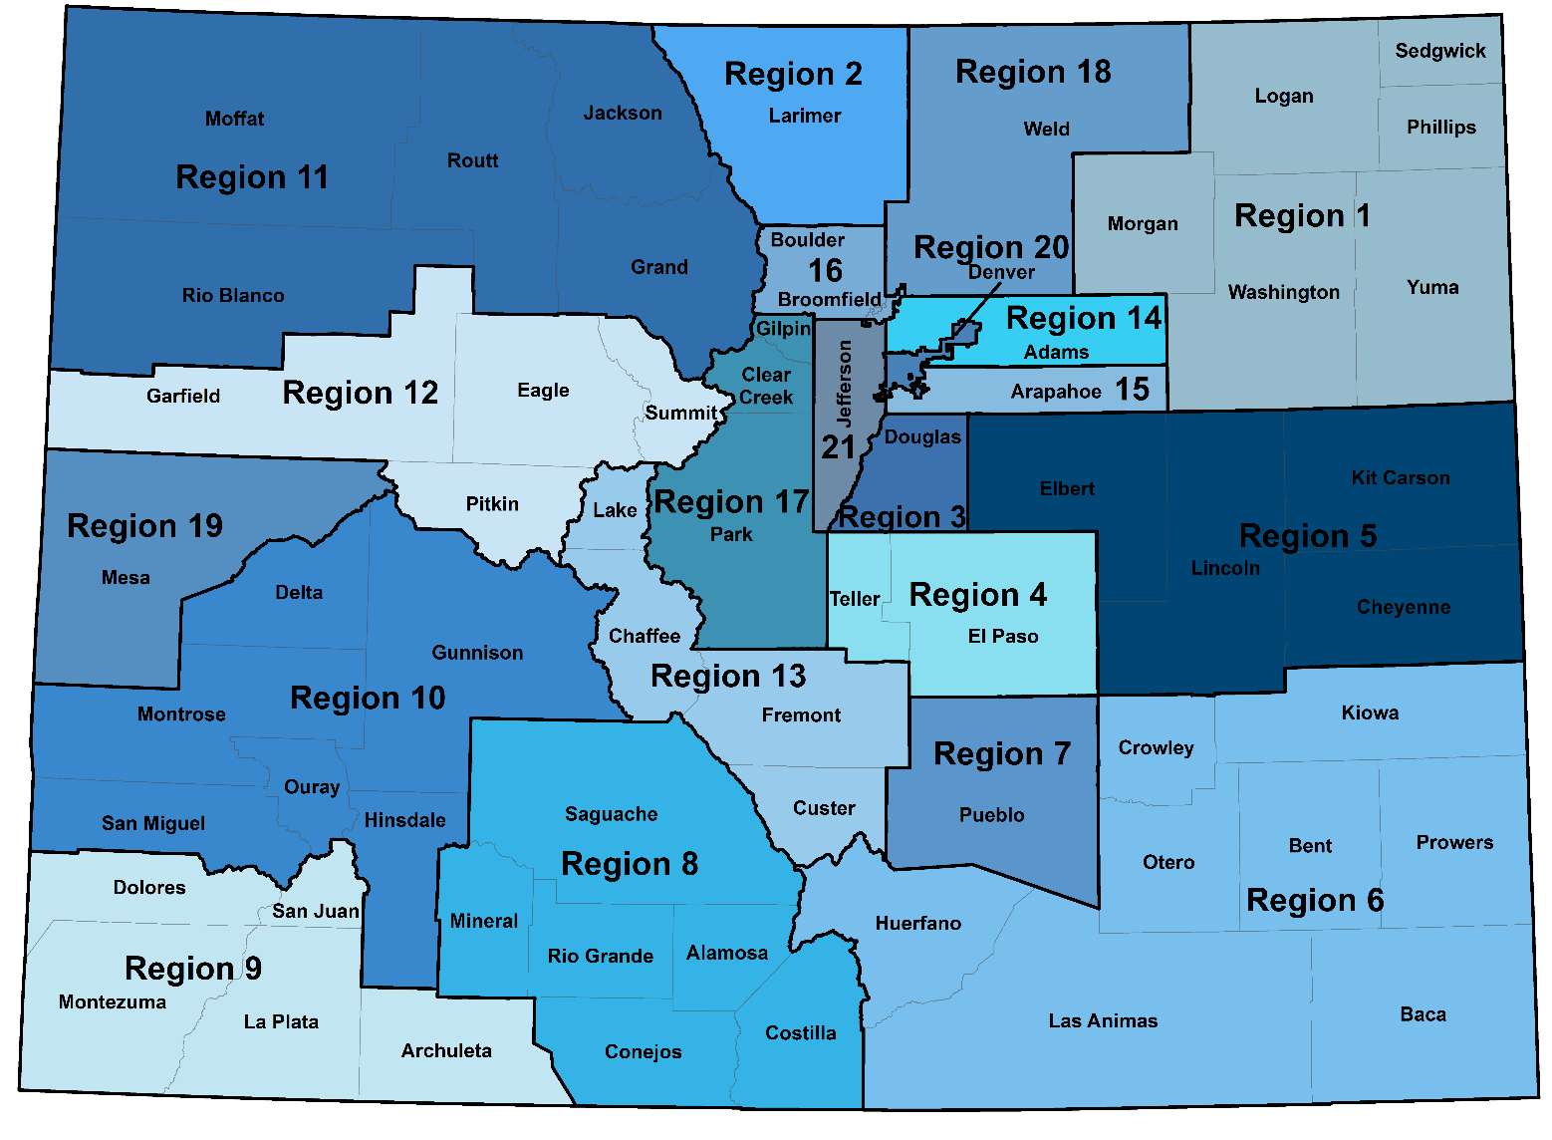
RHCs work in 21 regions across Colorado

Slide 16

Regional Health Connector – Region 12 (Pitkin, Garfield, Eagle and Summit Counties)
West Mountain Regional Health Alliance
Cristina Gair Namrata Shrestha
Executive Director Senior Regional Health Connector
cgair@mountainfamily.org nshrestha@mountainfamily.org
970-618-4646

Slide 17

RHC – Innovative Support Program
Supporting Practice Transformation
Linking community partners
Sharing up-to-date resources
Promoting collaboration among clinical, government and community partners.
RHC support in quality improvement work :
  Social determinant of health
  Mental health
  Substance use disorder

Slide 18
RHC – Local Priority Program
Community Resource Network (CRN)
  Support CRN team in implementing the program
  Share the CRN with clinical, government and community partners.
  Facilitate monthly call
  Developing an online care coordination/resource system
  Motivating CRN partners' staff on engagement weekly.

Slide 19
RHC – Other programs
Accountable Health Communities Model.
  Social Needs screenings completed through March 2021: 10,522
  Patients Identified for Navigation – 681
  Support 24 Clinics and Hospitals on Implementation, Data, and Resources
RHC – Office of Behavioral Health – COVID response for individuals experiencing homelessness
RCORP lead for Eagle Valley
  Development of a Substance use disorder program for prevention, treatment, recovery and provider education

Slide 20
How can RHC support you
Overarching goal of the Regional Health Connector workforce is to promote and support health system change for transformation.
RHCs can offer support in the following ways:
  Collaboration
  Connection
  Resources
  Data
  Facilitation/Convening
  Strategic planning
  Training.

Slide 21
Q & A
Thank you for your time and energy!
Cristina Gair Namrata Shrestha
Executive Director Senior Regional Health Connector
cgair@mountainfamily.org nshrestha@mountainfamily.org
970-618-9723 970-618-4646

Slide 22


Mary Burt
REGIONAL HEALTH CONNECTOR
Delta, Montrose, Gunnison, San Miguel, Ouray Counties
Tri-County Health Network is committed to collaborating with our communities
to improve health for everyone.

Slide 24
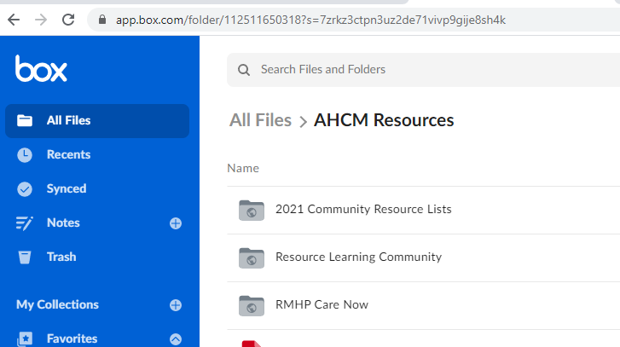
https://app.box.com/s/npueap14693yxnm6zb699aznrncfr4q0
Notes:
Give me thumbs up if you have used this during month of September

Slide 25
Tri-County Health Network Team
Amy Rowan Care Coordination Manager AHCM Lead 970.614.7311 oc-montrose@tchnetwork.org | Amber Kancilia Care Coordinator Ouray / Montrose Counties 970.369.9255 cc-montrose@tchnetwork.org | Amy Efurd Medicaid Care Coordinator Non-Medicaid Wrap Around West End 970-765-8336 cc-we@tchnetwork.org | Mary Burt Regional Health Connector Gunnison, Hinsdale, Montrose, Delta, Ouray & San Miguel Counties 970.729.8373 rhc@tchnetwork.org
Rocky Mountain Health Plans Care Coordination Line 888.282.8801 |  | Shelley Tucker Care Coordinator Gunnison 970.641.7922 Shelley.Tucker@state.co.us | Jamie Hughes Care Coordinator Delta 970.787.5852 Jamie.Hughes@rmhp.org
Regional Care Coordinators
We fight for diversity, equity, and inclusion

Slide 26

Compassionately connecting people to health and well-being resources
Practice Transformation Support
Provide practice transformation opportunities, and information on the Innovation Support Project to practices in the region.
Virtual Collaborative Care Team Project
Improve collaboration between care navigators in our region. The platform will link clinical, behavioral and social service providers to ensure key resource and referral partners can seamlessly care for vulnerable populations.
Krystal Baker
Regional Health Connector
The Health Partnership
kbaker@ncchealthpartnership.org

Slide 27
QHN and RHC Alignment
The Regional Health Connector program focuses on building cross-sector partnerships and synergies between primary care and community health organizations to improve health outcomes.
QHN’s Community Resource Network (CRN) enables Colorado’s medical, social service, and behavioral health providers to better communicate, prioritize actions, collaborate, and improve client outcomes.

Slide 28
QHN’s Priority Project
Increase whole-person care coordination across domains
Increase screening, assessment, and referrals between organizations
Ensure clients access resources
Provide population-level data and outcomes to community leaders and stakeholders

Slide 29
Alignment with NQF
QHN’s project impacts National Quality Forum (NQF) measures in the following ways:
NQF0418- Depression Screening- CRN captures depression screening. Further, addressing SDoH needs such as basic needs, employment and income, and connection to services is shown to improve the mental wellbeing of people.
NQF0421- BMI (Adult)- Linking patients to services and interventions that improve their environment, patients are more likely to be able to live a healthy lifestyle.
NQF0004- Alcohol and Other Drug Screening. CRN can provide critical linkages for people struggling with SUD to services that help address those factors.
NQF0059- Hemoglobin A1c- Diabetic patients need access to refrigeration, healthy food, and need time and support to manage their disease for healthy outcomes and A1c levels.

Slide 30
Our Activities
Engage with the RHC network and participate in statewide and regional trainings and dialogues
Provide information and resources to area providers to meet SDoH needs
Education, support, and problem-solving at a deeper level with practices around SDoH screening and intervention

Slide 31
Next Hot Topics- Save the Dates!
May 19th- QHN’s eCQM Solution
June 16th- Advanced Care Planning
July 21st- CRN Update- New Features and Insights

Slide 32
Thank you!

