Slide 1
Hot Topic
CRN: New Features and Insights
Jason McRoy
July 21, 2021

Slide 2
BIO
Jason McRoy is the Analytics Director for Quality Health Network (QHN), a health information exchange service Western Colorado. With over 18 years of experience in the human services and health industries, Jason has worked collaboratively with community and government agencies to implement innovative solutions to improve the delivery of health and human services. Prior to joining QHN Jason McRoy previously held leadership roles with IBM Watson Health, Boulder County Housing and Human Services and the City and County of Denver.

Slide 3
Outline
Through the CRN Data Looking Glass!
CRN Data Philosophy
Upcoming Data Features: Form Builder and Business Intelligence
Insights and Observations
Summarize the CRN Experience to Date
Presenting Opportunities using CRN data

Slide 4
CRN’s Data Philosophy
Collect
Avoid manual entry where possible
Secure
Share information appropriately using CRN consent and access frameworks
Optimize
Use data to create opportunities to improve cross-sector care
Leverage interfaces and data connections
Offer options for custom entry and collection
Leverage scores or aggregates to share facts without revealing details
Help deliver the right intervention at the right time

Slide 5
CRN Data
Individual Demographics
Identifiers, Contact Information, Characteristics, Census Attributes
Household and Social Connections
Household Members, Relationships, Contacts, Network
Consent and Care Team
Consent Processing, Status, Care Team Membership, Access History
Network Referrals, Logged Referrals, Loop Closure and Results, Searches
Referral Activity
Need Identification
Screens and Assessments, OneView, Health Record Feed, Social Indicators

Slide 6
Upcoming Features
Customized Form Builder
In production now and being used to develop screener and assessment templates (ie. AHCM Screener)
Working on user testing and training plan for roll out to partners
Will allow for customized form templates for: screeners, assessments
and as part of referrals
Sisense Business Intelligence
Embedded report and dashboard utility
In testing now with some development features still underway
Working on a user testing and training plan for roll out to partners

Slide 7
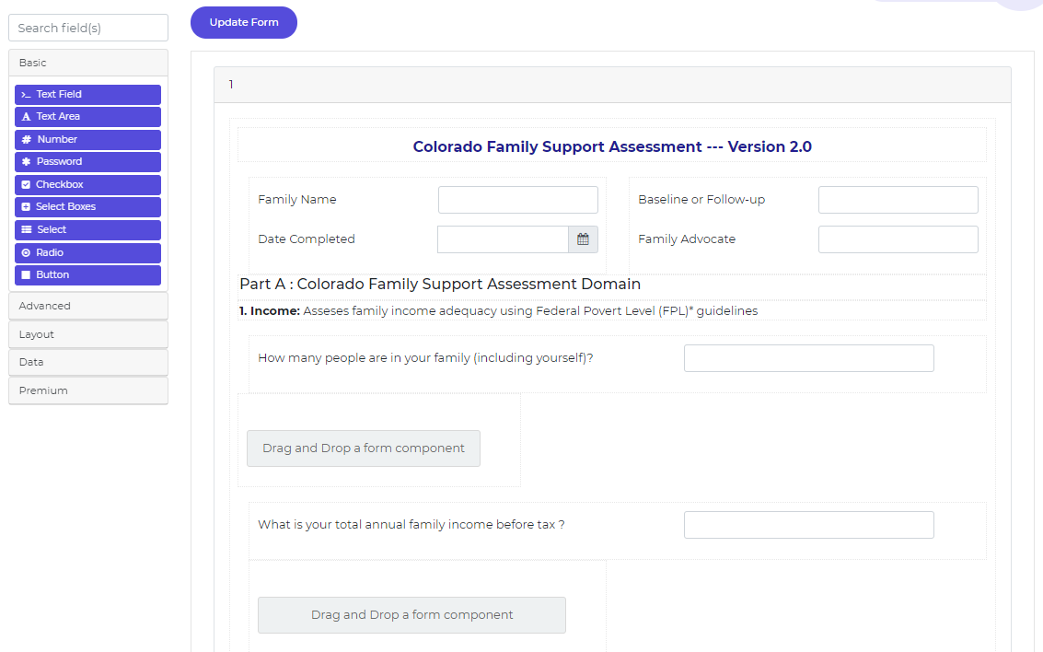
Form Builder

Slide 8
Current Reporting Capabilities
Topical Charts and KPIs
Demographics, Referrals, Care Teams and Consent
Demographic reports currently available at the network level
Export capability by chart/report

Slide 9
Current Reporting
Clickable detail reports

Slide 10
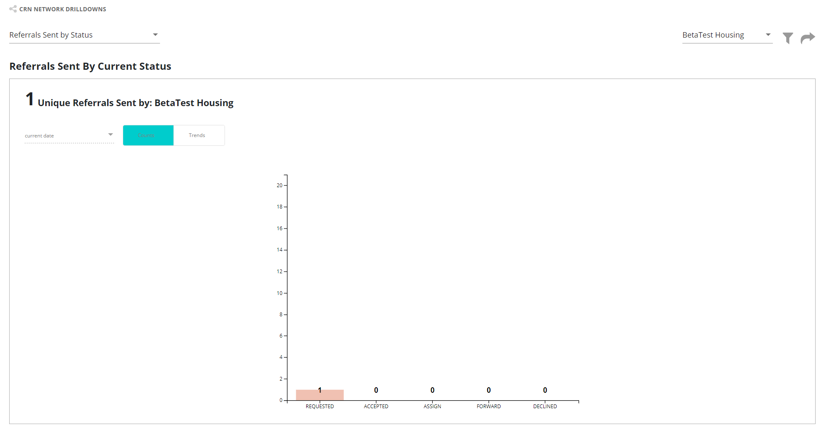
Current Reporting
Export, note filtering does not work

Slide 11
Sisense Integration
Sisense is a 3rd party business intelligence platform
Embedding in CRN to offer more capabilities
Interactive dashboards
More expansive data models
Self-service reporting capabilities

Slide 12
Sisense Dashboard

Slide 13
Sisense Dashboard

Slide 14
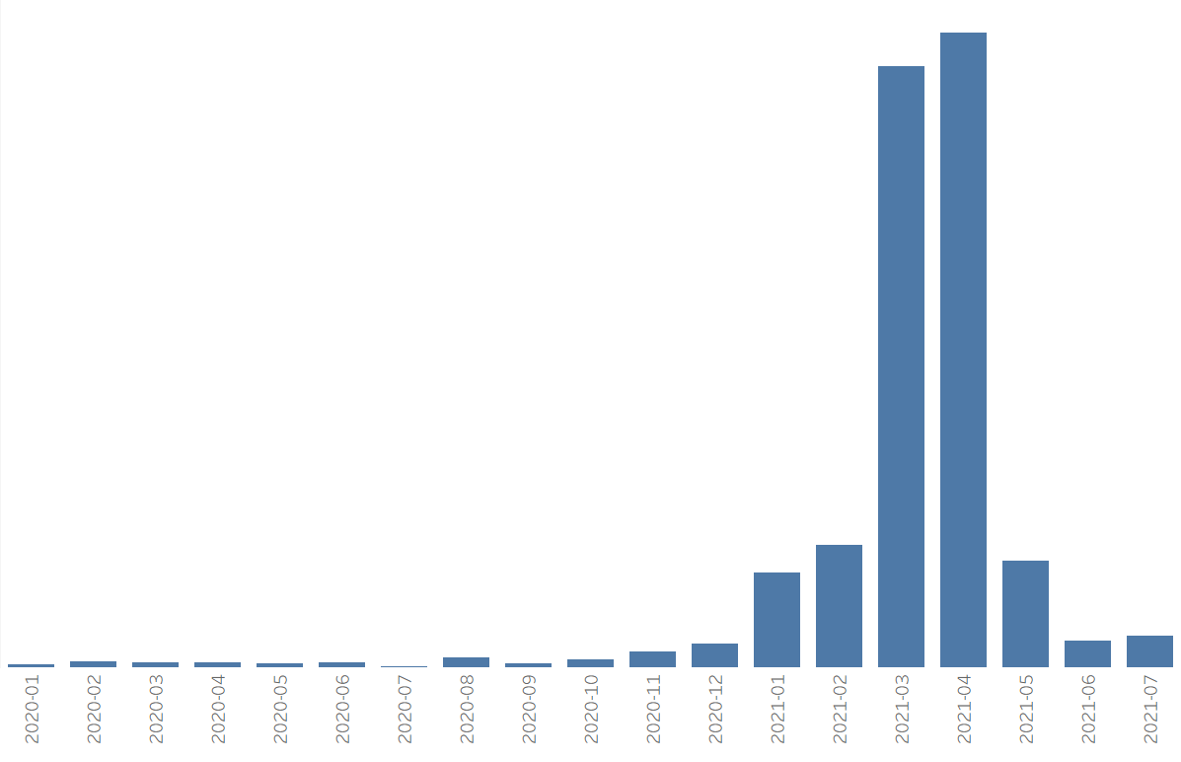
Summary Statistics
2,478 Individual Records in CRN
Delta County Network 2
Mesa County Network 1,931
West Mountain 545

Slide 15
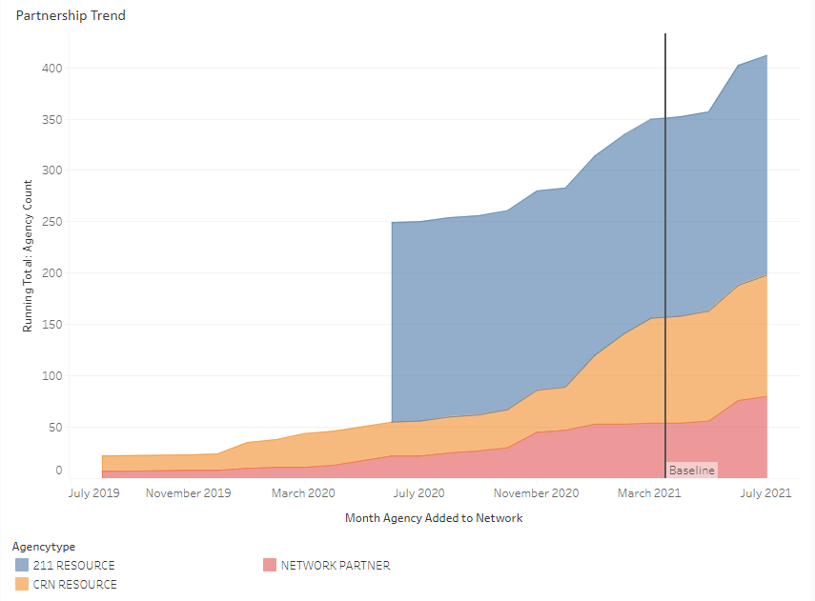
Network Composition
Over 400 agencies in the CRN Resource Directory.
80 are active Network Partners.

Slide 16
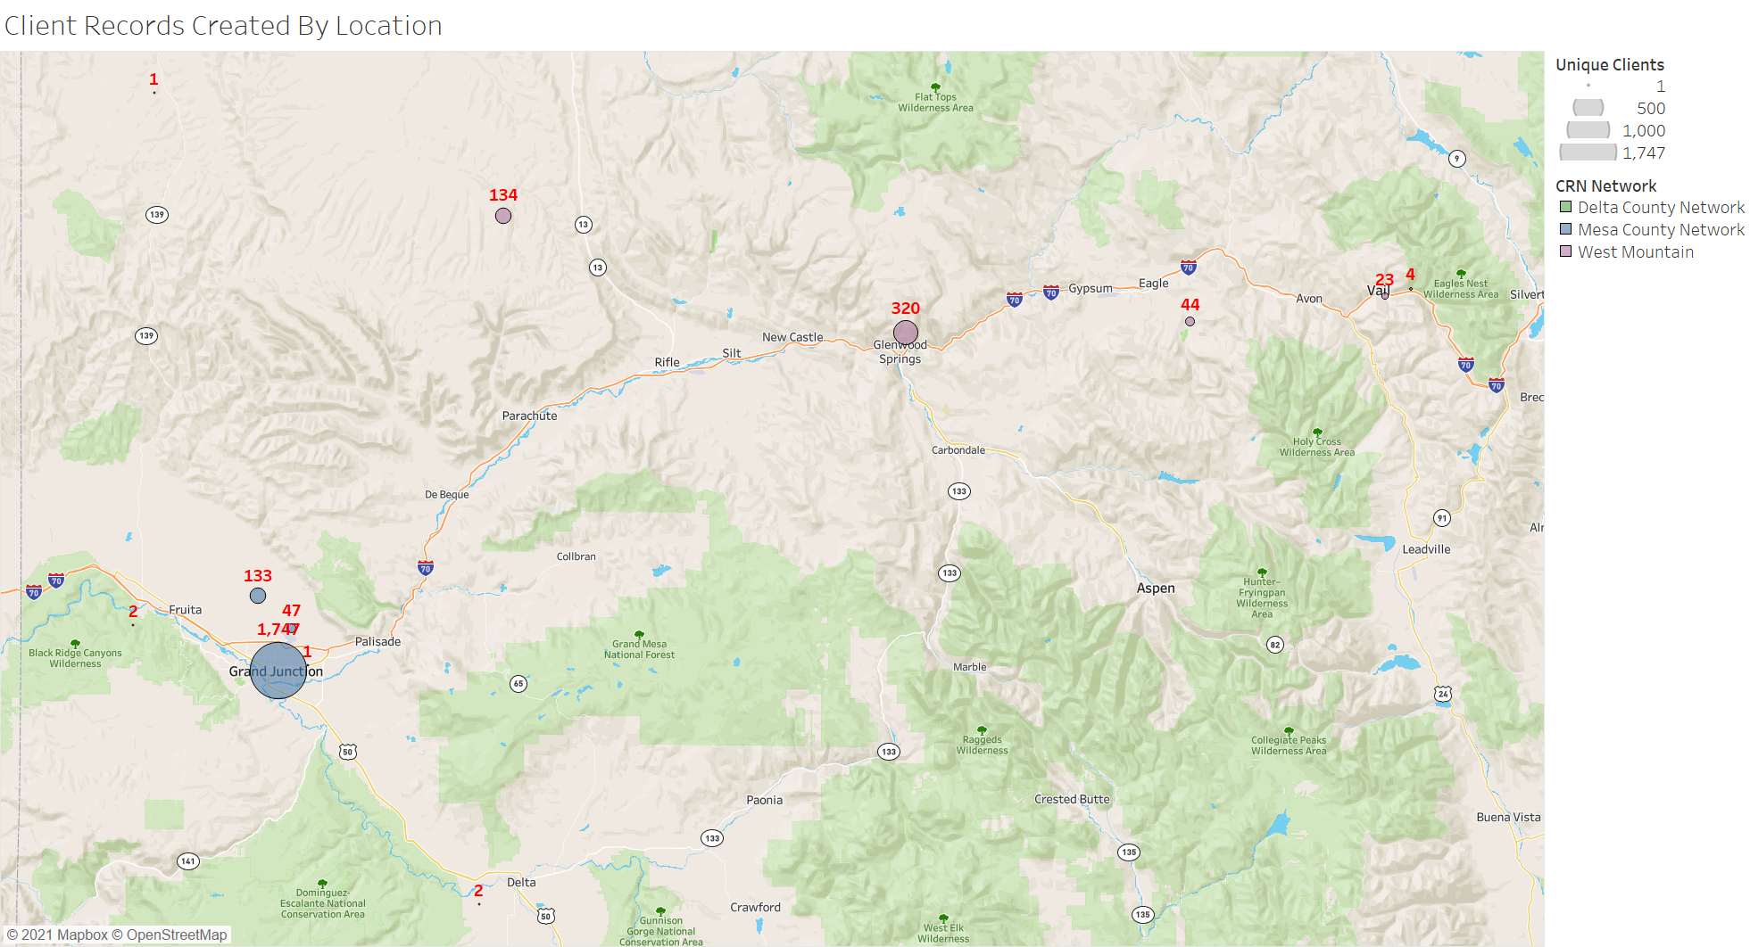
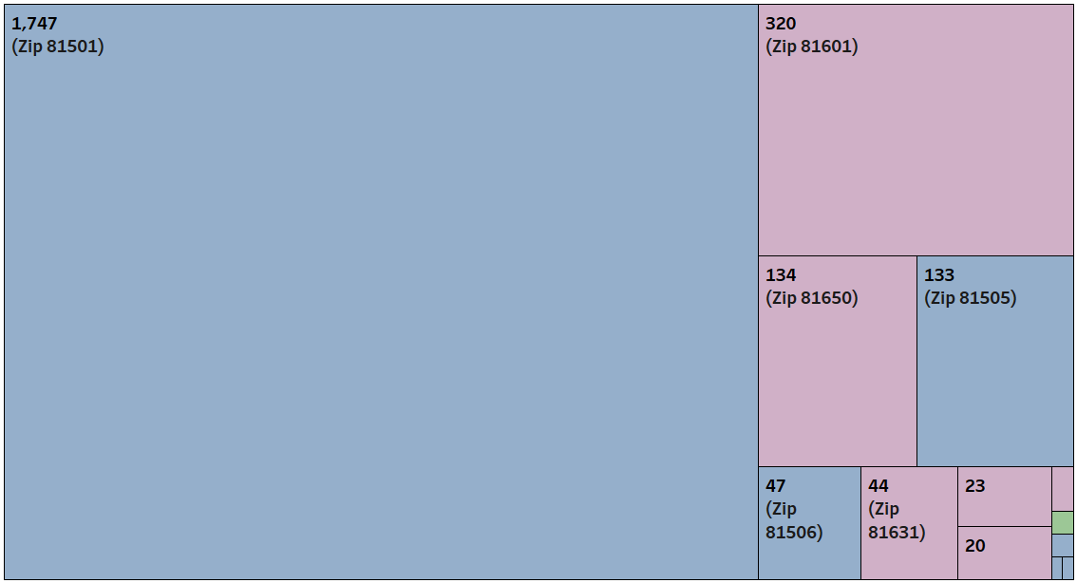
Clients Created by Location of Agency

Slide 17
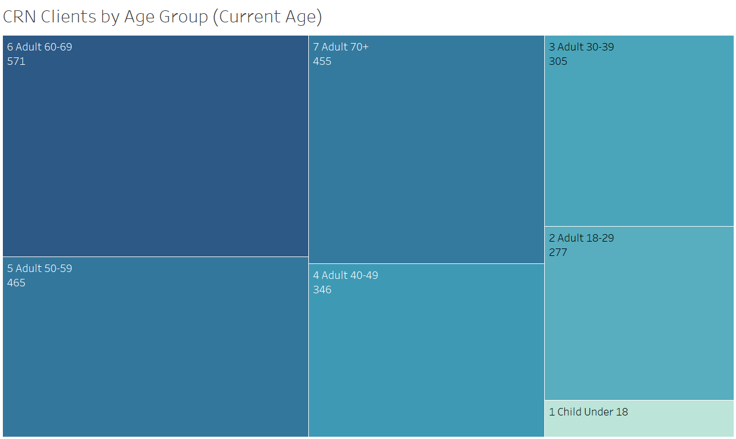
Client Demographics

Slide 18
Consent and Care Team

Slide 19
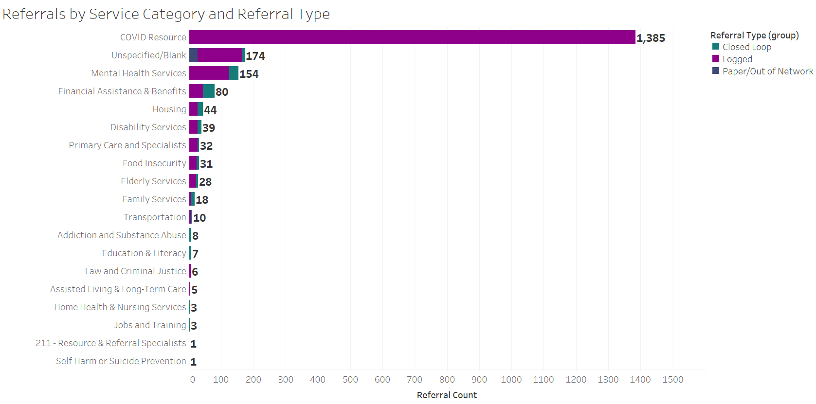
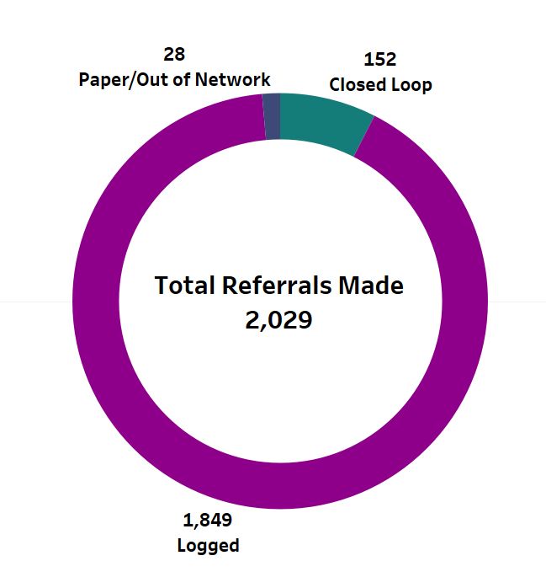
Referral Statistics

Slide 20
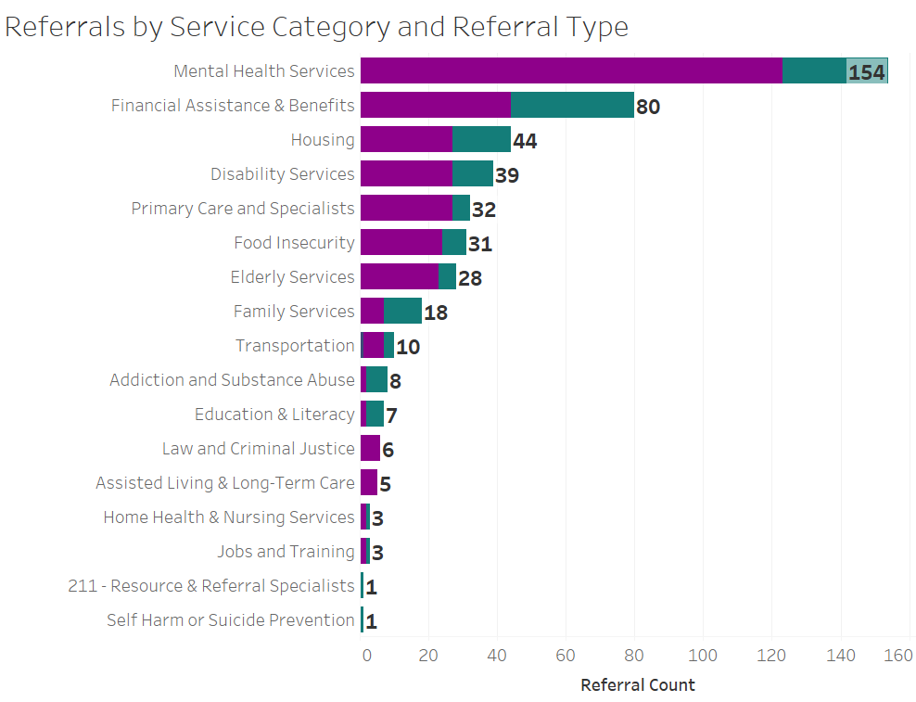
Insights and Observations
When we exclude the large volume of COVID referrals, the next largest referral category is for Mental Health Services.
Financial Assistance and Benefits has the best ratio of “Closed Loop” Referrals to “Logged” Referrals of the top need categories.

Slide 21
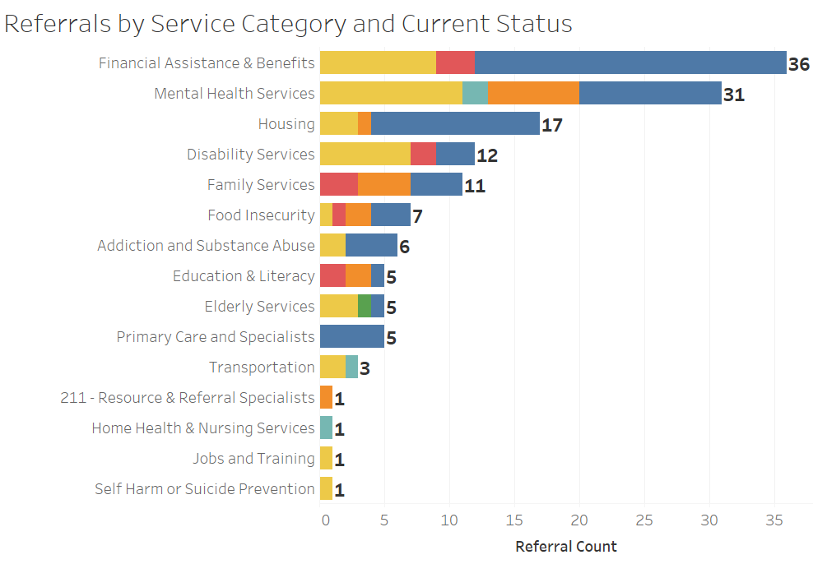
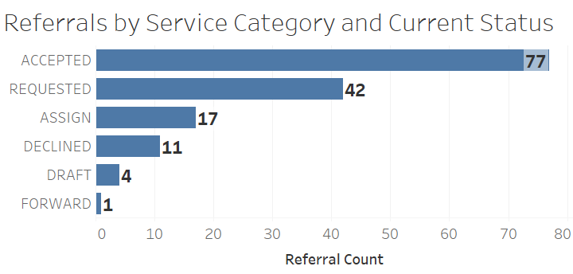
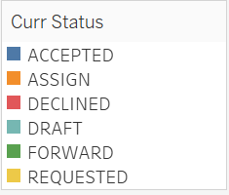
Insights and Observations
We’ve had 142 “Closed Loop” Referrals made, meaning the referral was electronically sent to a CRN Network Partner who had an opportunity to close the loop. This represents 7.5% of all referrals recorded in CRN to date.

Slide 22
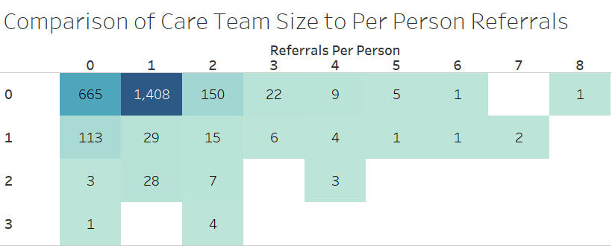
Insights and Observations
Most clients do not have a Care Team in CRN
Care Team Size
188 People who have had referrals to 2 or more organizations, who conceivably could coordinate collaboratively on a Care Team.
117 People who have a Care Team (consent in place) but no active referral activity to date.

Slide 23
Insights and Observations
510 CRN Clients (21%) have a recorded AHCM Screener
captured as part of the AHCM project.
354 of those (70%) have at least 1 identified need.
For comparison, the need rate for AHCM overall is closer to 38%.
173 (49%) have an AHCM Navigation Plan.
Number by Need Reported
Food | Housing | Transportation | Utilities | Safety | Social Isolation
264 | 228 | 189 | 89 | 45 | 134

Slide 24
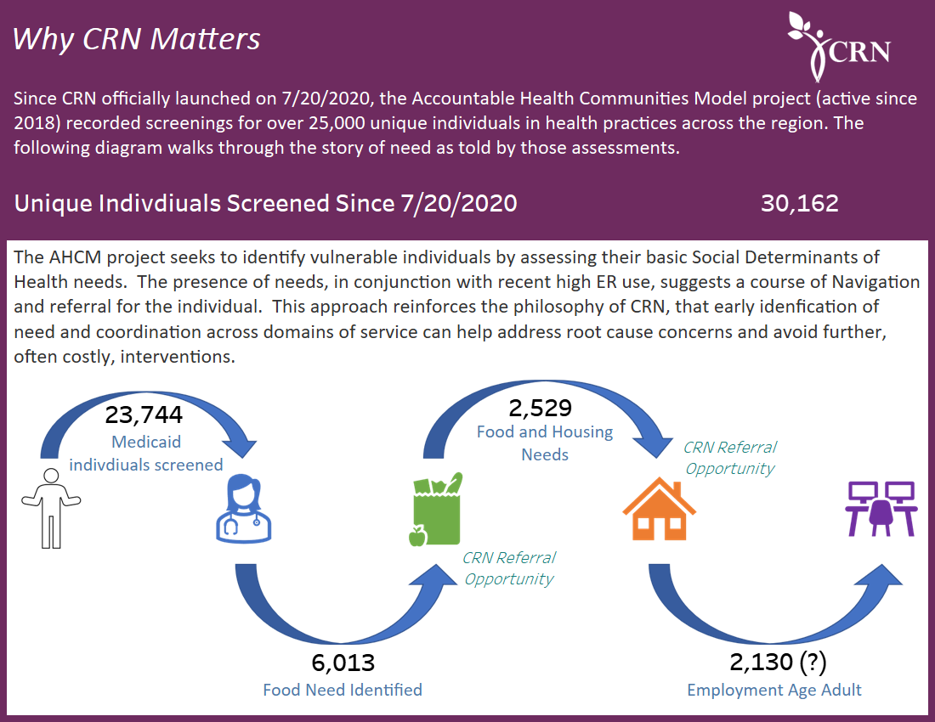

Slide 26
Next Hot Topic
Wednesday, August 18th 2021

Slide 27
THANK YOU!
THANK YOU! Questions?
Connecting People. Changing Lives.
CommunityResourceNet.org
Notes:
Add questions
Maybe troy pic, pillars

