Slide 1
QHN Hot Topic Presentation
March 16th, 2022
What is QHN and How Can We Help You?

Slide 2
What is QHN?
We are western Colorado’s first Health Information Exchange (HIE)
What is an HIE?
Wikipedia.org: Health information exchange (HIE) is the mobilization of healthcare information electronically across organizations within a region...
Hospitals, providers, post-acute care facilities, home care agencies and other health and social service providers are using QHN’s systems in creative and innovative ways to improve the quality and efficiency of care and the way care is coordinated.

Slide 3
Our Mission: Quality Improvement
Facilitate the availability of information to optimize the health of our communities.
Improve economic efficiencies of patient care
Bring value to our stakeholders

Slide 4
QHN Footprint

Slide 5
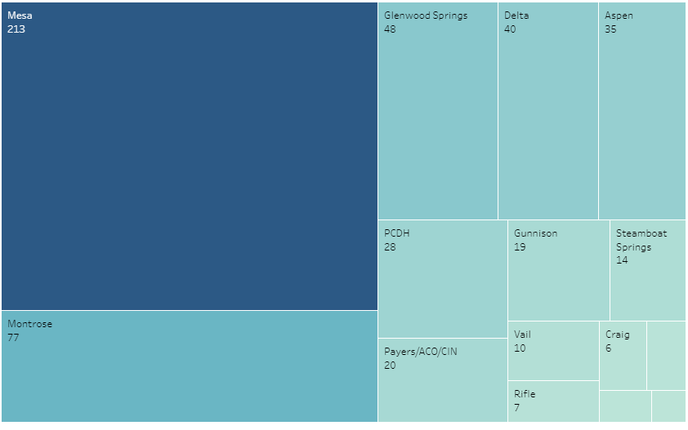
QHN Footprint

Slide 6
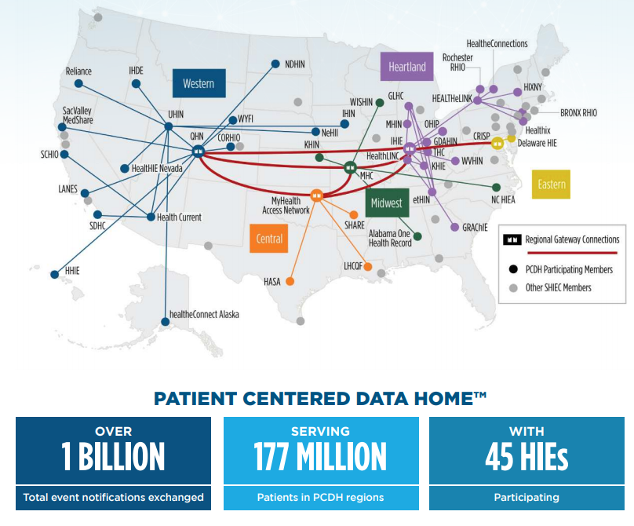

Slide 7
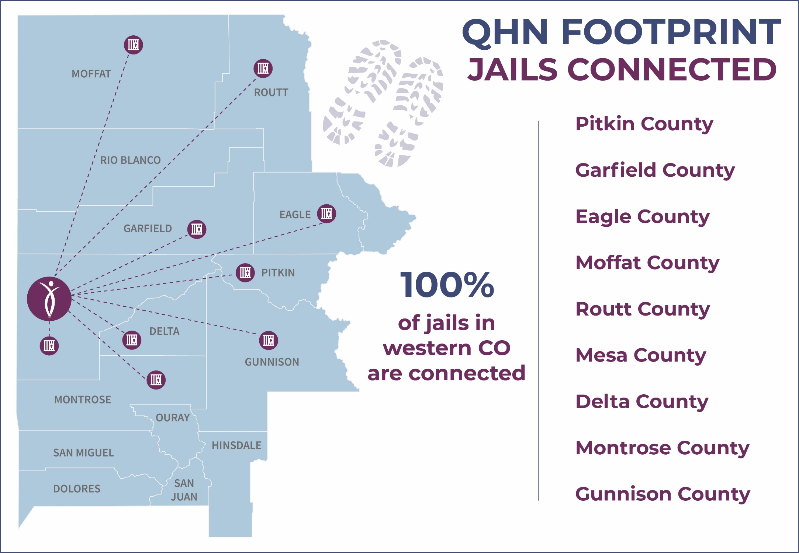

Slide 8
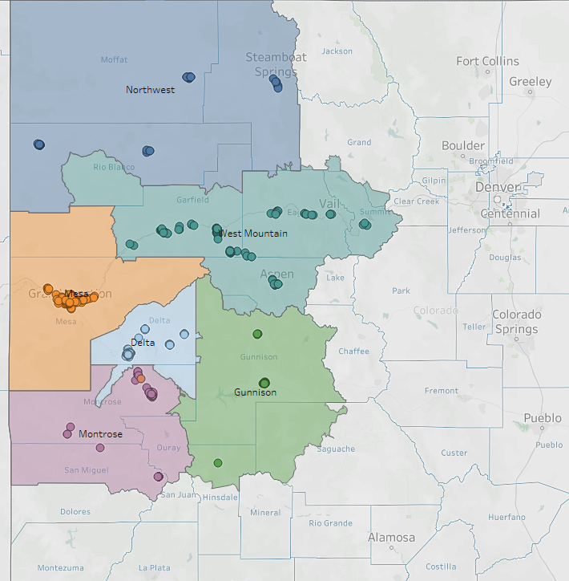
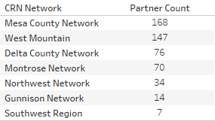
Building Community Collaboration

Slide 9
Stories about how we help:

Slide 10
Stories about how we help:

Slide 11
How Can We Help You?
Notification when an event occurs for one of your patients
Several new options
Results Delivery to your Electronic Medical Record (EMR)
Single Sign On to our Patient Summary from within your EMR
Query medical history from our Patient Summary
Utah Health Information Exchange included (May of 2021)
Query External Sources
CORHIO
Arizona
Utah
VA
Send Secure Direct Messages in QHN
Access images
Single Sign On into Opisafe (Prescription Drug Monitoring data) or the PDMP

Slide 12
How Can We Help You?
Single Sign On to our Community Resource Network (CRN) from QHN providing:
Care Coordination
Screening and results
Reporting
Capturing care coordination work and closed-loop referrals
Custom reporting now available
We can help with quality measures and grant reporting
Easier screening options
Tablet functionality for SDoH screening
Broader Resource Directory with regions

Slide 13
DEMO OF QHN / DEMO OF CRN

Slide 14
Questions?
Quality Health Network
Sherri Corey – scorey@qualityhealthnetwork.org
Northwest and Mountain Regions
Cherie Schmitz – cshmitz@qualityhealthnetwork.org
South and Southwest Regions
Jackie Sievers – jsievers@qualityhealthnetwork.org
Director of CRN Implementation
Customer Support– support@qualityhealthnetwork.org

Slide 15
QHN Hot Topic Series
Next Hot Topic Session is scheduled for April 20th 2022 at 12:15. Mark your calendars.
Agenda coming soon!

Slide 16
Thank You!
Questions?
qualityhealthnetwork.org

