Slide 1
April 2022 Hot Topics:
QHN Update
April 20, 2022

Slide 2
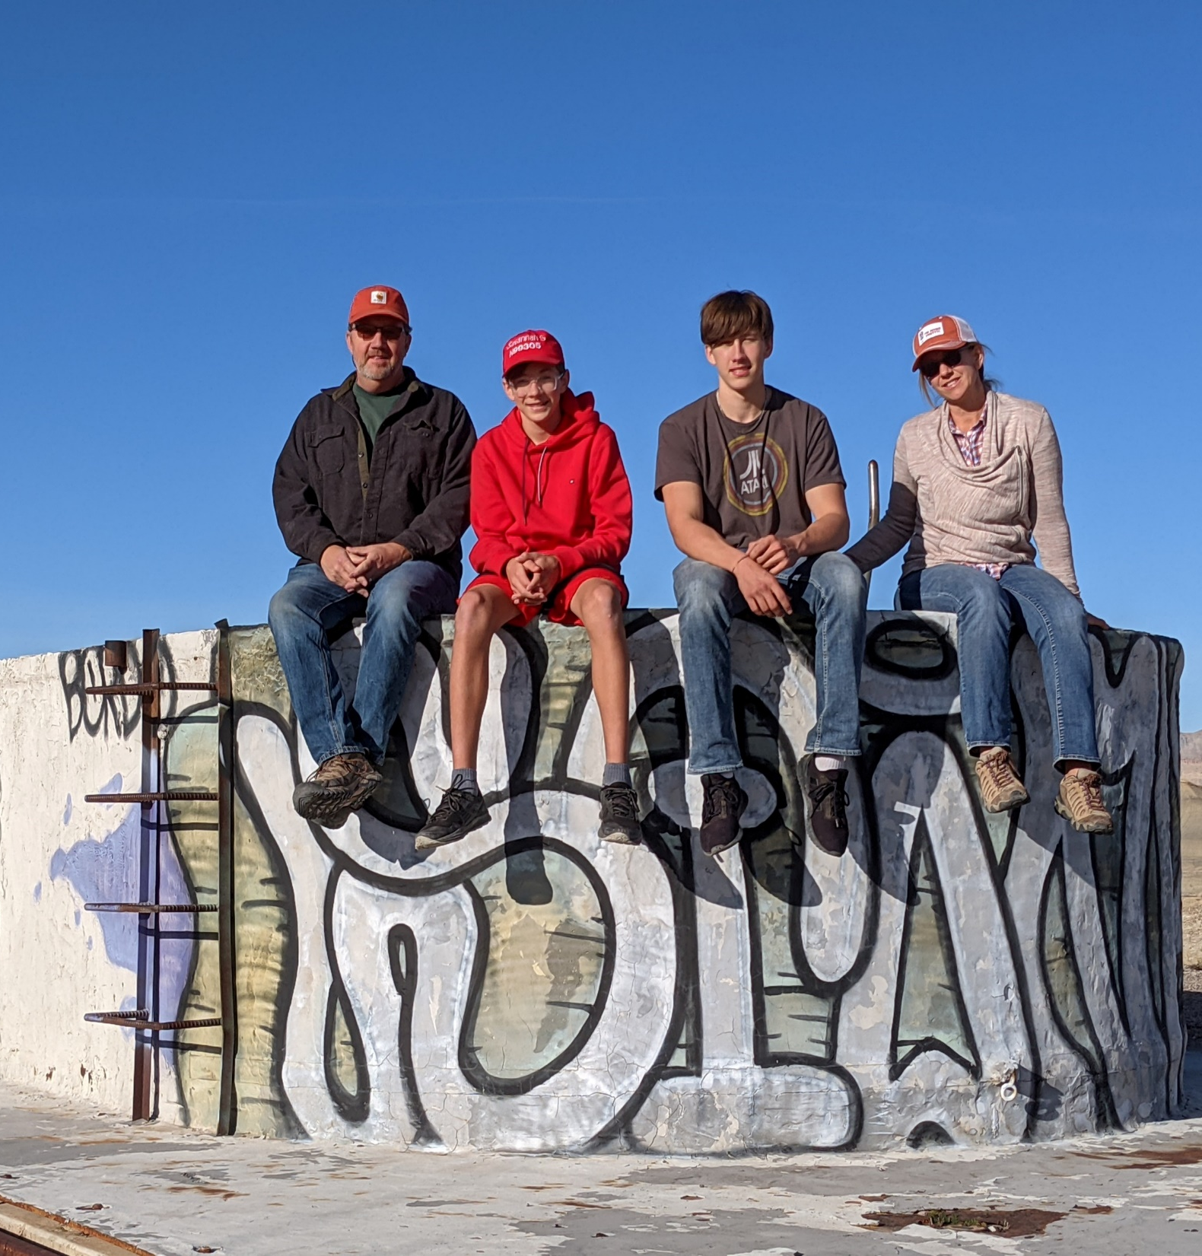
About Marc
Moved to Western Colorado in 2005
Started at QHN in 2006
Database Admin→IT Director→CTO→iCEO
Former Colorado eHealth Commissioner
Serves on Joint Agency Interoperability (JAI) Leadership Council

Slide 3
About QHN
Founded in 2004 as a 501(c)3 with goals:
Facilitate achievement of optimal health status
Implement population health management tools
Improve patient safety
Improve access to data – where and when its needed
Improve effectiveness and economic efficiency
Eliminate unnecessary redundancy
Support changing reimbursement models
Improve patient and provider satisfaction

Slide 4
QHN Basic Data Types
What We Do- Our Value

Slide 5
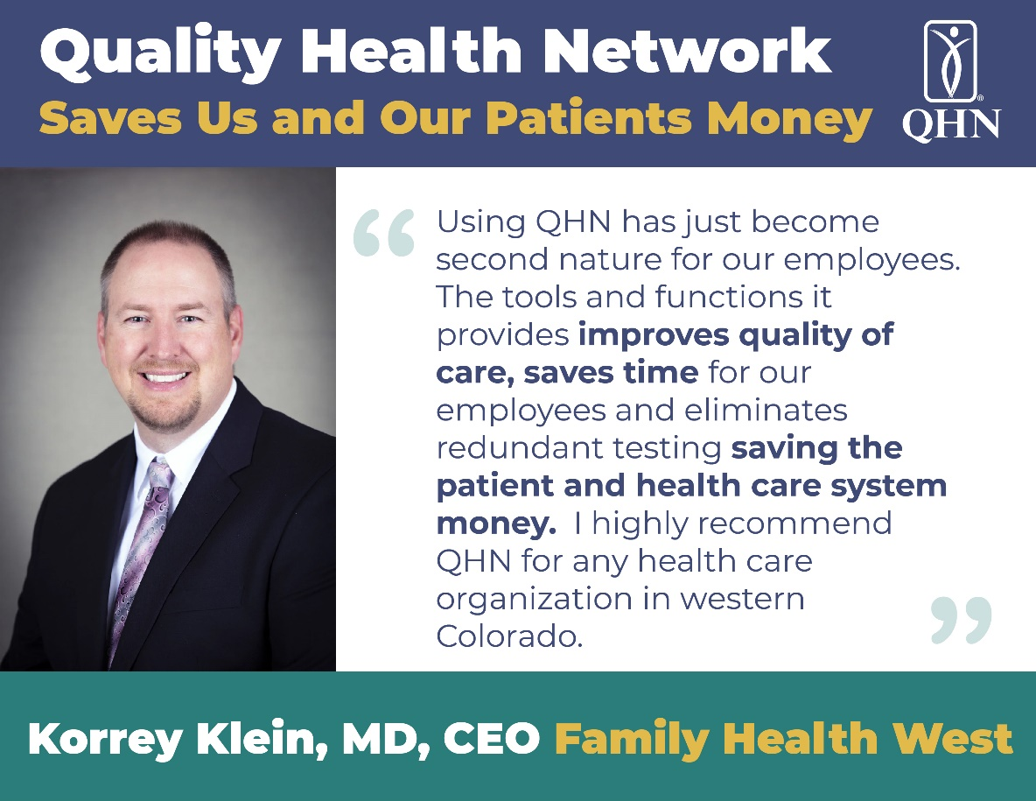
What People Say About QHN

Slide 6
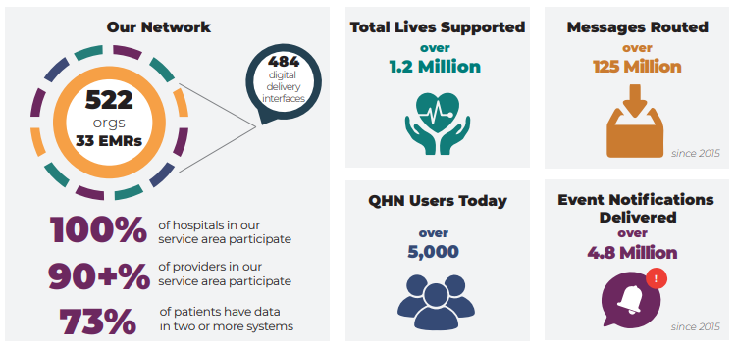
QHN Basic Data Types
The QHN Network Today

Slide 7
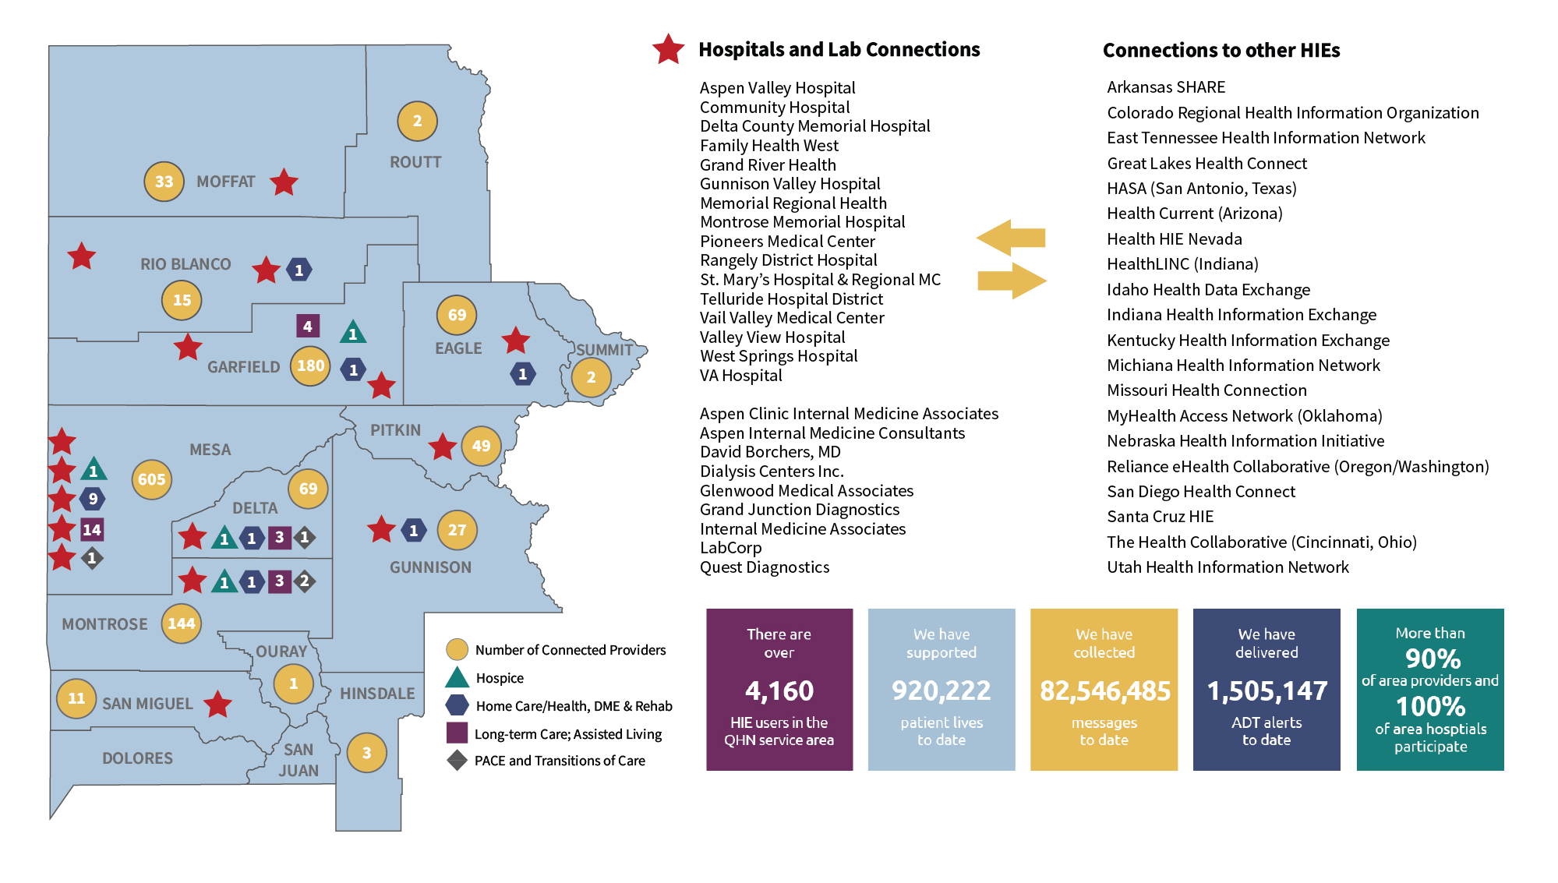
QHN Participants

Slide 8
QHN Solutions
Data sharing and aggregation
HIE, BHIE, SHIE
Help care providers to integrate data
Make it easy for provider to get data
Use data to drive value
eCQM, HTP, HEDIS, quality reporting
Collaborate on the data via CRN

Slide 9
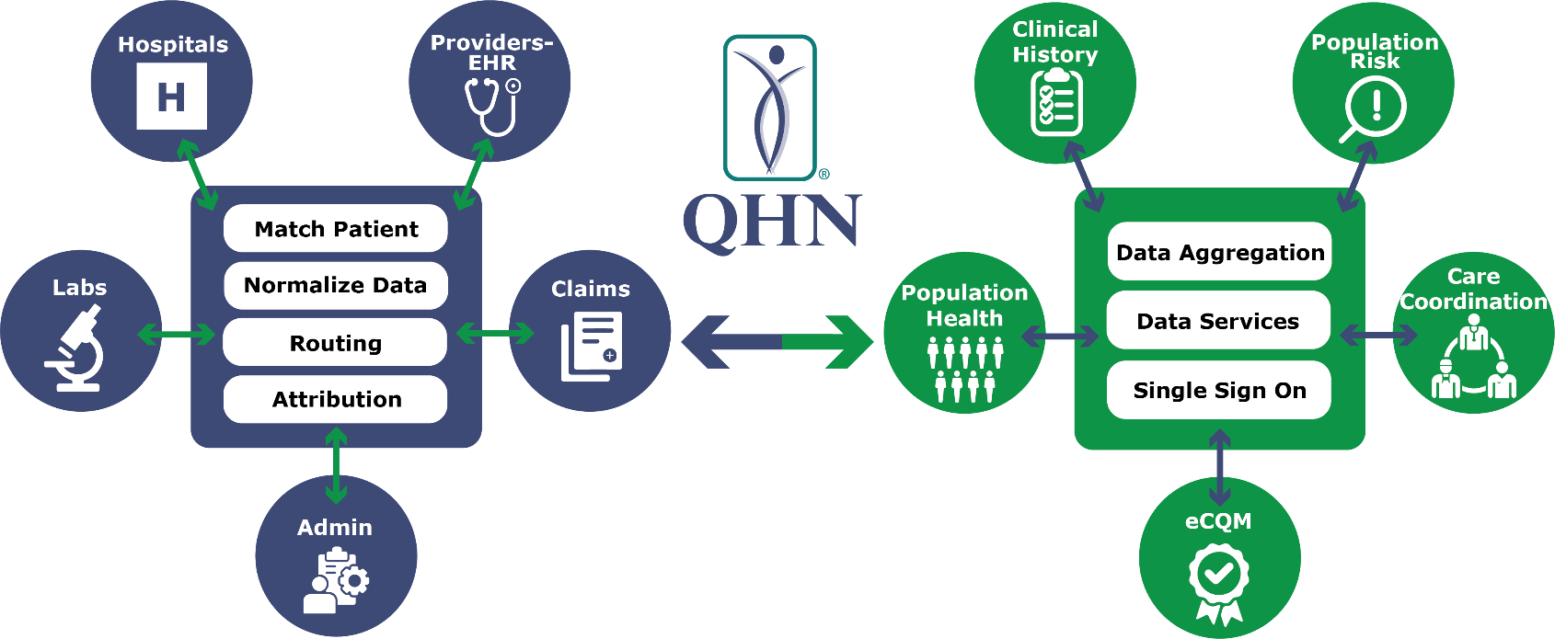
QHN Solutions
Data sharing and Aggregation
SOCIAL
BEHAVIORAL

Slide 10
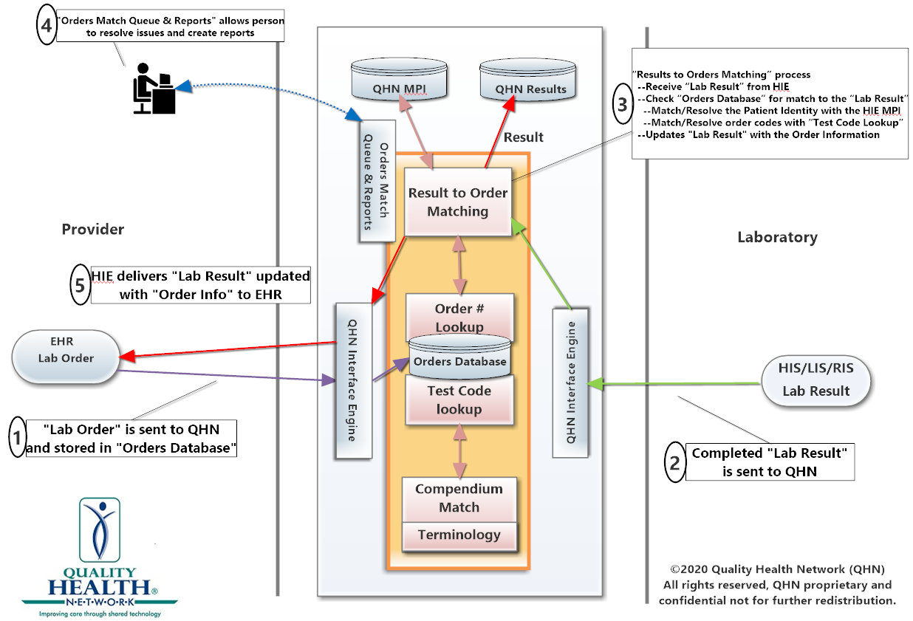
QHN Solutions
Easy for providers to integrate data - Lab reconciliation

Slide 11
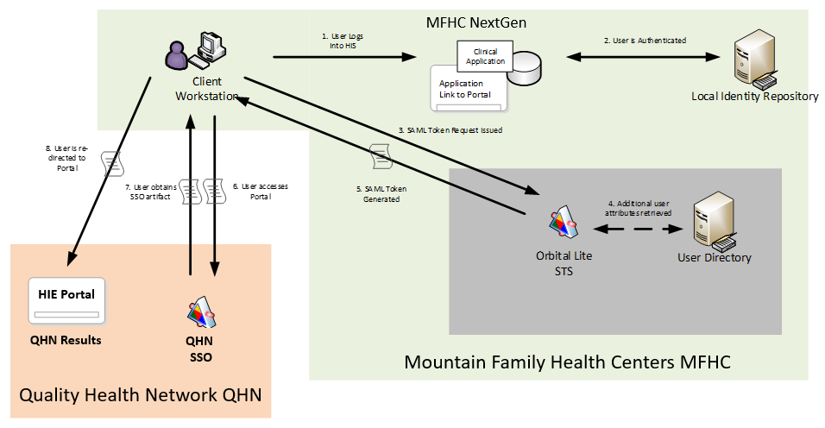
QHN Solutions
Easy to get to the data – SSO & Opisafe/PDMP

Slide 12
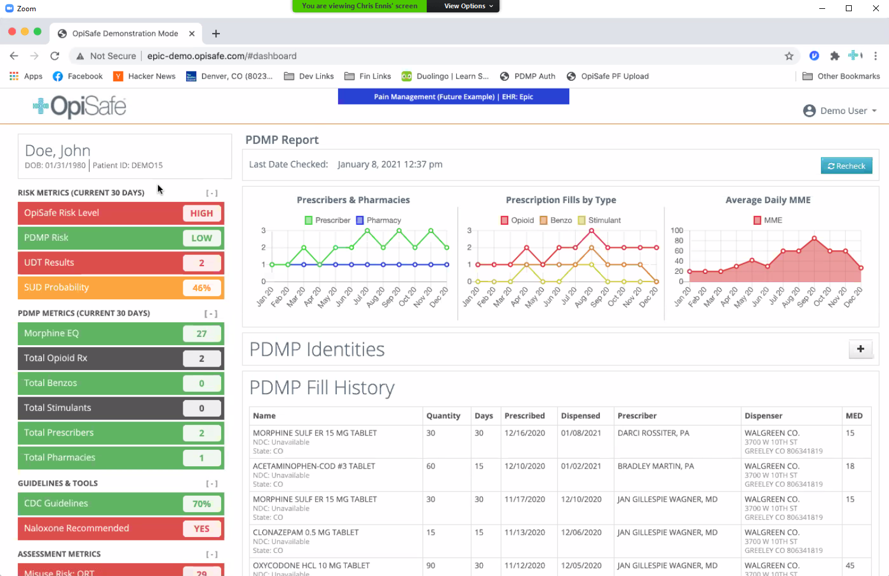
QHN Solutions
Easy to get to data – Opisafe/PDMP

Slide 13
QHN Solutions
Care providers collaborate via CRN

Slide 14
QHN Solutions
Data helps drive value
Quality reporting eCQM, HTP, HEDIS
State
Medicaid
APM
QHN
eCQM
Provider Sign-Off
Practices
CCD
RMHP
EMRs
HEDIS
HIE

Slide 15
CCMCN Joint Venture – The need
Growth capacity to help drive mission
Expansion of Whole Person Care
Enhanced EHR data extractions
Expansion of analytics & HIE capabilities
More opportunities for staff

Slide 16
About CCMCN
CCMCN’s vision is to help create healthy Colorado communities that are unified through innovative solutions.
Colorado Community Managed Care Network (CCMCN) is a Colorado non-profit organization governed by Colorado’s Federally Qualified Health Centers (FQHCs).
CCMCN is developing a flexible and interoperable Social Health Information Exchange (SHIE) ecosystem that is accountable for person and family centered care coordination for Colorado.

Slide 17
CCMCN’s Currently Supported Networks
Networks
FQHCs (Federally Qualified Health Center) statewide
Northeast Colorado, RAE 2, NCHA (Northern Colorado Health Alliance)
Statewide rural health centers and critical access hospitals
Boulder and Jefferson County FHS Partners
Stats
24 Employees
130 organizations
300 locations
Data on 3 million people
EHR, labs, HIE, claims, vaccinations, criminal justice, vital records, attribution

Slide 18
More info and Question and Answers
?
Community Advisors
Sherri Corey - scorey@qualityhealthnetwork.org
Cherie Schmitz -cschmitz@qualityhealthnetwork.org
Wade Montgomery - wmontgomery@qualityhealthnetwork.org
Angela Rodriguez -arodriguez@qualityhealthnetwork.org
On the web, email, and phone
https://qualityhealthnetwork.org/
support@qualityhealthnetwork.org/
970-248-0033

