Slide 1
Dynamic Transformation Together
Kim Bimestefer, Executive Director​
Colorado Department of ​
Health Care Policy and Financing​
Governor’s Cabinet
October 13, 2022

Slide 2
Partnerships & alignment for a better tomorrow
Importance of public/private partnerships
Western Slope leaders, esp Mesa County Health Leaders Consortium
QHN critical partner
Outstanding collaboration
THANK YOU for your engagement & partnership!
Congratulations, QHN!
QHN’s Community Resource Network (CRN) won national 2nd place in the RWJF SDoH challenge - western CO leadership on whole person care

Slide 3
Agenda: Dynamic Transformation Together
COVID Impact: Workforce, inflation, jobs, disparities, ARPA
Investing in our workforce & key providers
Advancing health equity, closing health disparities
Improving quality, health outcomes, affordability
Health care systemic transformation
Leveraging value based payments to incent better results
Wrapping all into Accountable Care Collaborative 3.0
Ensuring coverage continuity, improving service & access

Slide 4
Health care workforce & access transformation & investment
Thank you health care, frontline workforce!
Rate increases, raising specific wages, relief payments
2022 new state laws create PPE stockpile, help w/ tuition & training for health care workers & support existing workforce, help move CO from pandemic responsiveness to endemic management and pandemic readiness
Cross State Agency partnership with providers, advocates, members, families, and workers

Slide 5
Free training to increase & support
the healthcare workforce
Please help promote tuition-free training to become part of the healthcare workforce
The Care Forward Colorado program is revitalizing Colorado’s healthcare workforce through zero-cost, short-term training programs at community and technical colleges
In a year or less, trainees can learn skills to become CNAs, EMTs, MAs, DAs, phlebotomy techs and pharm techs desperately needed in Colorado’s healthcare facilities
Senate Bill 22-226 dedicates $26M in state recovery $$ to train healthcare workers.
https://cccs.edu/new-students/cccs-transfer-training-programs/new-students-cccs-transfer-training-programs-care-forward-colorado/

Slide 6
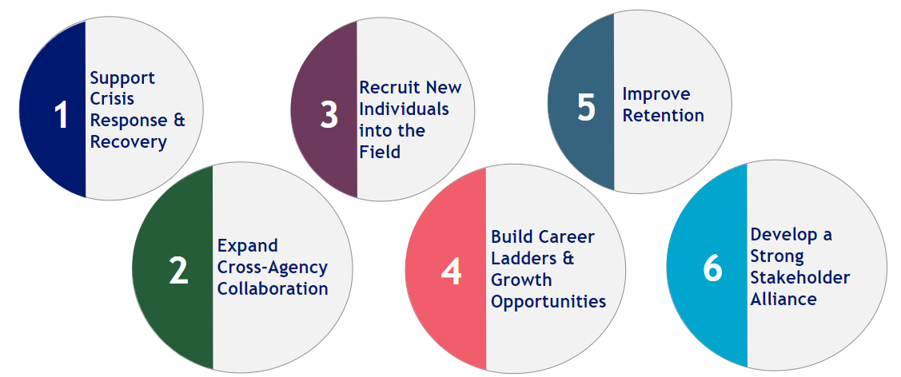
Home & Community Based Services
Direct Care Workforce Work
$175.5M
$95M
$2.15M
$600K
$13M

Slide 7
Additional Home & Community Based Services
Transformation
4,000+
ARPA Stakeholder Engagement, Driving Priorities
63 Projects
$530M ARPA Investment 90% Directly benefiting the community *3.5% Admin
Improving services to people with disabilities
CO.gov/HCPF/ARPA

Slide 8
Nursing Home Transformation
Need to reimagine Nursing Facilities: Consider what Coloradans want, need, safety. Sustainability. Consider NH & hospital rural collaboration.
Challenge | Approach
Staffing Crisis | One-time payment to relieve staffing pressure Annual supplemental payment contingent on paying at least $15/hour Studying impact of staffing agencies
Instability of the Industry & Changing Consumer Preference and Needs | In collaboration with stakeholders, develop a state-wide long-term sustainability plan Review and update provider reimbursement policy to prioritize quality, sustainability and fiscal stewardship methodology

Slide 9
Rural Hospital Transformation
HTP Rural Support Fund. $12M each yr over five years ($60M) to help 23 critical access and rural hospitals modernize, better serve their communities and prepare for value-based payments - $24M has been paid to date
Rural Connectivity & Access to Virtual Care ($17.4M in fed matching funds over 4 yrs) - 86% rural safety net providers now connected to state HIE to support rural member access to care & keep care local
Improving Rural Access & Affordability - $10M grants for access & affordability
Providers of Distinction unique model
Community partnership, i.e. NHs
See: https://hcpf.colorado.gov/rural-provider-access-and-affordability-stimulus-grant-program

Slide 10
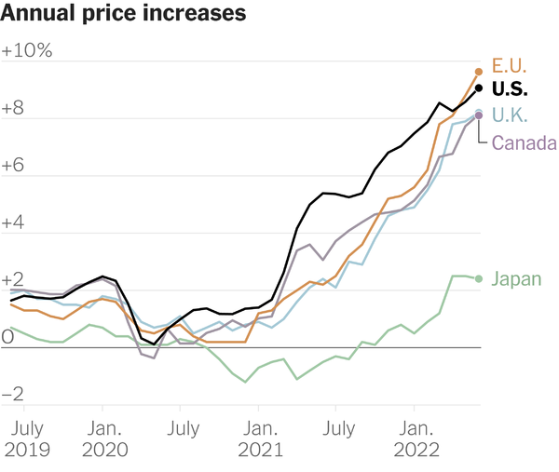
Global supply chain disruptions amidst rising demand
Resulted in global inflation: food, gas, other goods
Chart showing annual change in Consumer Price Index each month up to June 2022. | Source: O.E.C.D.

Slide 11
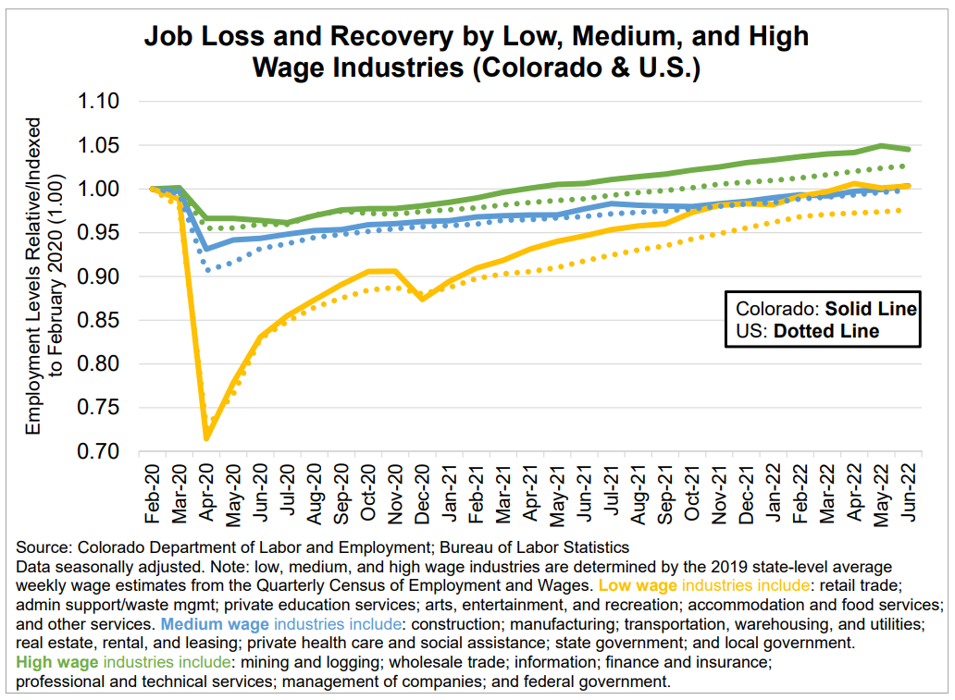
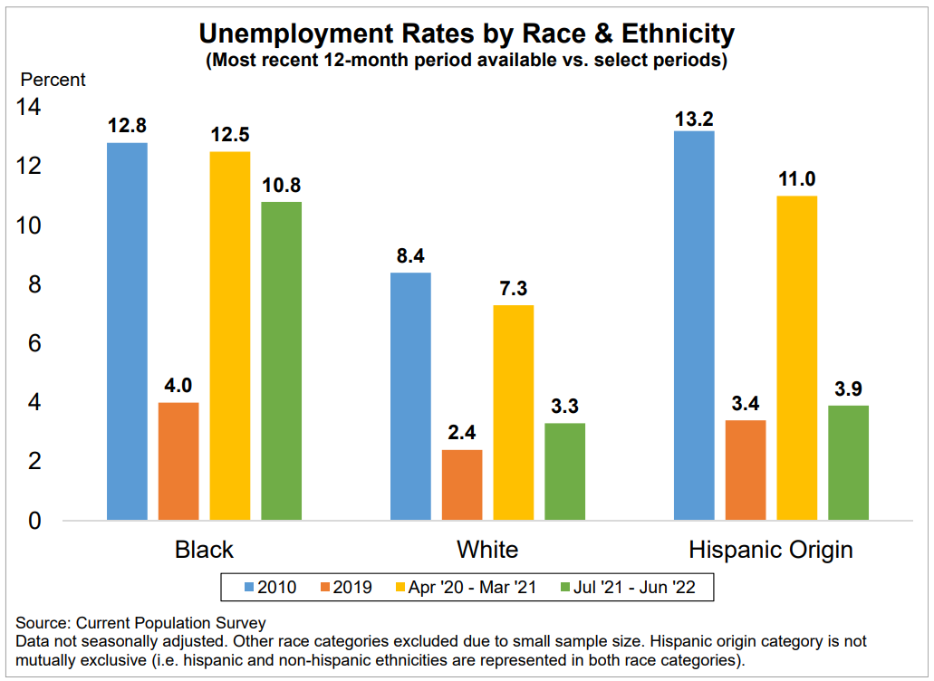
Longer, Uneven Recovery for Low Income & BIPOC
Colorado Department of Labor and Employment, Press Release: Colorado Employment Situation – Jun. 2022

Slide 12
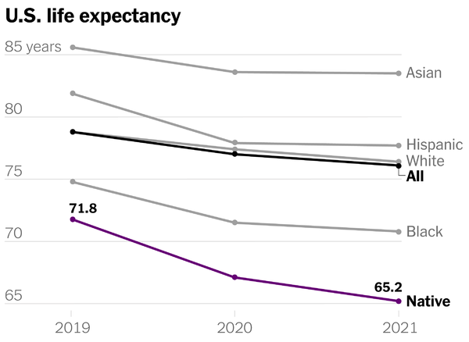
COVID has impacted us in so many ways, including Life expectancy - Drop of about 3 years overall. But Native American / Alaskan Native population's life expectancy has dropped 6.5 years since COVID started, double what the US average life expectancy dropped.
“Carol Schumacher of the Navajo Nation … was not prepared for the devastation of Covid: Since it arrived in the U.S. more than two years ago, she has lost 42 family members to the virus.”
Sources: cbsnews.com/news/u-s-life-expectancy-drops-worst-two-year-decline-in-a-century-covid-pandemic
NYT 9/8/22

Slide 13
Health Equity Transformation
CDPHE - Office of Health Equity & Health Equity Commission leading CO health disparity reporting & community grants awarded to >36 community-based orgs ($7M FY22-23)
BHA - BH Task Force & Advisory Council lived experience to address gaps and create equitable solutions
CDHS - new EDI Director to advance efforts
DOLA - HB21-1271 increasing affordable housing by providing incentives and grants to local communities
DOI - CO Option standardized ins plans; requires lower prem for individuals, families, sm busi by 15% by 2025
HCPF focus: COVID vaccinations, maternity, BH, prevention
CO.gov/HCPF/health-equity

Slide 14
Behavioral Health Transformation & Investment
BHA launched July 1. Coordination across state agencies.
Purpose: All Coloradans deserve to experience whole-person health.
Vision: BH services in Colorado are accessible, meaningful, and trusted.
20+ bills, $550M+ in ARPA stimulus to transform the industry
Redefining the safety net and increasing high-intensity outpatient services
125 new adult beds, youth residential beds, tribal SUD facility
Funds to increase integrated care
Care coordination technology
Mobile crisis and secure transports
Community investments and much more!
HCPF New Office: Office of Medicaid & CHP+ Innovations and Coverage
Medicaid > $1B (+$400M since 2019). > 1000 BH added last yr (10k+)
7 workstreams to improve CMHC community accountability

Slide 15
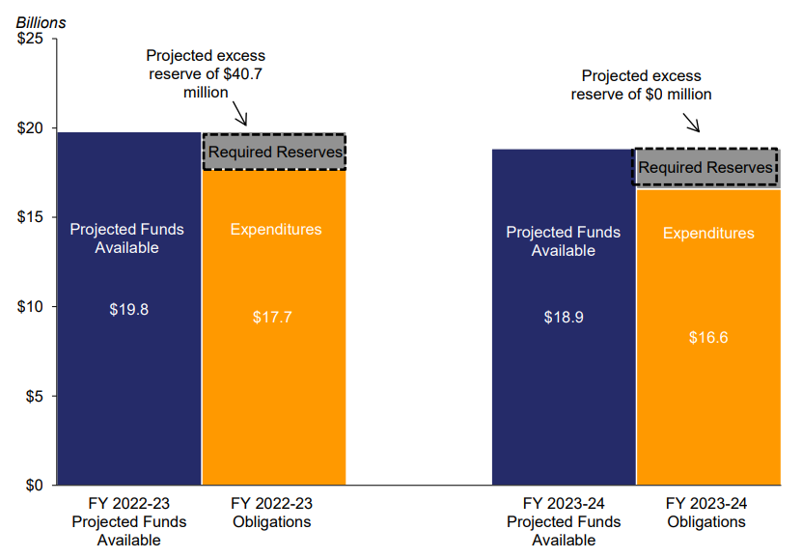
Sept. 2022 Economic & Fiscal Outlook, General Fund
CO.gov/governor/economics

Slide 16
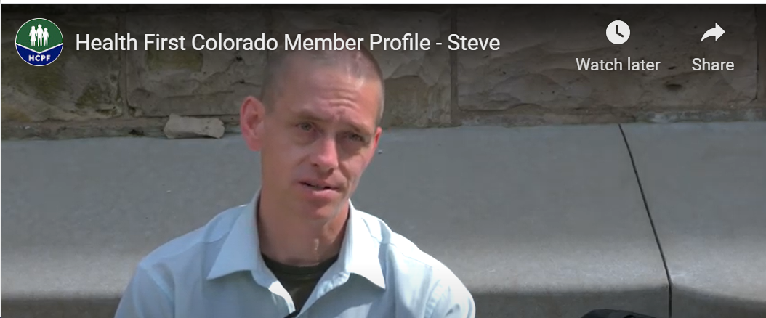
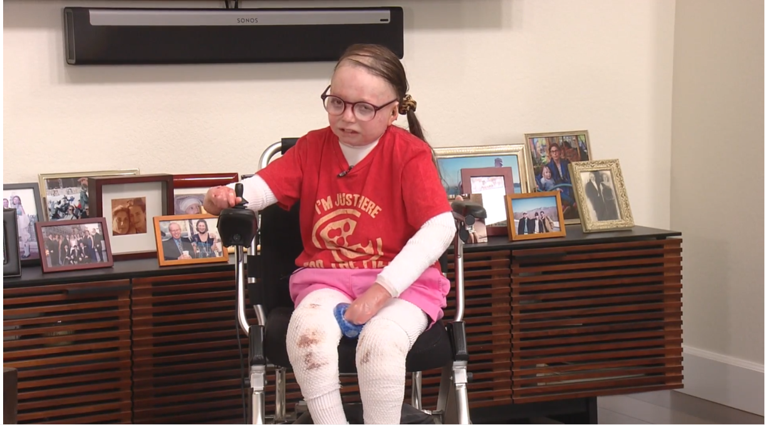
Result: Medicaid is serving 1.69M Coloradans, up 35% or 440k
$14.2B Total Funds, $4.1B General Funds
Jessica wants people in the Deaf community to know they can feel confident with coverage from Health First Colorado
Covering 1 in 4 Coloradans
43% of the state’s children
43% of births
4.1% of members use long-term services & supports (LTSS)
⅓ of the state’s budget
Play: https://www.youtube.com/watch?v=Eufi9fRsM8w

Slide 17
Improve Medicaid Affordability Thru Quality Focus
Improve quality
Quality metrics dashboards & transparency
HIE connectivity efficiencies
Better tools for providers: eConsults, Prescriber Tool, Cost & quality indicators to support referrals
Efforts to tie lab data from EHR to incentives that reward better health outcomes, quality
Align RAE, CHP+, incentives w/CMS Core Measures
Affordability priorities in Medicaid:
Protect current benefit and eligibility access
Protect provider reimbursements

Slide 18
eConsults
Allow asynchronous electronic clinical communications between Primary Care Medical Providers and Specialists
Enable expanded care in PCP office, improving access
Reduce specialist no-shows
Enable referrals to higher performing docs, reducing disparities & improving quality
Drive affordability while improving care access, quality, health equity
Supported by value based payments that reward results
Target for vendor selection is Jan. 2023; target go-live is Aug. 2023

Slide 19
Providers of Distinction
Producing cost & quality indicators to inform referrals & member choice
Driving affordability while improving care access, quality, health equity
Analyzing which providers are seeing Medicaid members, which aren’t - addressing “ghost providers”
Supported by value based payments that reward results
Unique advantages for rural providers and communities: access, jobs, revenues, closing disparities
Bids have been received; plan to award ITN in Spring
Target 2024/25 implementation

Slide 20
Prescriber Tool
Phase 1: OpiSafe
helps prescribers prevent misuse/abuse of opioids, benzos, controlled substances.
5,250 allocated licenses
Phase II: Affordability
shares real-time prescription benefit check, empowering prescribers with drug affordability and cost options. 10k users (42% Medicaid prescribers)
Phase III: SDoH prescribing programs not just pills: will build upon existing architecture, connecting technology platforms used by social, physical, and behavioral healthcare providers to provide whole-person, next gen care
CO.gov/HCPF/prescriber-tool-project

Slide 21
Other Affordability Efforts: Hospital Workstreams
Hospital Transformation Program (quality focus too)
Implement new hospital price transparency law: Create Colorado hospital price dataset & tools. Identify pricing outliers. Meet with hospitals and communities.
Continue to drive Price, Profit, Cost, Reserve, Community Investment insights and policy
Nationally leading hospital reports | CO.gov/HCPF/hospital-reports-hub
CIVHC data | CIVHC.org/affordability-dashboard-2
Affordability toolkit | CO.gov/HCPF/affordability

Slide 22
Other Affordability: Initiatives to Reduce Prescription Drug Costs
5 recommendations | Progress made on all recommendations
Value-based contracts & payments | Hold drug manufacturers accountable for clinical outcomes while rewarding prescribers for being part of the affordability solution
Drug importation | Contracts finalized. Submitting SIP application to the FDA this year
Rebate & contract pass through | HB22-1370: Beginning 2024, insurers required to ensure 100% of rebates are used to lower costs for employers and consumers
Prescription Drug Affordability Board (PDAB) | Authority to review Rx and evaluate if certain drugs are unaffordable to Coloradans. Ability to establish an upper payment limit for drugs deemed unaffordable & make other policy recommendations to General Assembly
Prescriber Tool | Real Time insights - Commercial & Medicaid: OpiSafe & Affordability modules: 10k+ Medicaid prescribers using the tool (42%)
Source: Reducing Prescription Drug Costs in Colorado, 2nd ed., 2021, CO.gov/HCPF/publications

Slide 23
You get what you pay for… value based payments reward quality, equity & affordability results of all these efforts
Hospital: Quality through HQIP & HTP
Nursing Homes, PACE providers
Primary Care: PCP Attribution, moving to capitation
Maternity Care: bundled payments
Rx: with manufacturers, use Rx Tool to incent docs to be part of the solution
Providers of Distinction
Behavioral Health
Target: 50%+ in VBP by 2025
CO.gov/HCPF/value-based-payments

Slide 24
Building Innovative Initiatives into Medicaid Accountable Care Collaborative Phase III (ACC 3.0)
Ongoing Stakeholder Activities WE NEED YOUR VOICE
Fall stakeholder engagement on design skeleton
November 2023
Draft Request for Proposal
September 2024
Vendor Awards
Transition activities. Member, provider transition & preparation
Revise draft RFP based on feedback
Ongoing community engagement & feedback
Proposal review.
Implementation work
March 2023
Concept Paper
April 2024
Request for Proposal
July 1, 2025
GO LIVE

Slide 25
End of the PHE Planning & Readiness
When Continuous Coverage Ends | 1.65M redetermined over a year upon their renewal month.
Planning to keep Coloradans covered | Important collaboration with Connect for Health to cover ~ 300k who may no longer qualify for Medicaid & CHP+ (SB22-081)
Budget Impact | Enhanced 6.2pt FMAP ends, currently providing net reduction of ~$100M GF/Q (>$950M over 10 quarters to date)
County & System Readiness Work | County collaboration & work volume clarity. Process Automation. PEAK & Mobile App enhancements.
Goals:
Member continuity of coverage
Smooth transition and member experience
Minimize impact to county and MA site eligibility workers

Slide 26
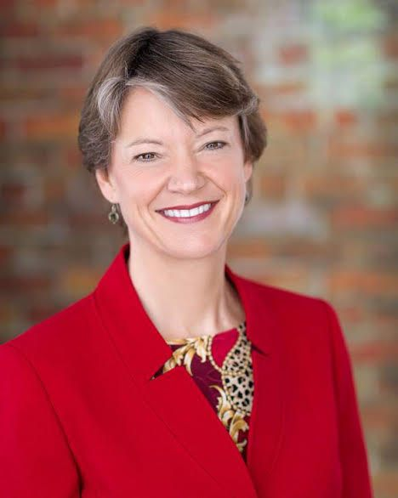
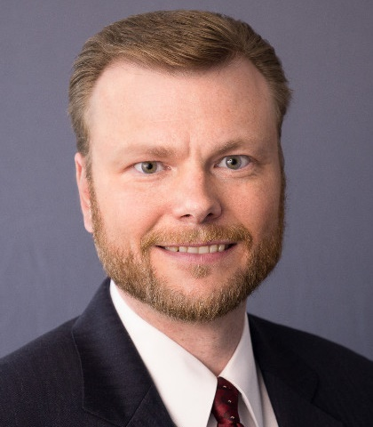
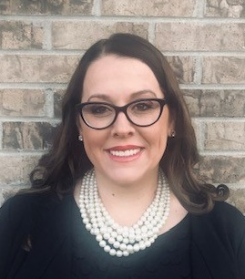
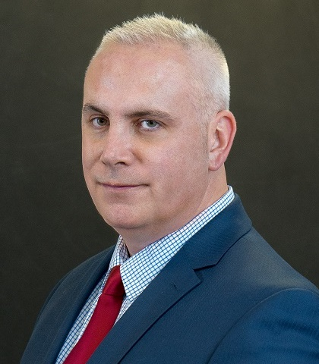
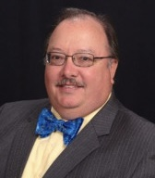
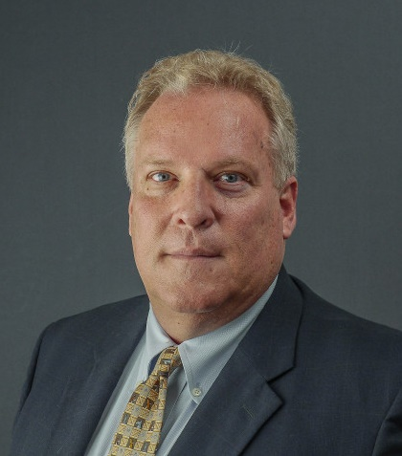
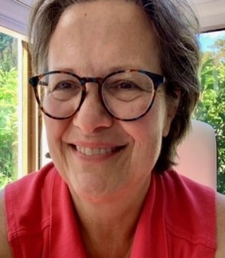
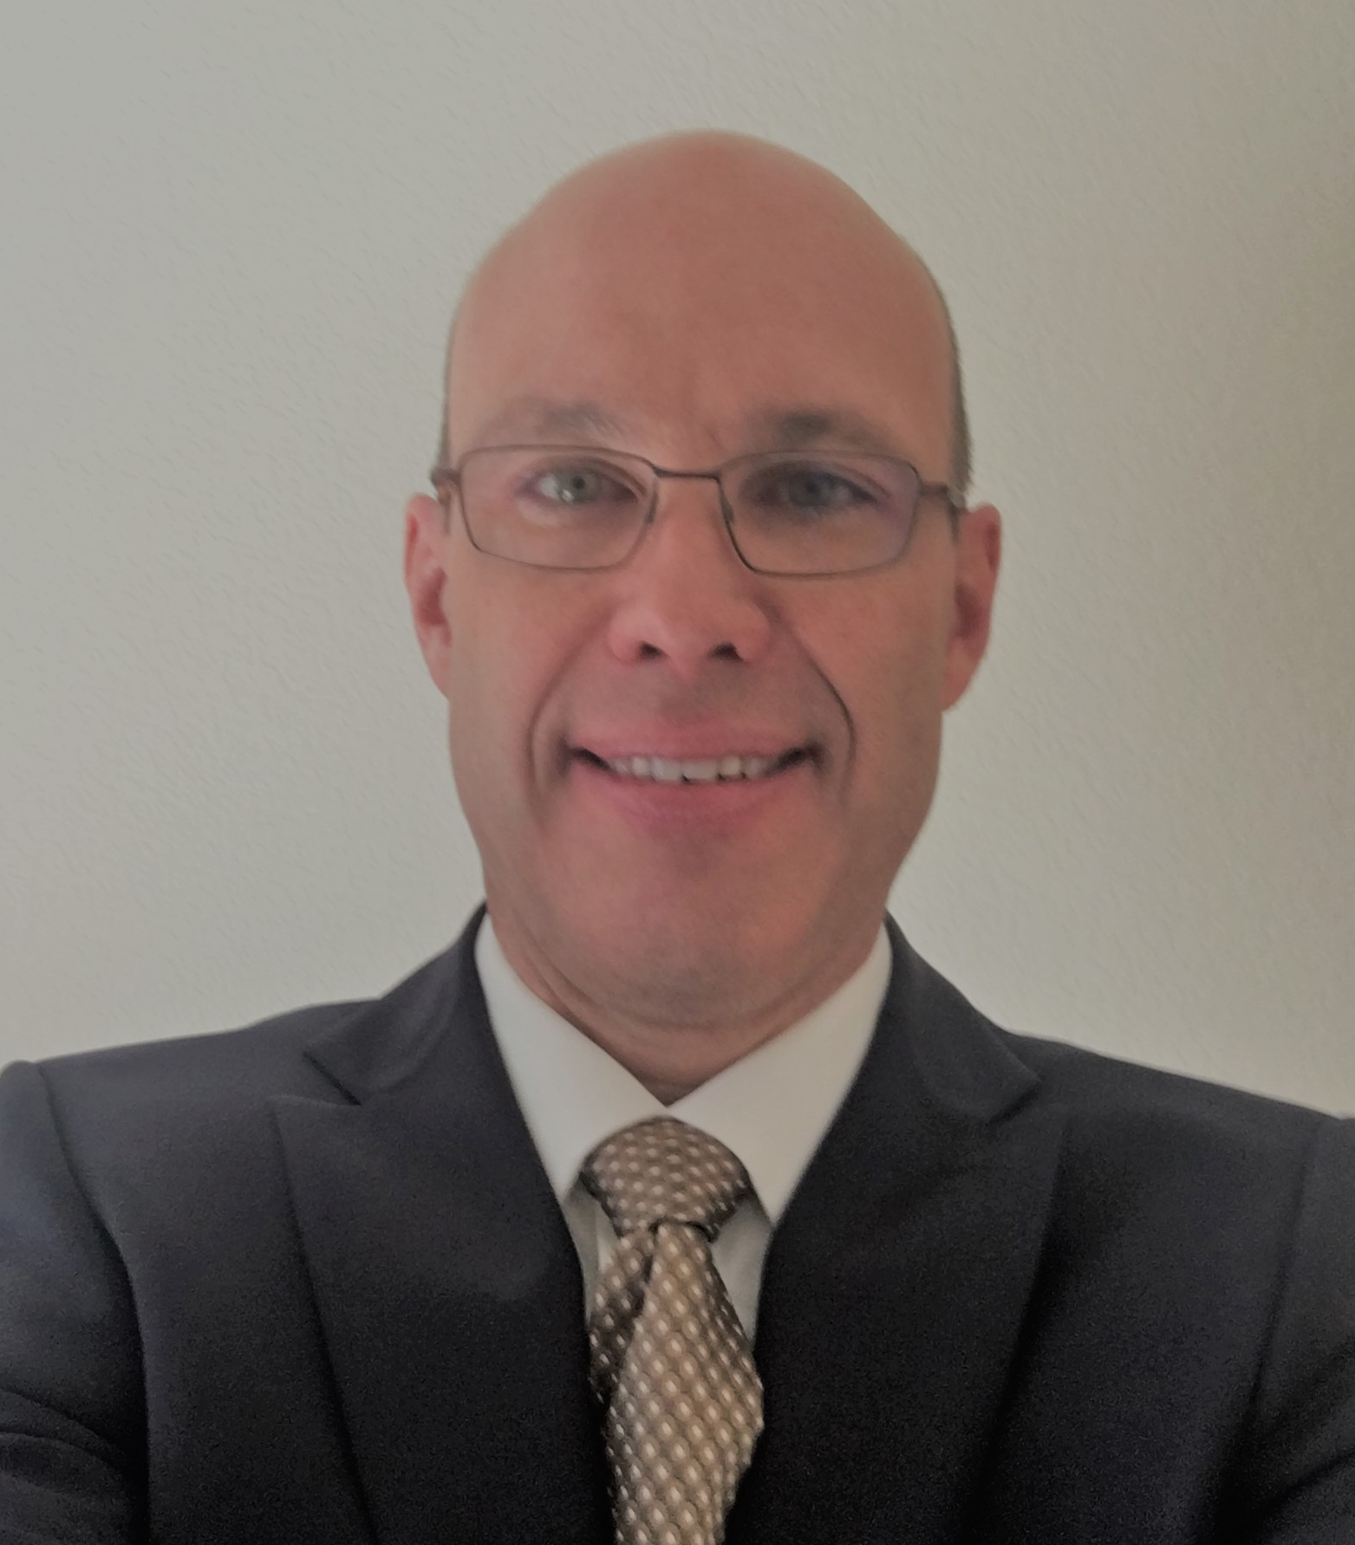
HCPF Executive Leadership Here to Partner & Support through Dynamic Transformation
Kim Bimestefer, Executive Director
Todd Jorgensen, Chief of Staff
Chris Underwood, Chief Administration Officer
Adela Flores-Brennan, Medicaid Director,
Health Policy Office
Bonnie Silva, Office of Community Living Director
Cristen Bates, Office of Medicaid & CHP+ Behavioral Health Initiatives & Coverage Director
Bettina Schneider, Finance Office Director
Parrish Steinbrecher, Health Information Office Director
Ralph Choate, Medicaid Operations Office Director
Tom Massey, Policy, Comms & Admin Office Director
Charlotte Crist
Cost Control & Quality Improvement Office Director
Tom Leahey, Pharmacy Office Director

Slide 27
Questions? Thank you!

