Slide 1
Food Insecurity
on the Western Slope
QHN Hot Topic Session
4/19/2023

Slide 2
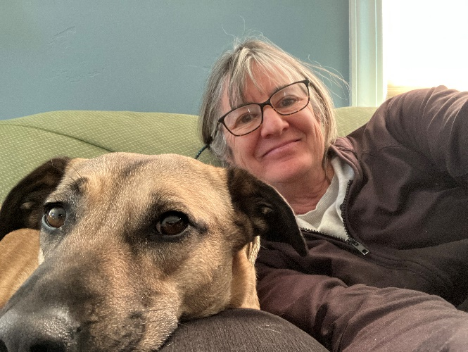
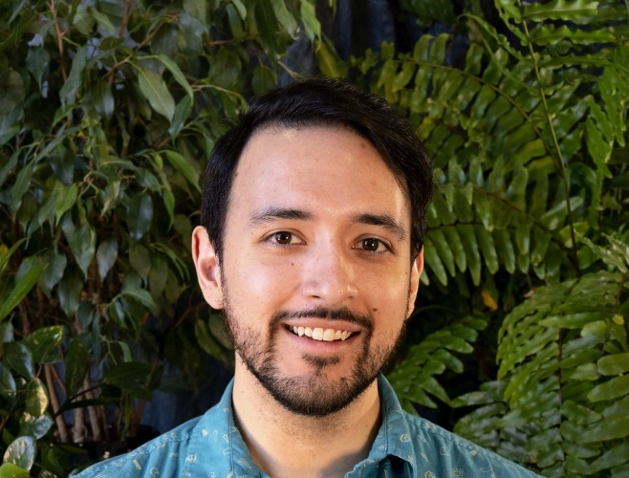
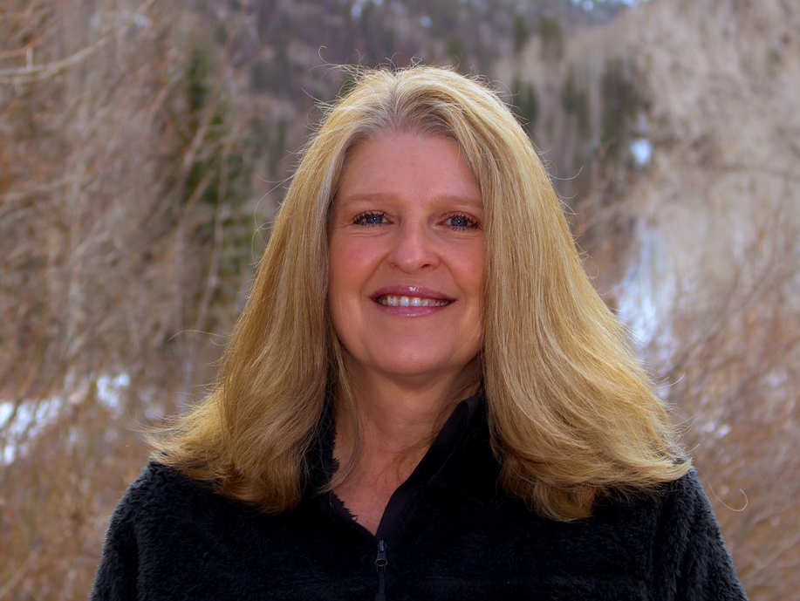
Our Speakers
Christine Dolan has been a Registered Dietitian/ Nutritionist at Garfield County Public Health for 25 years. Her work in Public Health focuses on disease prevention, therapeutic nutrition, and healthy food access for all.
Andrew Escamilla has been with 211 and Hilltop as a Coordinator for over a decade. This community has meant a lot to him and he feels so privileged to be a part of a program that is dedicated to helping the people of this amazing area in Colorado.
Leslie Sparks is the Community Programs Manager at Tri-County Health Network. She has many years of experience in the private sector, social service organizations, and working with non-profits. Leslie has a passion for serving individuals with a variety of needs and has expertise in crisis management and substance use disorder services

Slide 3
Mountain Coalition Food and Nutrition Security
Ivan Jackson Lift Up
Christine Singleton Dolan – Garfield County Public Health
4/19/23

Slide 4
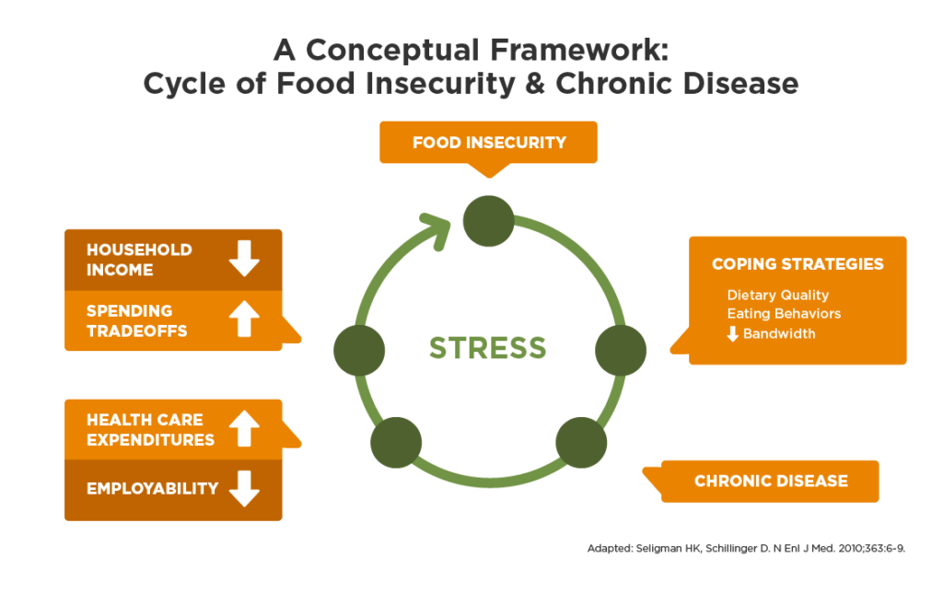
Notes:
Food insecurity creates a complex system of problems. Once a family experiences food insecurity they are forced to make choices that impact their overall health. Cheaper food is typically lower quality and less nutritious. Which sets people up for becoming overweight, and or developing chronic diseases. Unhealthy diets account for almost 20% of U.S. health care costs from heart disease, stroke, and diabetes, according to a new study.Dec 17, 2019
Chronic disease can lead to lower rates of employability and missed work because of sick days, Less money from lower income forces choices of poorer quality food which leads to possible worsening health.
We don’t have time today but the subject of the addictive qualities of highly processed foods should be discussed with families and clients.

Slide 5
National Hunger, Nutrition, and Health Strategic Priorities
Improving Food Access Affordability
Integrating Nutrition & Health
Empowering all Consumers to Make and Have Access to Health Choices
Supporting Physical Activity for All
Enhancing Nutrition and Food Security Research
Ending Hunger and Reducing Diet-Related Diseases and Disparities | health.gov
Notes:
The current administration has recognized the issues around health and nutrition during the 9/22 conference on Hunger, Nutrition and Health. Pillar 1 addresses the goal of connecting people to food benefits thru government programming like SNAP, WIC senior nutrition programs and supporting food pantries and food banks in supplying healthier foods to clients. Pillar 2 focuses on enhanced screening for food and nutrition insecurity and programing around the concept of food as medicine and financial support for home delivery of medically tailored meals 3 front of package food labeling, nutrition education, long term goals for sodium reduction in foods4 enhanced connections to people and parks and other support for PA 5 bolstering funding to improve research to inform nutrition and food security policy, particularly on issues of equity and access; and implementing a vision for advancing nutrition science.

Slide 6
Our Purpose and Values
Our Purpose
We believe food and nutrition security is a right that can be best delivered through a regional approach that provides sustainable food access, education, and storage to ensure the health of our region.
OUR VALUES:
Accessibility – we advance affordable, attainable, and culturally responsive strategies.
Regionalism – we practice a systems approach that values and responds to the individual needs of our communities to achieve scalable and sustainable solutions.
Equity – we advance food production and distribution strategies to those who are marginalized.
Notes:
MCFNS created our own statements and values to reflect local priorities

Slide 7
Our Goals
Nutritious food will be accessible to 100% of individuals who need it, in their community.
Increase annually the % of food sourced from Colorado-based producers.
90% of those served by the MCFNS partners annually will report “high satisfaction” with the quality, consistency, and cultural responsiveness of their experience accessing food.
50% of the region’s annual funding, food sourcing and distribution will be done through collaborative initiatives among MCFNS partners by 2026.
MCFNS will expand community partnerships for securing volunteers, funding, and food sourcing to meet regional food system needs.
Notes:
MCFNS was created as a response to barriers identified from siloed work and in response to the food and nutrition needs of a highly mobile workforce. We identified 5 areas of primary focus. 1 food Availability to all 2 MCFNS wanted to focus support and purchase of local foods. As we saw during the pandemic our food system is too dependent on sources outside our community. We want to support local growers for that reason in addition to the nutrition quality and taste of local food. 3 quality service 4 the benefits of team work, grants, avoiding duplication and a desire to streamline services.5 together we are stronger

Slide 8
MCFNS – Governing Council Members
Facilitator/Coordinator – West Mountain Regional Health Alliance
Lift-Up - Chair
Garfield County Public Health, WIC – Co-chair
Food Bank of Rockies
Valley Meals and More
Pitkin County Human Service
Garfield County Human Service
Eagle County Human Service
Safe and Nutrition Abundance Alliance
Up-root
Harvest for Hunger
Eagle Valley Community Foundation
City of Aspen

Slide 9
Success
Collaborative funding proposal
Partner around food hub study, CMU
Collaborative strategy around 12 private and public entities
Collective sharing of data
Food tote/72 hours bag
Notes:
Each organization has brought collaboration and partnership to the table.

Slide 10
Solutions & Strategies
Coordinated Response
Expanding food and nutrition access
Coordinating food collection and distribution
Build public and private partnership
Collaborate funding to scale sustainable solutions.
Notes:
Food Hubs
Co-located Distribution Sites
Public and Private Resources
Philanthropy

Slide 11
Opportunities to Support MCFNS
POLICY
FUNDING
PARTNERSHIP
Notes:
Suggestion – connection between adequate nutrition. Nutrition relates chronic disease. $$$ save, Medical save and health. Cost of saving. Source: CDPHE, County Health Ranking

Slide 12
Andrew Escamilla, CRS (he/him)
Coordinator, Western Colorado 211
Hilltop Community Resources
My name is Andrew. I’ve been with 211 and Hilltop for over a decade now! I was born in Texas, but raised here in Grand Junction. Even though I’m mostly a city boy, I can appreciate the beauty this state has to offer. This community has meant a lot to me over the years, and I am so privileged to be a part of a program that is dedicated to helping the people of this amazing area in Colorado.

Slide 13
What is 211?
211 is a confidential and multilingual service connecting people of all ages and from all economic backgrounds to vital
resources across the state. No matter where you live in Colorado or in the U.S., you can find information about resources in your
local community by dialing 211.

Slide 15
Over the past 3 years (2020 – 2022)
958 Connections to Food Resources
594 Connections to Food Pantries
283 Connections to Food Programs (TEFAP, CSFP, SNAP)
147 Connections to Soup Kitchens/Meals
34 Other Food-related programs
Western Colorado 211 distributed more than 450 Food Brochures to callers between 2020 - 2022

Slide 19
TCHNetwork is a nonprofit dedicated to health equity since 2011 serving over 13K people annually
We are committed to collaborating with our communities to improve health for everyone
Our programming ranges from community outreach and education to direct services
Programs are created to ensure care is accessible, affordable, and available to all community members regardless of their circumstance
By taking a whole-person approach to health, our team can identify and address underlying social factors that may impact an individual’s ability to live as healthfully as possible
We envision vibrant and healthy communities where everyone has the opportunity and ability to thrive
Notes:
Bullet 2 is our mission
Bullet 5 is our vision.

Slide 20
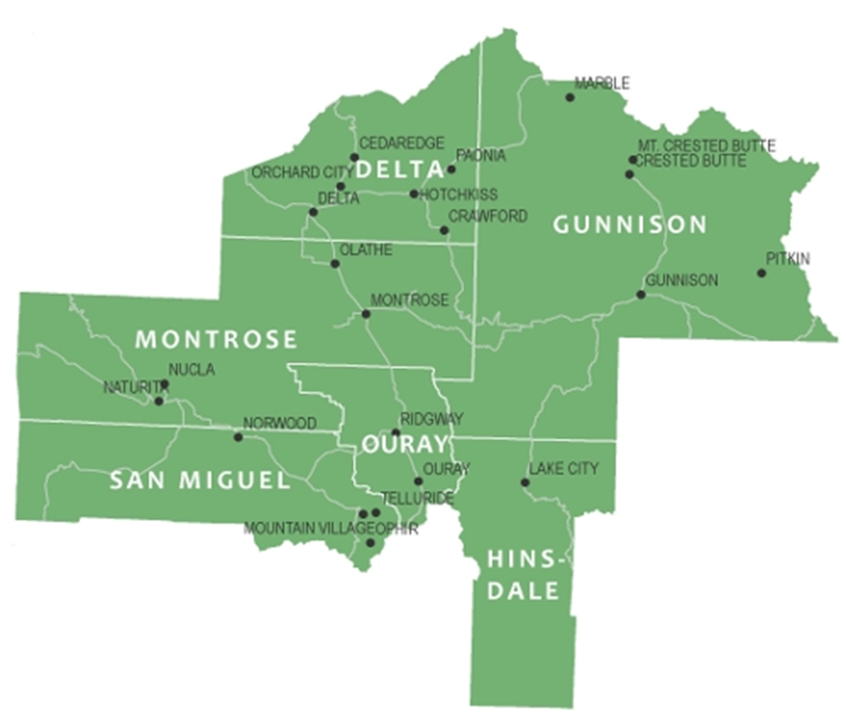
We Serve Western Slope Communities
2011
Started with 2 community outreach programs serving 2.5 counties
Today
We manage over 25 programs and initiatives supporting a 6-county region
Notes:
TCHNetwork is celebrating our first decade! We continue to expand programming in response to community needs.

Slide 21
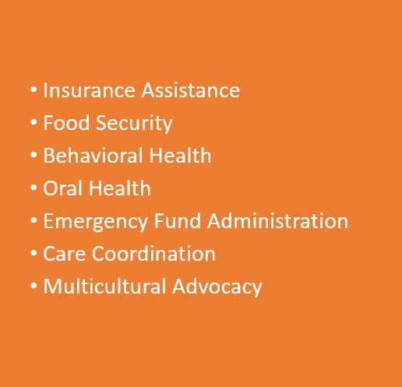
2022 TCHNetwork Programs – Delta County
Notes:
Although we have been working in Delta county for years, we are making a more concerted effort to expand our programs now.

Slide 22
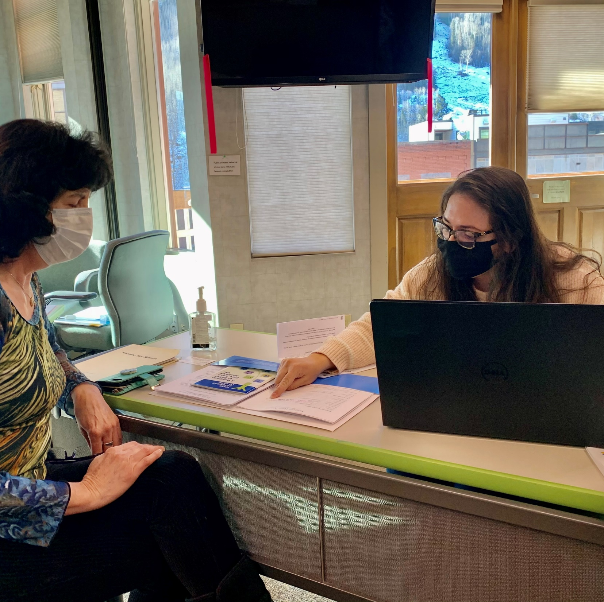
Insurance Assistance
TCHNetwork is available year-round to help community members navigate the complex and ever-evolving world of health insurance.
Health First Colorado (Medicaid) - No-cost health and dental insurance.
Children’s Health Plan Plus (CHP+) - Low-cost to no-cost health insurance available for children and pregnant women.
Connect for Health Colorado - Insurance available to residents without access to employer-sponsored health insurance.
enrollment@tchnetwork.org
Notes:
Tri-County can help any individual in need of health insurance. Our enrollment navigators will assess the client’s eligibility based on their income levels. If they qualify for Medicaid or if their children are eligible for Child Health Plan Plus, we will complete the application with them on the state website.
For clients, whose income is above the limits for either of these programs, we will complete an application with them through Connect4Health Colorado. Many people do qualify for either lower premiums and/or lower co-payments.
Connect for Health Colorado is the official marketplace for health insurance made available by the Affordable Care Act. Annually from November 1 to January 15 an open enrollment period is offered to Colorado residents to purchase health insurance.
Outside of Open Enrollment, a CO resident can get insurance on the marketplace if they experience a qualifying life event. That includes job loss, marriage, birth, adoption, or falling off your parent’s insurance. In these cases, you have 60-days to enroll.
Our team receives 40+ hours of training each year and is well versed on the subject. If you know someone without insurance, please refer them to tchnetwork.org or call 970-708-7096. With options available for various income levels there is certainly no reason to go without.

Slide 23
Behavioral Health
Our program is designed to reduce stigma and promote awareness about behavioral health through education and direct services.
Education – SafeTalk & MHFA
Online Resource Guide
Teletherapy
Notes:
If you hurt your ankle playing soccer and are in excruciating pain, what do you do? Most likely you visit the doctor to get an Xray and make sure nothing is broken. Assuming that the injury doesn’t require a cast, you go home and follow the doctor’s instructions to rest, ice, compress and elevate until your knee heals. Going to the doctor is expected in this situation and nobody questions why you went because they saw your swollen knee.
However, if you are experiencing anxiety or depression there often isn’t that same immediate reaction to visit a physician. And the same external cues aren’t present for others to easily recognize that something is wrong (i.e. no limping no swollen knee).
Although we know that mental health is just as important as physical health stigma still exists that prevents people from seeking help for mental health issues in the same way they do for physical ailments. We are working to change this through programs and education.
Due to the shortage of mental health professionals in our area, TCHNetwork’s teletherapy program provides community members with an affordable way to connect to Colorado-licensed behavioral health professionals via their computer, phone or tablet. It’s healthy to talk to a professional about life challenges and using technology to do so allows you the freedom to dictate when and where you meet with your therapist. There are funds available in many cases, so don’t left cost be a barrier to care. Please note if you are a teacher or student from a participating school the service is free. And our team includes both English and Spanish-speaking therapists.
Education plays a crucial part in eliminating stigma. Through a variety of courses, we offer training to help community members recognize the signs and symptoms of mental health disorders and provide them skills to effectively engage with a person who is experiencing a crisis. Please contact us for more details or if you or your team would like to enroll in Mental Health First Aid, safeTalk suicide prevention, NAMI Family to Family or a support group. Our team will be happy to walk you through the different options.
Finally, don’t forget that we provide an online directory of mental health resources that should be the first stop for anyone who is looking for assistance.

Slide 24
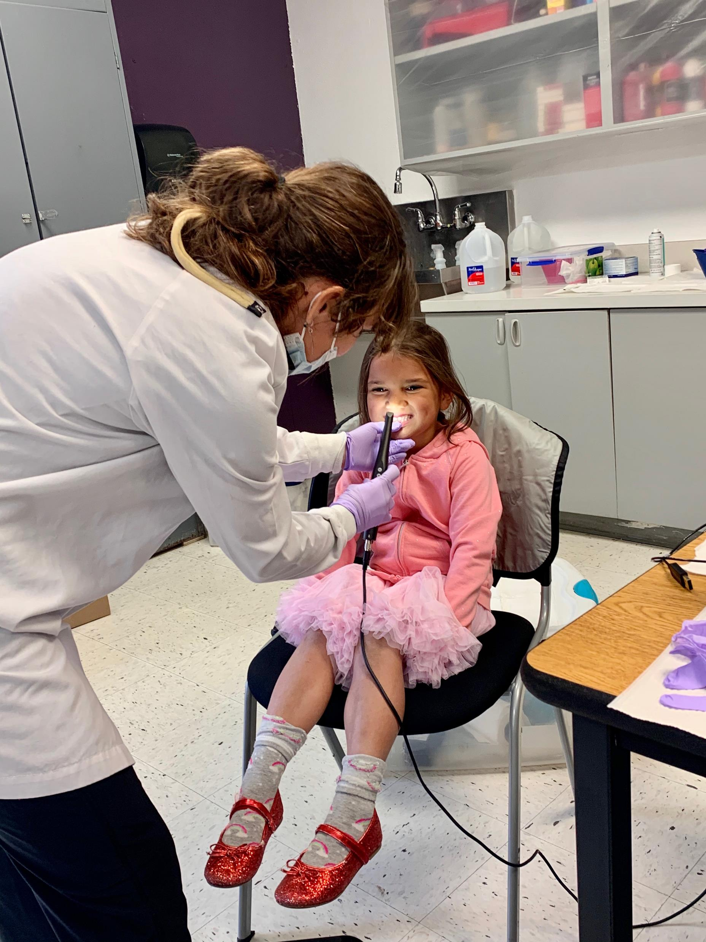
Oral Health
Our program reduces barriers and improves access to quality oral healthcare.
Skippy
A mobile dental clinic providing kids aged 0-18 with care to prevent tooth decay. Services include exam, cleaning, x-rays, sealants and restorative care.
Since 2011, we have partnered with area schools who host our clinics onsite during the school day.
Notes:
Our mobile dental program was developed is in direct response to the geographic needs we see in our communities. There are limited dental providers in our region and some towns don’t have any dentists at all. With transportation and distance being a barrier for many, TCHNetwork sets up mobile clinics in central locations and in schools to make it as easy and convenient as possible for people to access dental care.
The service we provide is the same state of the art service you would receive in a dental office. Our full suite of oral services includes an exam, cleaning, xrays, oral cancer screen and fluoride treatment. After the hygienist finishes with the checkup, she consults virtually with a dentist who reviews the information and provides recommendations. If cavities need to be treated, she is certified to remove decay without numbing and drilling! Instead, she applies a liquid that crystalizes the decay and prevents it from spreading. It’s a great alterative to traditional fillings and certainly reduces the apprehension factor many experience when visiting a dentist! In cases where further treatment is necessary we will refer the patient to a local provider.
So who do we help? Our community clinics help Medicaid members. Although dental care is an included benefit of health insurance through Medicaid, not all dentists accept Medicaid so we fill that gap. Our school-based program, Skippy, is offered in schools across 4 counties and has been one of our longest-running programs. The program offers a huge convenience factor, when parent don’t have to take time off to drive their kids to the dentist.

Slide 25
Emergency Fund Administration
We administer and disburse financial assistance from emergency funds established to help individuals continue to live and work in our community.
Energy Outreach Colorado and LEAP
Notes:
Our Good Neighbor Fund was created to provide financial support to individuals experiencing an economic crisis so they can continue to live in the community. The fund can be used for assistance with rent, mortgage, car repair, mental health needs, utilities, energy sources and more. To access the fund you must live or work in San Miguel, Ouray, the Western portion of Montrose County or the town of Rico.
Although the GNF has been around for a decade, you can imagine that fund disbursements increased dramatically during the pandemic.
A recent recipient worked in our community for 5 years cleaning homes while her husband worked in local restaurants. They have two children, only one of whom was born in the United States. Due to their immigration status, the family is not eligible for federal assistance, stimulus checks, unemployment benefits, and they cannot live in affordable housing units.
As a result, the Good Neighbor Fund was their only lifeline during this crisis. Helping the client with their rent and providing them with a gift card to the local grocery store helped them to survive while restaurants were closed, and cleaning jobs unavailable.
The funds allowed the kids to continue in school and the family to stay here.
The client expressed her gratitude by writing, “I can’t be thankful enough for the help you are willing to give me. You all have been angels to us. Especially to those of us who have no legal status. It has become extremely difficult during this time especially when all I can depend on is the little work I have. Due to unforeseen events the small cleaning company I worked for was shut down in the spring. Thank you for the bottom of my heart and God bless you all.“
Tri-County Health Network also provides energy assistance so people with overdue energy and heating bills don’t have those services cut off by utility companies.

Slide 26
Care Coordination
Our program helps community members navigate and get connected to resources based on their individual care needs.
Whole person health approach
Aging and Disability Resource Center
Palliative support services
Wrap care coordination for non-Medicaid members
Notes:
Our care coordination program is based on a whole person approach to health. It’s the belief that there are a variety of factors that influence your ability to live a healthy lifestyle and thrive. These factors are known as the social determinants of health.
A person's health is more than genetics in fact genetics is only 30% of the healthcare puzzle. In fact, environment, access to health care, and behavior have more influence. If you are living out of your car, taking care of your diabetes is probably not your highest priority. Our care coord team screens for these kinds of social needs. Does a person have enough food to eat, and access to housing and transportation? Do they have steady employment? How is their mental health?
After screening, Care Coordinators work extensively with individuals to develop a care plan and help them connect to services and access resources.
In the past, when a patient visited a doctor, they were asked to provide their medical history. But it’s also important for doctors to be aware of any social challenges a patient faces. In efforts to drive adoption of social determinant screening, Rocky Mountain Heath Plans asked for help from TCHNetwork. By working with our local clinics across 6 counties, 37 clinics have incorporated social needs screening into their practice.
Our team also helps individuals with more complex needs, as well as assisting older adults, and those with a disability or chronic condition, navigate resources, and long- term care options. And in San Miguel county we provide specialized coordination for individuals at end of life.
If you know someone who meets this criteria, please contact our care coord team. We can perform an In-house assessment and make sure they get the help they need.

Slide 27
Multicultural Advocacy
Our program seeks to champion diversity, equity & inclusion through advocacy, partnership, collaboration, education and policy work.
Racial Equity
Language Justice
Diversity, Equity, and Inclusion Training
Notes:
It can be difficult for someone new to a community to navigate all the services and resources available. But imagine also having a language barrier! Our team of bilingual and bicultural staff can provide assistance in Spanish to help residents get a drivers license, establish a PO Box, enroll in health insurance, and find childcare.
Our team also provides immigration legal assistance to low-income immigrant families in our community. With limited affordable legal aid available in the area, our DOJ accredited ILS representative is available to assist with initial DACA applications, DACA renewals, Green Card renewals, and Naturalization applications.
For TCHNetwork, this all directly ties to our organization’s commitment to racial equity. We acknowledge there are barriers diverse populations face as a result of inequitable systems. We joined efforts with local organizations including the Collaborative Action for Immigrants, Latinx Affairs Committee, Alliance for Inclusion, and Coalition for Immigrant Health to help elevate Latinx issues and to establish a more culturally sensitive and inclusive environment within our community.
Additionally, to facilitate community dialogue, TCHNetwork offers Diversity, Equity and Inclusion training. Our DEI series includes four courses - Introduction to Culture, Power Structures and Levels of Discrimination, Implicit Bias and Microaggressions, and White Privilege.
If you or your organization is interested in completing the series or an individual 2-hour course, please contact us and we can get you scheduled.

Slide 28
Diversity, Equity & Inclusion
The Multi-Cultural advocacy Team is working to facilitate two groups that will inform each other synergistically and ultimately make local healthcare more accessible, especially by removing language barriers
Community Advisory Council (CAC) to consolidate the voices of community members with firsthand experience of these healthcare access and language justice struggles.
Delta County Alliance for Inclusion (AFI) of local organization leaders to empower them with DEI principles to make top-down change and pool resources.

Slide 29
Community Health Needs Assessment
Identify the health-related needs of people living in our community
Lean more about the services community members are utilizing
Check to see if there are needs not being met.
Inform TCHNetwork and other local organizations of any new resources that are needed to improve the health of the community.
Notes:
We know people’s attitudes and behaviors toward their health and well-being have changed since the pandemic struck. We want to ensure the services being offered are utilized and uncover any unmet needs.
Our goal is to collect 1,400 surveys with 350 from each target community. Our survey covers San Miguel, Ouray, Delta and the West End of Montrose counties. We need your help to make sure all community voices are heard. Please complete the survey (hand out paper copies). When you finish I can provide you with a gift card. Otherwise, complete online and you will receive a Amazon gift card.
Survey results will be presented to the community this fall and will be available online.

Slide 30
Food Security
Our program is designed to connect community members to food resources and empower them to eat healthfully.
Supplemental Nutrition Assistance Program (SNAP) – A financial program designed to complement a household’s existing food budget.
Food Bank Support – Creating awareness and connecting more community members to food bank resources.
Notes:
Good health starts with eating well. However, 12% of our residents experience food insecurity and regularly don’t have enough to eat or access to the fresh fruits and vegetables necessary for a healthy diet.
Tri-County Health Network offers assistance with several programs to help people access food and learn about health and nutrition.
While most counties have a food bank, not all residents are taking advantage of this resource. We are collaborating with local pantries to build on their strengths and expand access to community members who are homebound or lack reliable transportation.
Additionally, our team can help individuals and families complement their food budgets with SNAP. Eligibility is determined by income level and the number of people in the household. Our team will enroll those eligible and make sure they understand all the associated benefits. Recipients then receive a debit card for groceries that can be used locally and on Amazon!
Cooking Matters is designed to help people cook healthy on a budget. Topics covered in the course include basic cooking skills, food preservation, cooking as a family, and healthy snacking. Participants learn how to prepare nutritious meals that feed a family of 4 for $10!
FoodRx is a more specialized program providing health coaching and vouchers for fruits and vegetables to those with chronic disease.
If you our someone you know could benefit for these programs, please contact us.

Slide 31
Learn more at tchnetwork.org
202 Main Street, Delta CO 81416
970-708-7096 | enrollment@tchnetwork.org

Slide 32
Thank You!
Questions?
qualityhealthnetwork.org

Slide 33
Next Hot Topic Session –
Wednesday, May 17th, 2023
qualityhealthnetwork.org

