Slide 1
Security and Trust: How QHN and Our Participants Keep Data Safe
May 17, 2023
Janet Terry Privacy and Security Officer, QHN

Slide 2
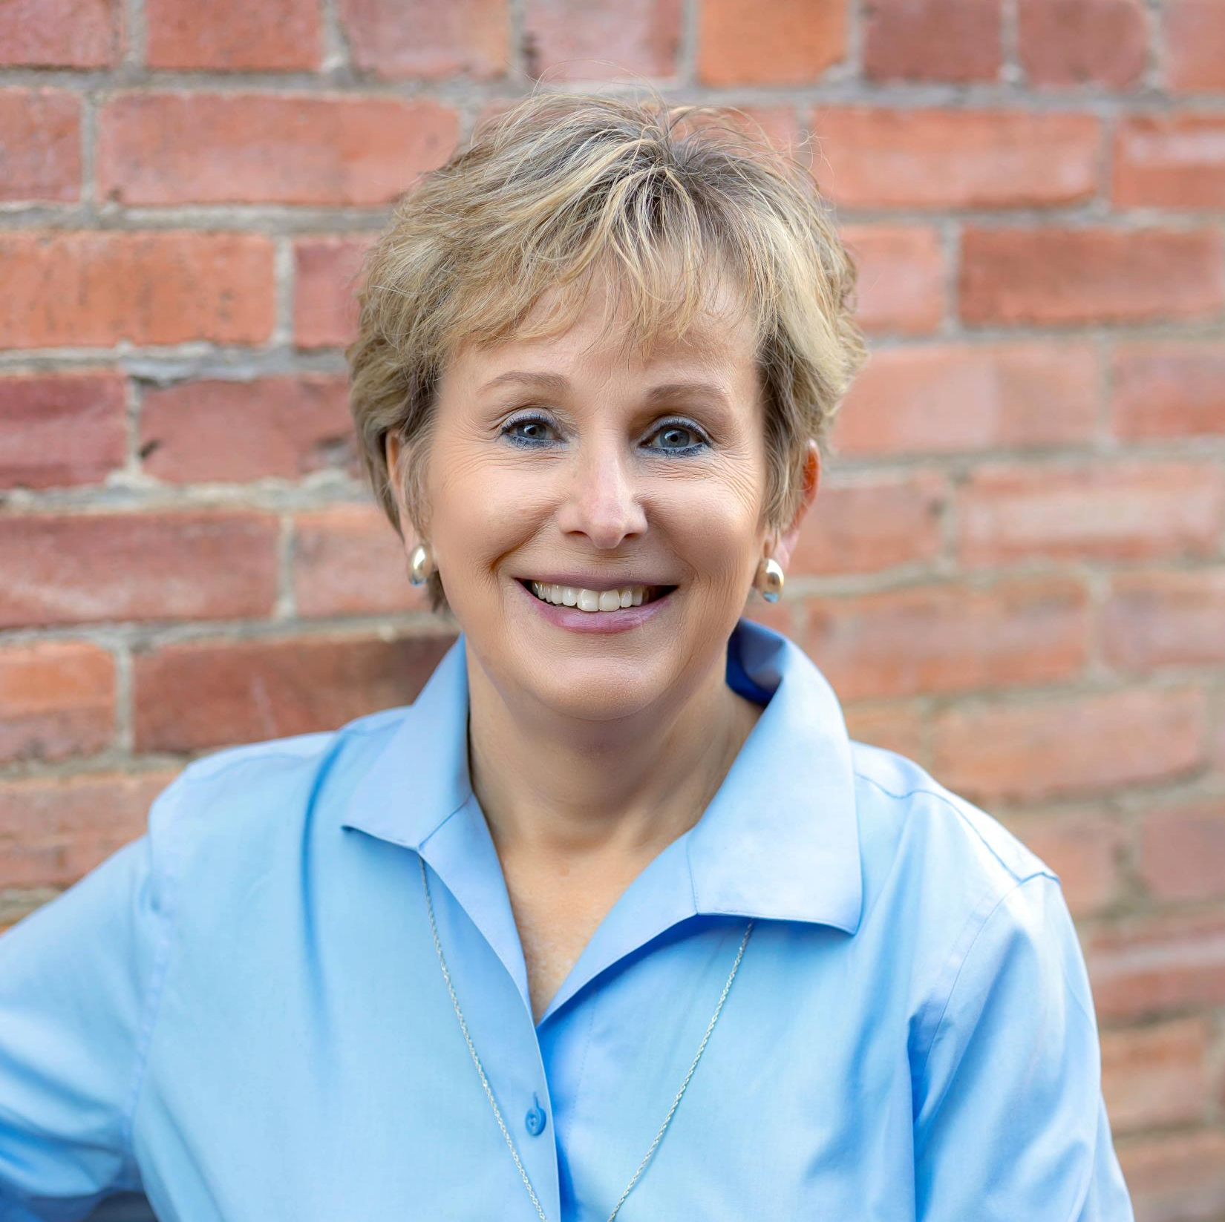
About the Speaker
Janet Terry
Has worked at QHN since 2010 and has been the Privacy/Compliance Officer at QHN for the past 10 years.
Notes:
Welcome and Thank You for attending today.
I hope to make this time with all of you a conversation about how we can best protect the privacy and security of the information
entrusted to all of us… this information, which represents the health records for over 1 million individuals in Western Colorado and beyond.
For me, the concept of protecting this information that impacts all of us, our friends and families, the responsibility of it all is very sobering.
And, I suspect it is for all of you, or you probably wouldn’t be here today, to discus what many believe is a very boring, dry subject…..But…here we are

Slide 3
AGENDA
Threats
What Can QHN Do?
What Can You Do?
Notes:
We will try to keep the agenda fairly simple today: Threats – What can QHN Do? – What Can You Do?

Slide 4
THREATS
From outside our organizations: PHI is valuable to the bad guys
From inside our organizations: Our Best Defense is USER AWARENESS……………. Our Biggest Weakness is the UNINFORMED USER.
Notes:
NOTE:
This is what I teach all our staff – You, as the user are the best defense we have against outside attacks and otherwise

Slide 5
WHAT CAN QHN DO:
We can use strong internal controls
We can use good physical security practices
We can implement strong password requirements
We can encrypt our system
We can audit every key stroke
We can become HITRUST Certified……
Notes:
Read Each Bullet – will talk a little more about HITRUST later….
You are all familiar with each of these Security Best Practices, since we are and have been regularly reminded of them, AT LEAST Once a Year…AND
These are all Best Practices that you have implemented into your operations, if for no other reason, than because we are required to do so.
Unfortunately, simply putting these practices into place, Both QHN AND your Organizations, has not been enough….
Each year, we have seen more and more privacy and security issues arise, both around the country, and beyond, as well as among QHN Users. So now what???

Slide 6
WHAT QHN CAN DO …...........IS ONLY PART OF THE EQUATION
Did you know that, in addition to the over 1 Million patient lives whose records are in QHN that:
There are over 7,000 QHN Users?
There have been more than 150 Million messages collected?
ALL OF THIS INFORMATION CAME FROM YOU!!
Notes:
I hope to help you understand that QHN is only a PART of the Equation needed to protect the vast amount of information in the QHN System.
DID YOU KNOW THAT, IN ADDITION TO THE 1 MILLION …..?
There are over 7,000 Users?
There have been more than 150 million messages collected into the system?
ALL OF THIS INFORMATION CAME FROM YOU…..
I Point this out to help you understand the responsibility QHN feels in keeping the information safe, but also to help you understand that this
Is your information for your patients and QHN cannot keep it safe without your help!!!

Slide 7
SO, WHAT CAN YOU DO?
You can share with your colleagues some of the examples of misuse we have seen and the consequences.
EXAMPLE: Jane Jones shared her password with coworker, Harriett, so Harriet could look at her child’s lab report; unfortunately, Harriett looked up multiple records of friends and coworkers.
CONSEQUENCES: Both employees lost their job
Notes:
What can You Do – This is a simple example, but unfortunately all too common, the consequences of which are REAL

Slide 8
…and more CONSEQUENCES:
The practice reported the breach to QHN. Because the access was a breach QHN took the following steps:
Reported the breach to the FIVE (5) Other Organizations whose records were breached
All 5 organizations were then required to notify the patient and to report the Breach to the Office of Civil Rights (OCR).
Notes:
COMMENT – I give you this example to help you understand that because the records are from so many organizations, when user mis uses their
QHN access, the impact can be very extensive and involved multiple other organizations.
Now, in these kind of circumstances, QHN does do everything to assist the practices, sending the patient notice on their behalf and filing the OCR report
On their behalf.
There are possibly more consequences, if the OCR decides to investigate, which could happen, and has occurred in W. CO.

Slide 9
WHAT MORE CAN YOU DO?
Keep QHN Informed
Let us know when someone leaves your organization
Let us know if someone has misused QHN
Constantly remind everyone NOT to share their passwords.
Review the access and active user reports from QHN
If misuse discovered, require password changes immediately
Notes:
Help us help you – Please keep us informed

Slide 10
NOW WHAT?
Look at your internal privacy and security practices and identify weaknesses
On a regular basis, communicate with your staff with helpful tips/reminders
If you have not performed a HIPAA Security Risk Assessment, it is required:
https://www.healthit.gov/topic/privacy-security-and-hipaa/security-risk-assessment-tool
Notes:
Just some helpful tips that you all can do right away
I mention the SRA required because if you ever get audited by the OCR, it will be a problem if not done

Slide 11
WHAT MORE CAN QHN DO?
HITRUST Certification
An arduous year’s long process of review by external auditors of all security domains: Physical, Technical, Operational, Policy and Procedures.
Not a one time review, but must be renewed annually
New and Improved Reports for You
Current lists of all your Active QHN users
Current activity of all your QHN Users
Notes:
So what more can QHN Do?
As I mentioned earlier, I would give you more details about the Hitrust certification QHN has achieved - comprehensive and renewed annually
ALSO,
Be looking for some more current reports we plan to send out, to better help all of us keep our systems current, such as Active Users.

Slide 12
FOR ASSISTANCE CONTACT:
Community Advisors
Sherri Corey scorey@qualityhealthnetwork.org
Cherie Schmitz cschmitz@qualityhealthnetwork.org
Angela Rodriguez arodriguez@qualityhealthnetwork.org
Wade Montgomery wmontgomery@qualityhealthnetwork.org
Privacy/Compliance Officer
Janet Terry jterry@qualityhealthnetwork.org
Customer Support
support@qualityhealthnetwork.org
Notes:
So what more can QHN Do?
As I mentioned earlier, I would give you more details about the Hitrust certification QHN has achieved - comprehensive and renewed annually
ALSO,
Be looking for some more current reports we plan to send out, to better help all of us keep our systems current, such as Active Users.

Slide 13
Thank You!
Questions?
qualityhealthnetwork.org

Slide 14
Next Hot Topic:
[June 21, 2023]

