Slide 1

Connecting People:
Exploring Transportation Services
in Our Communities
QHN June 2023 Hot Topic Session
6/21/2023

Slide 2
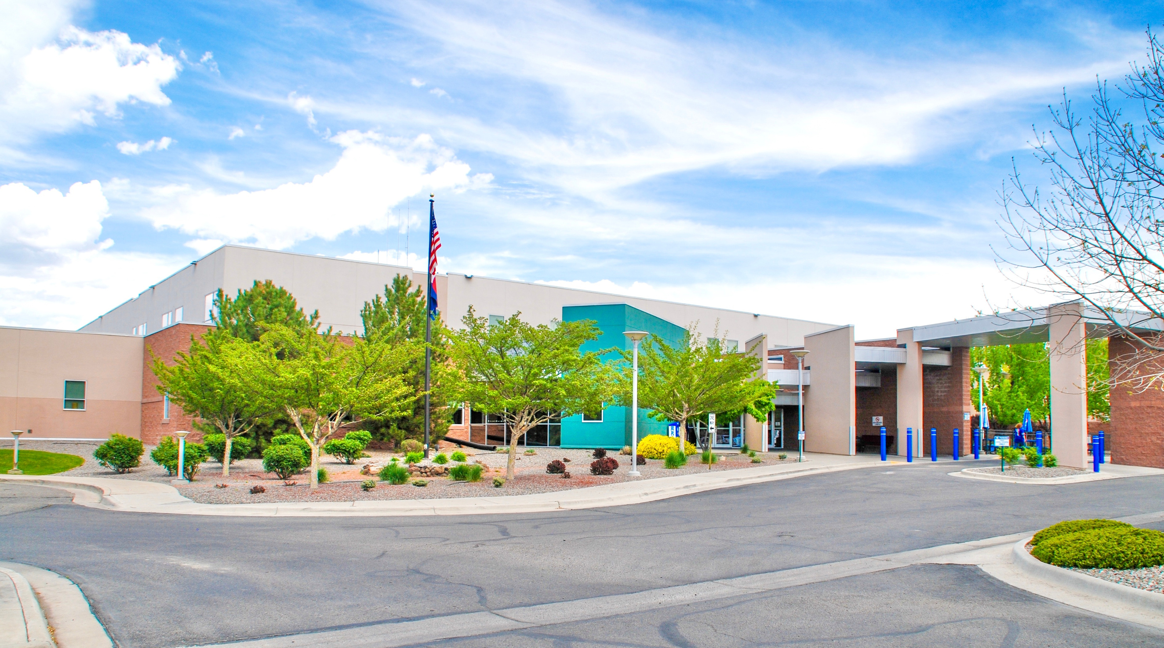

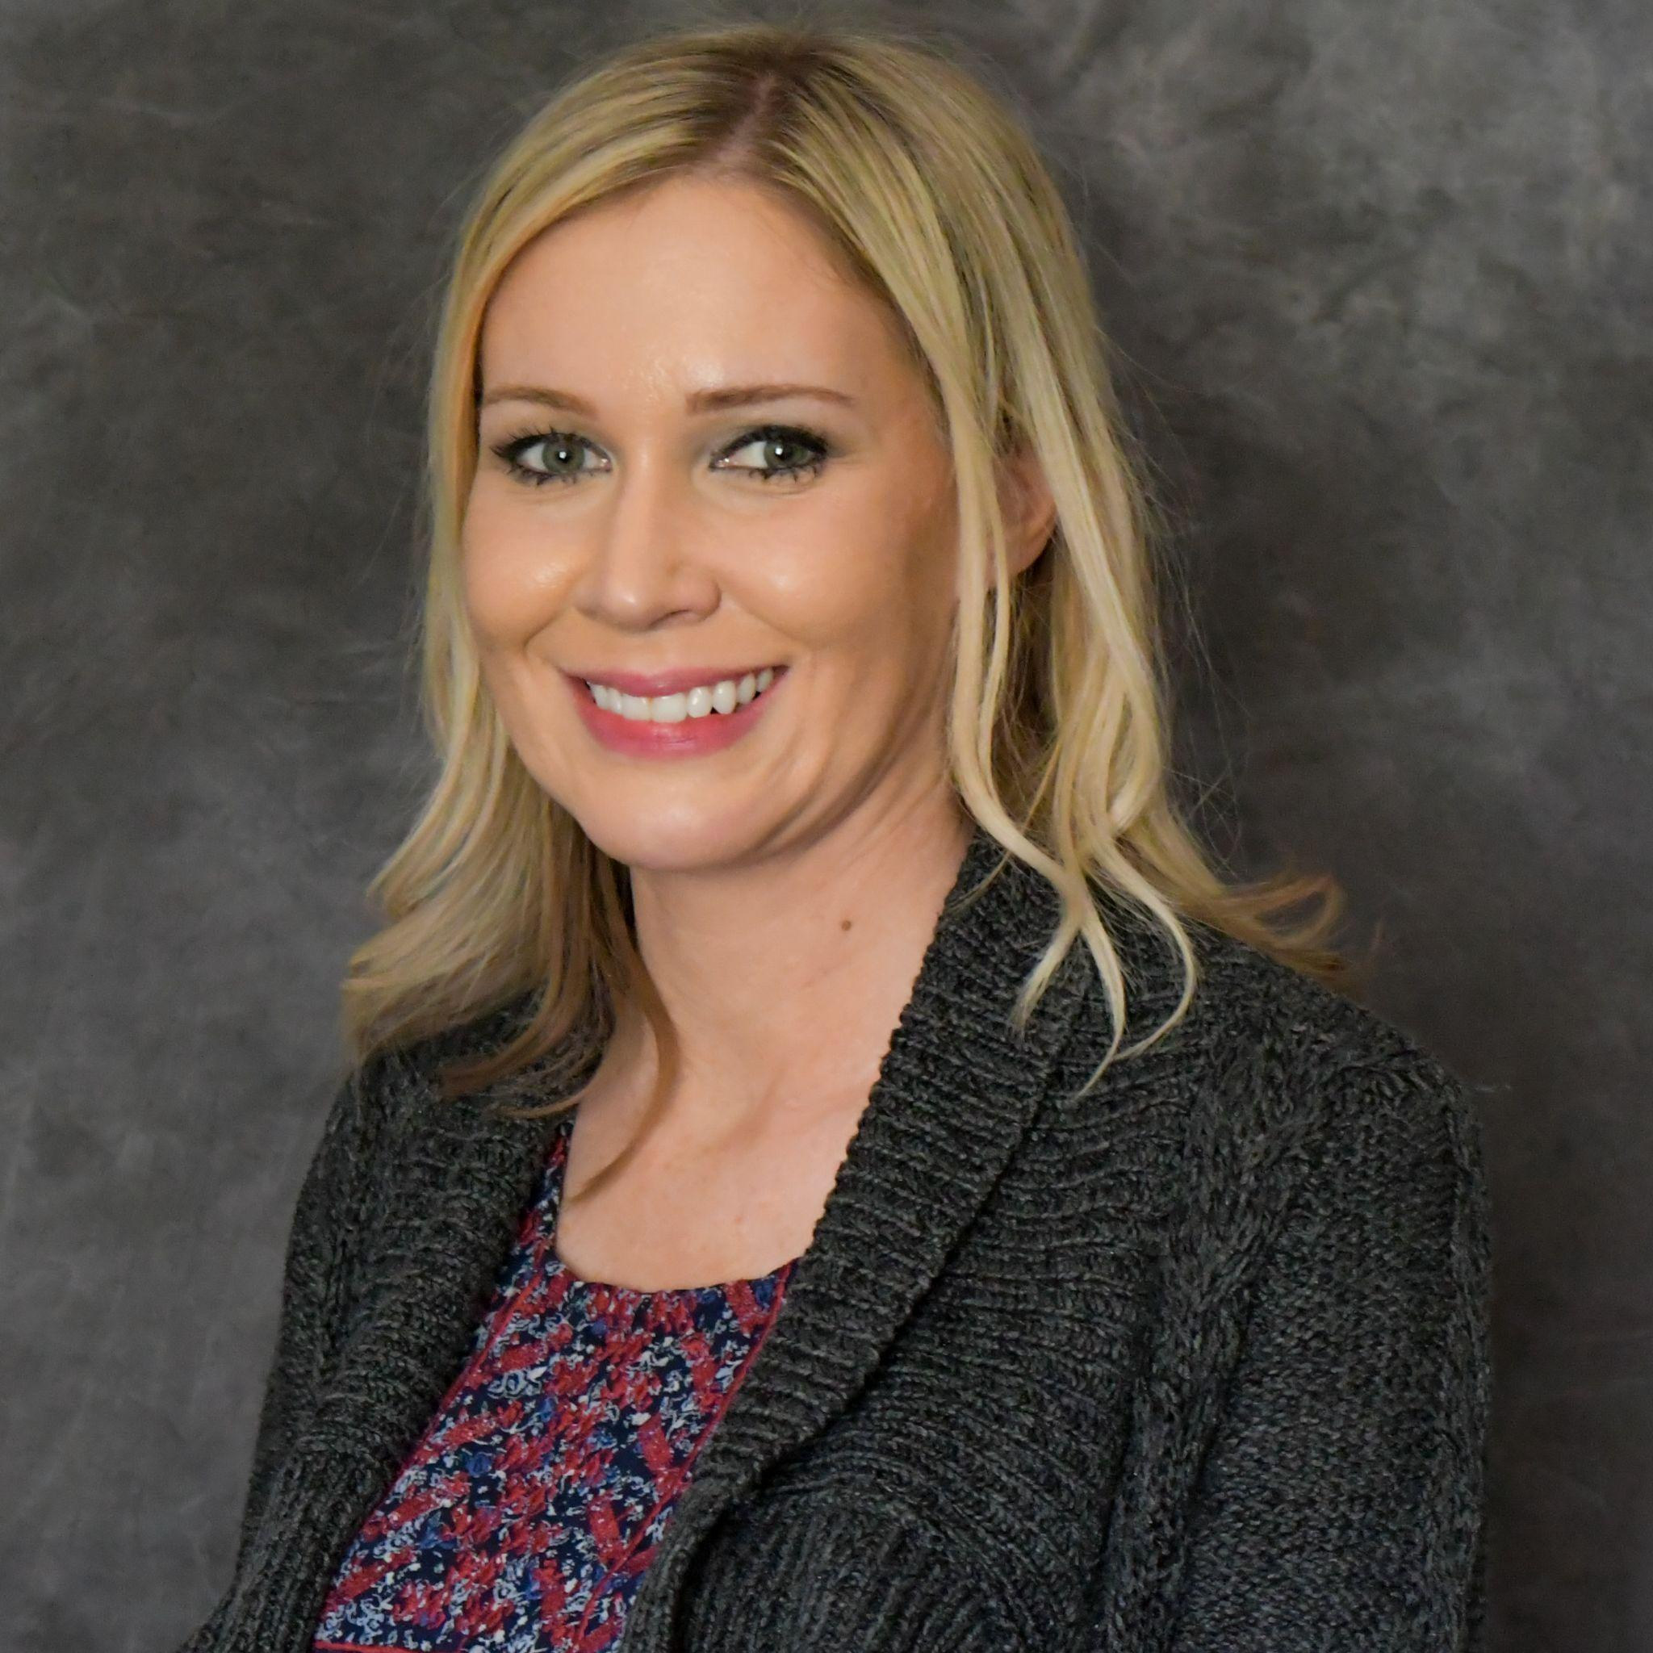



Brandi Vela, BSN, RN, currently works as the Quality Improvement Nurse at Delta Health and has been in this position for over three years. Since joining the Delta Health Quality Department, Brandi has worked as the project coordinator for several quality projects for Delta Health, including the Hospital Transformation Program, the Hospital Quality Incentive Payment Program (HQIP), and Leapfrog.
QHN Hot Topics –
Transportation

Slide 3

Delta Health Quality Initiatives
A current quality initiative at Delta Health is to screen patients for social determinants of health and connect patients to resources when needed.
Delta Health associated clinics have been working on this initiative for a couple of years.
The hospital is now embracing this quality measure as we embark on the Hospital Transformation Program (HTP).

Slide 4
Social Determinants of Health Screening and Referrals
Through HTP, we are now screening all of our inpatient Medicaid patients for social needs.
If a need is found, we are relying heavily on the Community Resource Network to connect patients to resources in the community.

Slide 5
Community Collaboration
Delta Health is participating in Community Advisory Meetings as part of HTP.
Transportation has become a focus of one such Community Advisory Meeting that Delta Health is hosting.
At this meeting, we have partnered with key stakeholders in Delta County and have been exploring what transportation is available and what gaps exist.

Slide 6

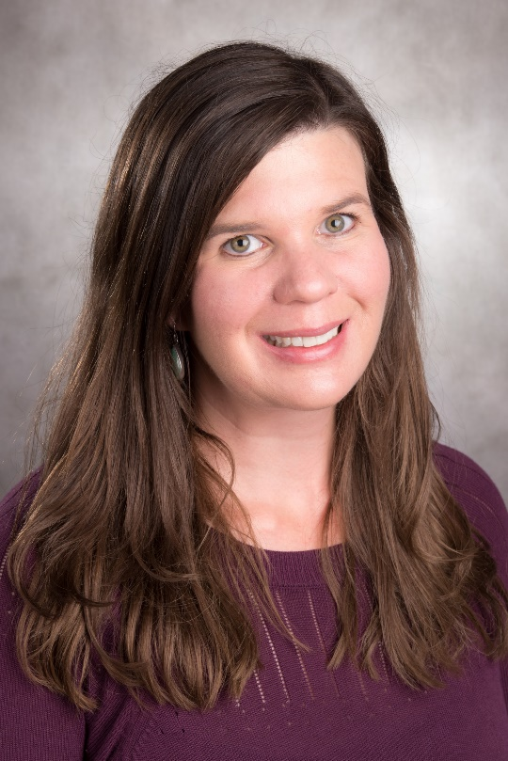
ALL POINTS TRANSIT
Services Update
QHN Hot Topics Transportation
Sarah Curtis is the Executive Director at All Points Transit. Sarah has lived in Colorado for over 20 years. Her passion has always been to work in the non-profit sector. Sarah was promoted to Executive Director of All Points Transit in 2016. She is a Certified Community Transit Manager by the Community Transportation Association of America and serves on the Transit and Rail Advisory Committee for the State of Colorado.

Slide 7

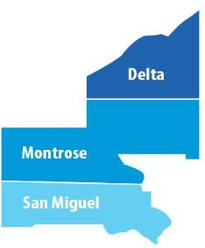
Serving over 4,500 square miles of rural and frontier communities on the western slope of Colorado
Quick Facts about APT
Providing rides since 1979!
501c3 non-profit organization
Up to 42 employees (mix of PT / FT) – 11 office / 31 Drivers
29 Passenger Vehicles in the fleet
(mix of minivans and 10-14 passenger buses)
$2.2M Operating Budget
Serving Montrose County (including West End),
Delta County, and some areas of San Miguel and Ouray
Funding from FTA / CDOT, Area Agency on Aging,
Medicaid, Foundation Grants, Local Governments,
Hospitals and Clinics, Foundation grants and ,
Fundraising (Join us for Montrose Oktoberfest on 9/30!)

Slide 8
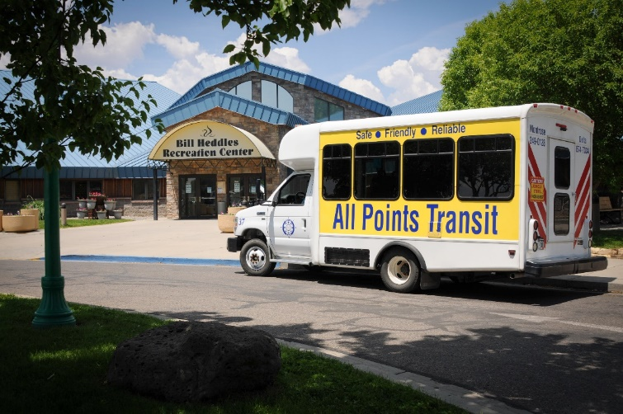
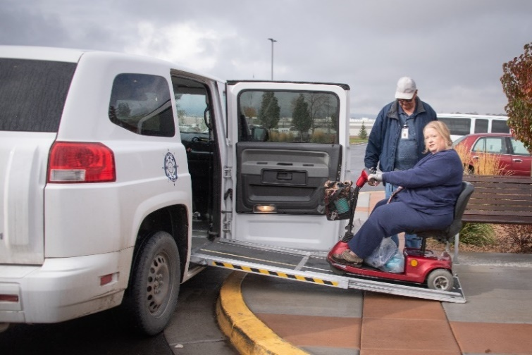
Current Transit Operations
Dial-A-Ride
Montrose County, Delta County & Parts of San Miguel County
- Pre-scheduled, demand response service with driver assistance.
- Trips scheduled 4+ weeks to 24 hours in advance of the ride.
- Regional shuttles connect rural communities to medical services in Delta, Montrose and Grand Junction
- Fares range from $5.00 - $10.00 each way.
- Medicaid reimbursements and support from the Area Agency on Aging ensure rides at no cost to passengers on pre-approved trips.
Montrose Public Flex Bus
- Deviated fixed route service in the City of Montrose area.
- Two routes in operation
- Bus passes start at $15 per month for unlimited rides
- Shuttle between Montrose and Olathe
Notes:
Dial-A-Ride serves wider area. Provides more assistance.

Slide 9
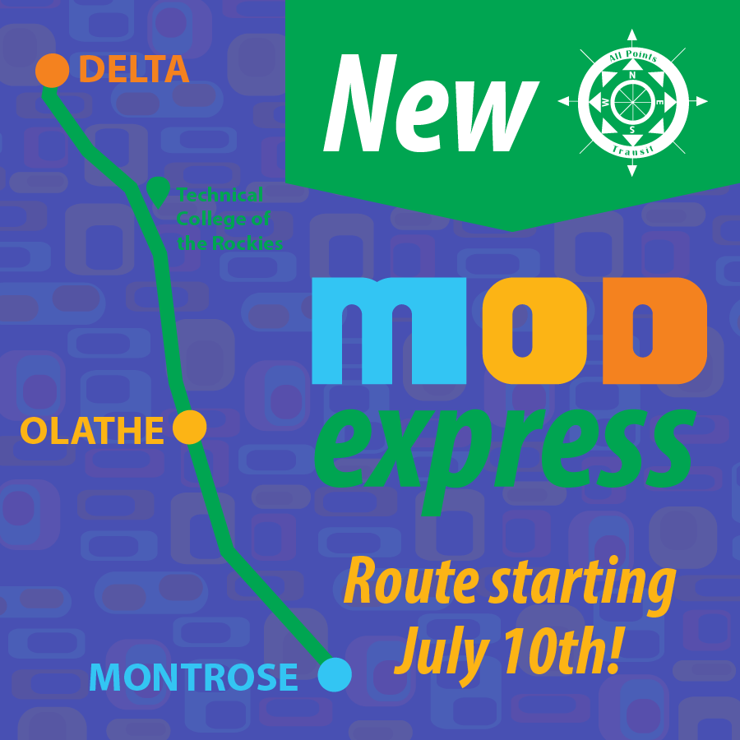
NEW!
COMMUTER BUS ROUTES
Montrose -Olathe -Delta
Stops at Technical College of the Rockies!
Monday – Friday, 7:00am -5:00pm
HOURLY HEADWAYS
Will replace current Olathe Shuttle
LAUNCHES JULY 10th!
Montrose-Ouray (coming soon!)
- 5 round trips in the summer (7am-10pm)
- 3 round trips in the winter (1am-6pm)

Slide 10

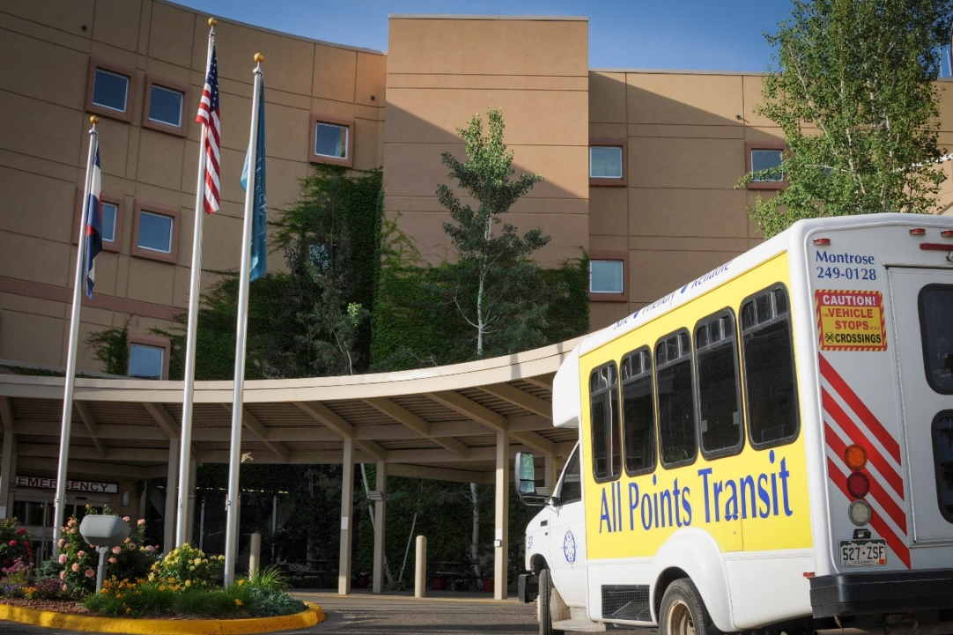
We Accept Referrals
Can be a general referral or appointment request
Please request appointments through this system at least 48 hours in advance
APT can follow up with client directly or with health navigator or clinic
Mobility Manager can provide trip planning, travel training and assistance with navigating funding options
Or just call us! 970-249-0128

Slide 11

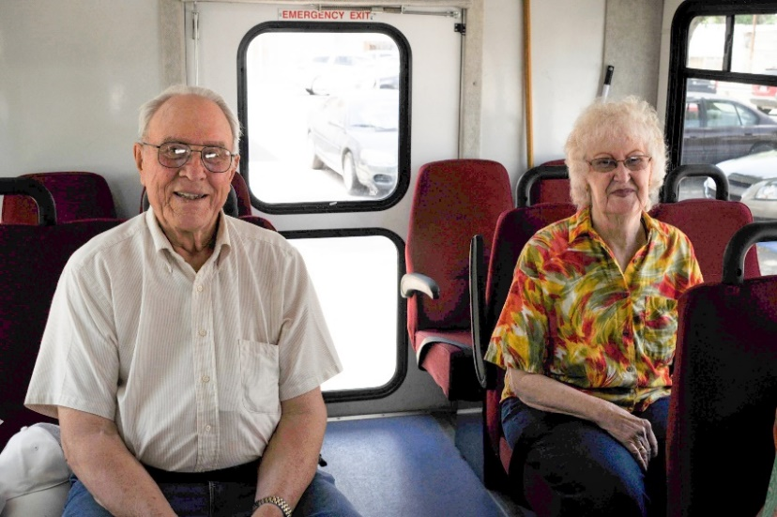

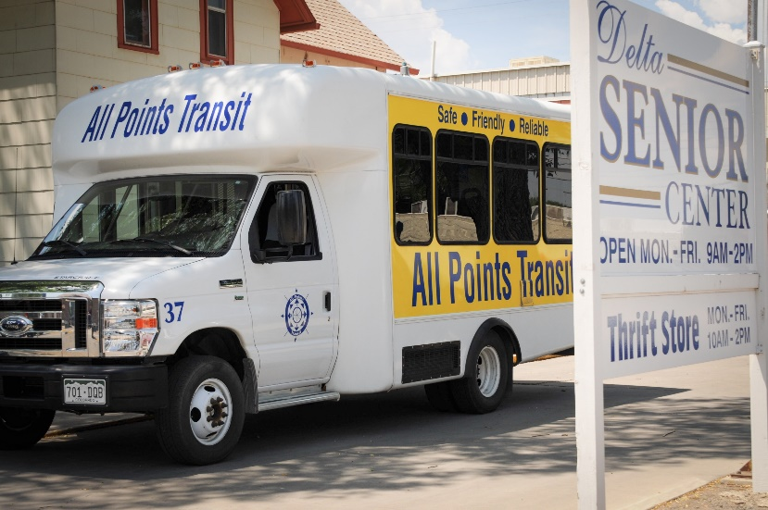
“Come ride with us, we know the way!”
Sarah Curtis
Executive Director
scurtis@allpointstransit.org
970-249-8865
btowle@allpointstransit.org
Web: www.allpointstransit.org
Facebook:
www.facebook.com/allpointstransit
Instagram:
www.instagram.com/allpointstransit

Slide 12

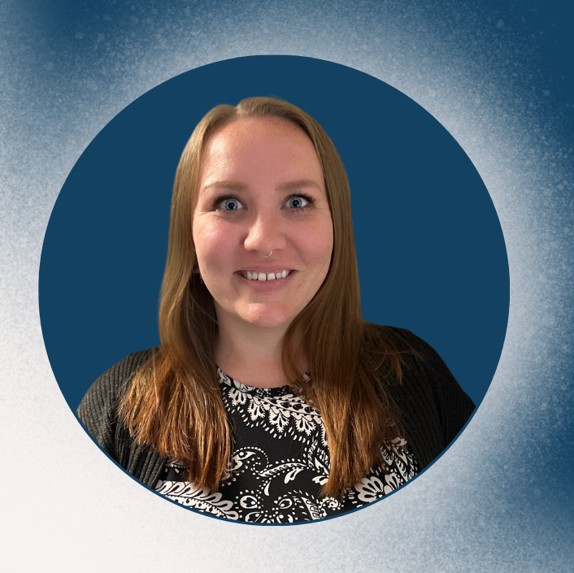
Heather Hendrickson
Promoting long-term
self-sufficiency and independence by preparing SNAP recipients for meaningful employment through work-related education and training activities.
Employment First Case Manager
Garfield County Department of
Human Services
hhendrickson@garfield-county.com
(970) 625-5282 ext. 3218

Slide 13
How does
Garfield County use CRN?
Receive referrals from various organizations to connect Garfield County clients to public benefits.
Send referrals to other organizations to assist clients with housing stabilization, mental health services, medical resources, etc.
Use CRN to coordinate services with other organizations.
Would you like to connect with Garfield County DHS through CRN? Please reach out to pulloa@garfield-county.com to discuss how we can work together to benefit our clients.

Slide 14
Transportation assistance and Garfield county DHS
Medicaid clients can bill taxi rides to and from health visits to Medicaid. They must partner with local taxi services to schedule the ride at least 10 days in advance, the taxi service will take care of billing.
SNAP recipients can enroll in the Employment First program and receive a monthly gas allotment while working with a case manager in Employment and Training activities.
Colorado Works/TANF clients can receive a monthly transportation bonus while working with a case manager in transportation eligible Colorado Works activities.

Slide 15


Al Alvarado
Manager of
Elias Transportation

Slide 16
Thank You!
Questions?
qualityhealthnetwork.org

Slide 17
Next Hot Topic Session –
Wednesday, July 19th, 2023
qualityhealthnetwork.org

