Slide 1
QHN Hot Topics:
Updates and Looking Ahead
September 20, 2023
Marc Lassaux, Executive Director and CEO
mlassaux@qualityhealthnetwork.org

Slide 2
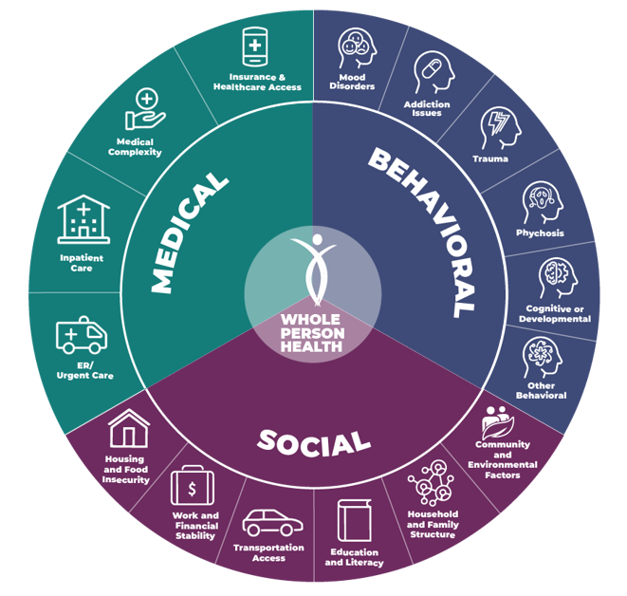
AGENDA
About QHN
Where we are now
Medical
Behavioral
Social
Where we are headed
Q&A

Slide 3
qualityhealthnetwork.org/qhn-summits/

Slide 4
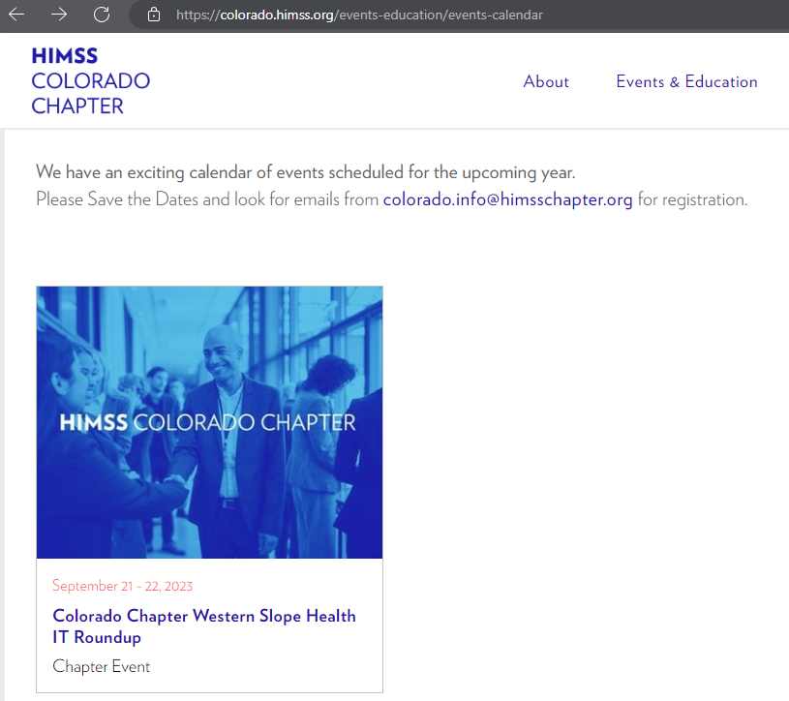
CHIMSS Event Western Colorado
Tomorrow Sept 21
2pm - 7pm
GJ Convention Center
https://colorado.himss.org/
Click on Events & Education

Slide 5
ABOUT QHN
Quality Health Network
Founded in 2004
Quality improvement organization
Secure HIE services in Western Colorado
90%+ of providers participate
100% of Hospitals participate

Slide 6
QHN Mission
Facilitate the availability of information to:
Optimize the health of our communities
Improve economic efficiencies of whole-person care
Bring value to our stakeholders

Slide 7
Why WHIE?
Physicians
Behavioral
Health
Community
Orgs
Labs
Hospitals
Corrections
LTSS
HIEs

Slide 8
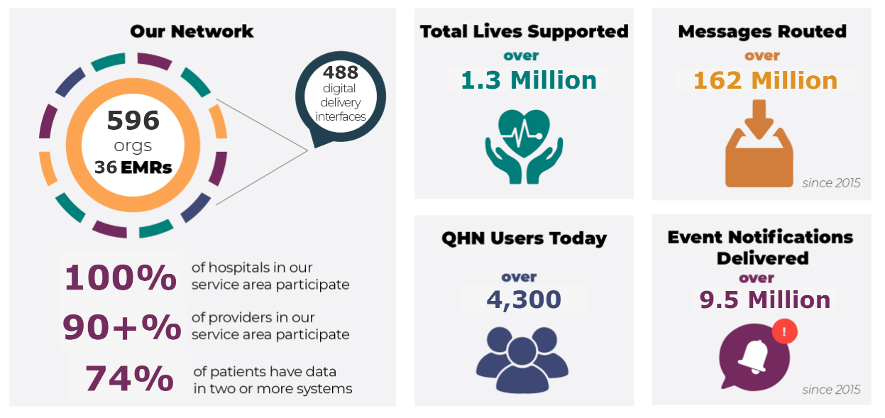
QHN Basic Data Types
The QHN Network Today

Slide 10
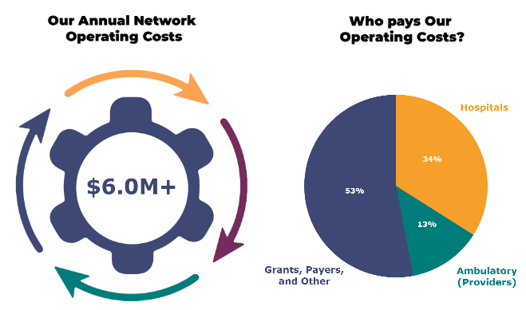
QHN Budget
$6.5M+

Slide 11
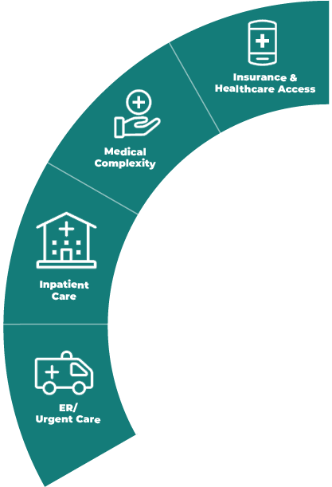
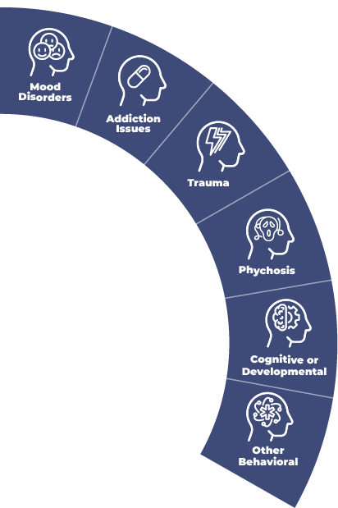
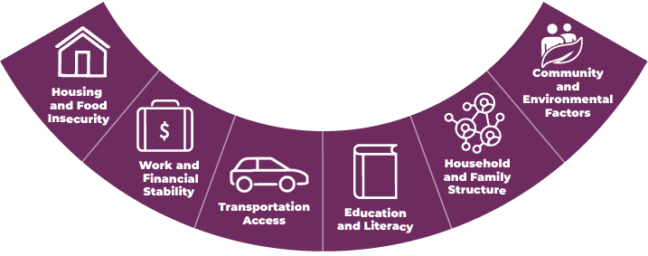
Medical Exchange
SOCIAL
MEDICAL

Slide 12
HIE Value Adds
Comprehensive Clinical History
Across care system & EHR boundaries
Real-time data delivery and notifications
“Subscribe” to patients
Quality Measure Reporting (eCQM) and HEDIS
Foundation to Value Based Care
Care Collaboration and Coordination

Slide 13
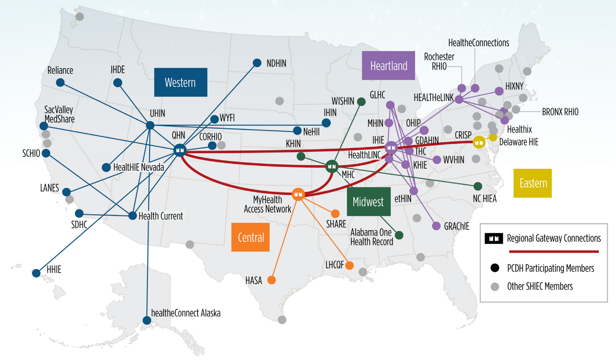
Patient-Centered Data Home

Slide 14
Behavioral Exchange
SOCIAL
MEDICAL

Slide 15
Behavioral Health
Regional behavioral health centers
Share data via QHN
With Consent!
Receive data from QHN

Slide 16
Behavioral Health Exchange Value
Reduce Manual Faxing
61% reduction in faxes sent
74% increase in electric data sent
Increase Primary Care Assignment
Understand who does not have doctor
Elevate status in Community
Easier to get data to and from facility

Slide 17
Social Information
SOCIAL
MEDICAL

Slide 18
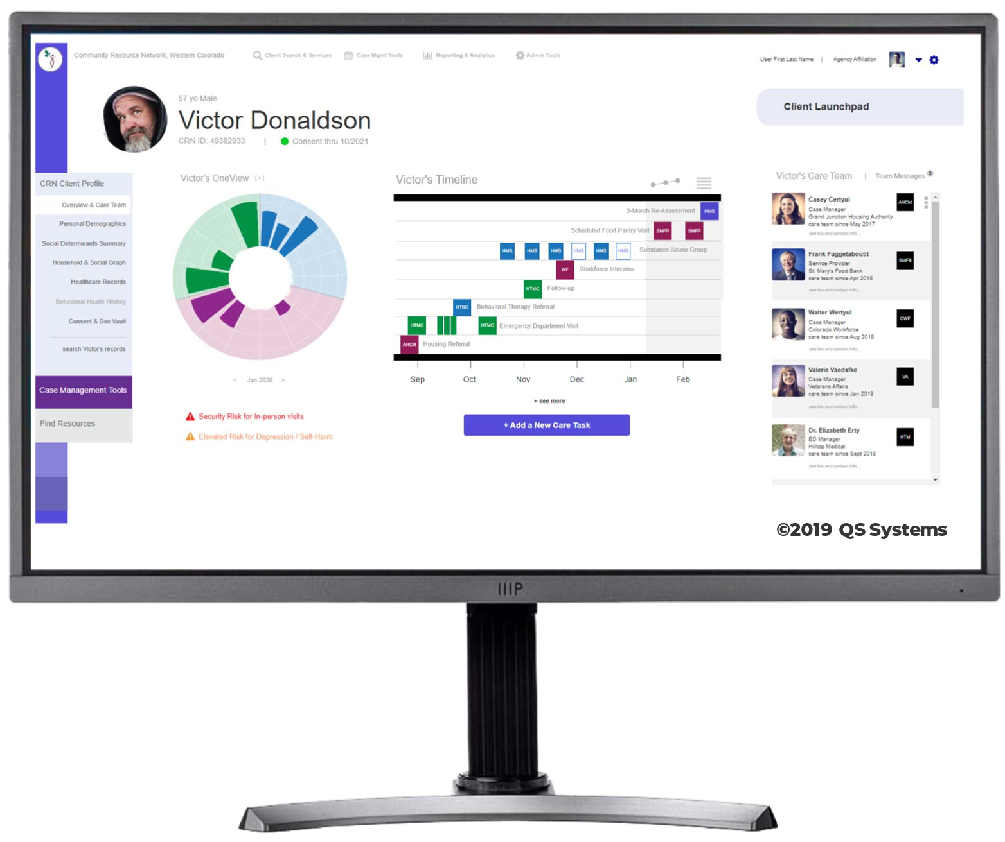
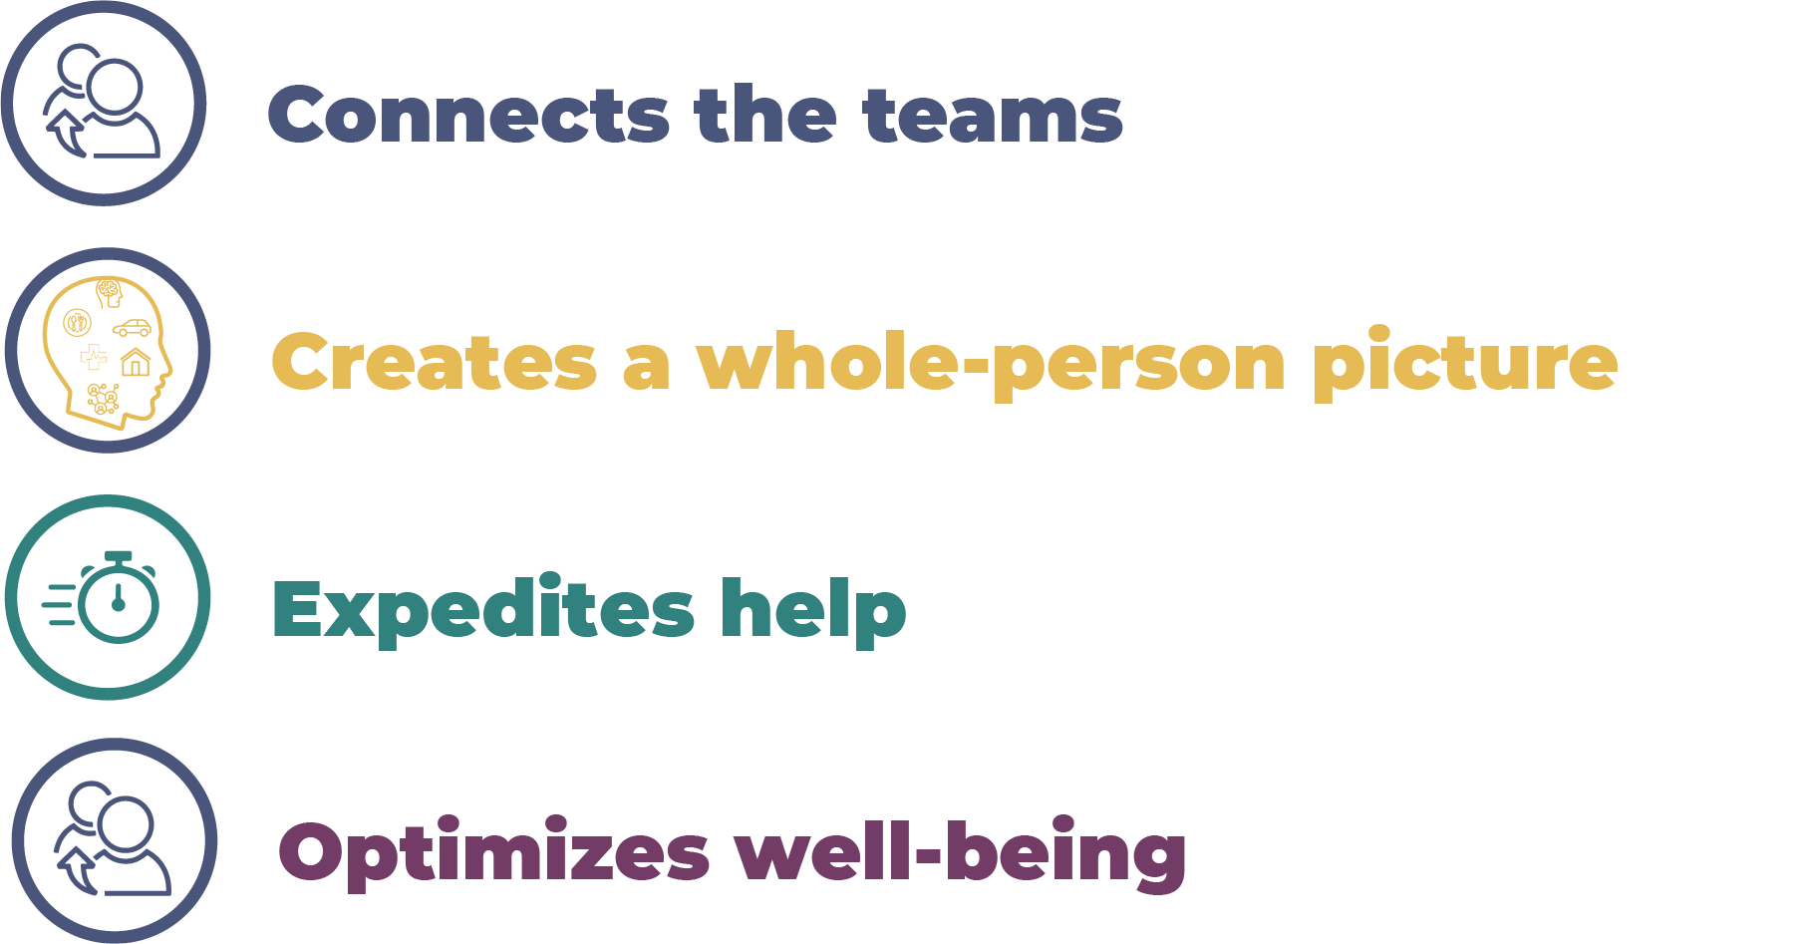
CRN Overview Connecting People, Changing Lives

Slide 19
Resource Directory

Slide 20
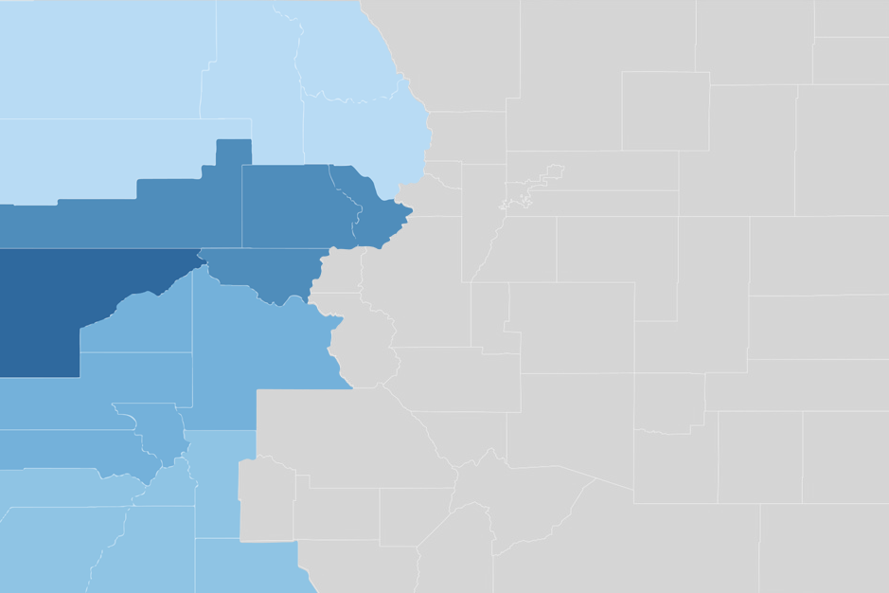
Participation
Steamboat Springs 13 active programs
West Mountain (Roaring Fork) 55 active programs
Delta County 24 active programs
Mesa County 50 active programs
Montrose County 23 active programs

Slide 21
Community–Wide Design & Collaboration

Slide 22
Community Resource Network
Robert Wood Johnson Foundation Innovation Award
Silver
Medal
September 2019

Slide 23
A New Home in Record Time
Loren Couch, a case manager at Homeward Bound, recently reported,
We helped a struggling family get access to housing in one-third of the time it normally takes to place someone.
CRN puts our clients at the front of the line in one-third the time!

Slide 24
QHN Looking Ahead
CRN SDoH expansion
Data strategy, analytics, and quality
Quality measurement
Reduce provider burden
Behavioral Health data, Meds data
National Requirement and Regs
21st Century Cures Act/TEFCA/QHIN/FHIR
QHIN Approach
Patient access to data

Slide 25
QHN & Contexture Affiliation
Letter of Intent LOI to Affiliate
Currently performing due diligence
Affiliation Benefits
Unified HIE solutions and better scale
Larger data sets for participants
Public Health, Pop Health, Care Coordination, Value Based Care/APM, +++.
Better serve local and regional communities at the state level
More in depth expertise in more areas

Slide 26
QHN & Contexture Affiliation
Why Now?
Great partners over time
New leadership structures at both orgs create opportunity
Colorado and Arizona are leaders in the HIT and HIE Space
The industry is evolving rapidly

Slide 27
THANK YOU!
THANK YOU! Questions?
Connecting People. Changing Lives.
Qualityhealthnetwork.org
CommunityResourceNet.org
Notes:
Add questions
Maybe troy pic, pillars

Slide 28
CHIMSS Event Western Colorado
Tomorrow Sept 21
2pm - 7pm
GJ Convention Center
https://colorado.himss.org/
Click on Events & Education

