Slide 1
The Next 20 Years of Healthier Together
Kim Bimestefer, Executive Director Colorado Department of
Health Care Policy and Financing Governor’s Cabinet
April 25, 2024

Slide 2
Congratulations QHN!
Celebrating 20 years of connecting hospitals, providers, and communities!
We are all looking forward to the next 20 years!
Thank you for all you have accomplished, the work that is happening today,
and all that is to come in the future!

Slide 3
Agenda: Partnership over the next 20 years
Social determinants of health
Current landscape
Innovative tools for a better tomorrow
Advancing health equity, closing health disparities
Leveraging value based payments to incent better results
Transforming behavioral health
Investing in our workforce and providers
Investing in rural and frontier communities
Accountable Care Collaborative Phase III
Affordability

Slide 4
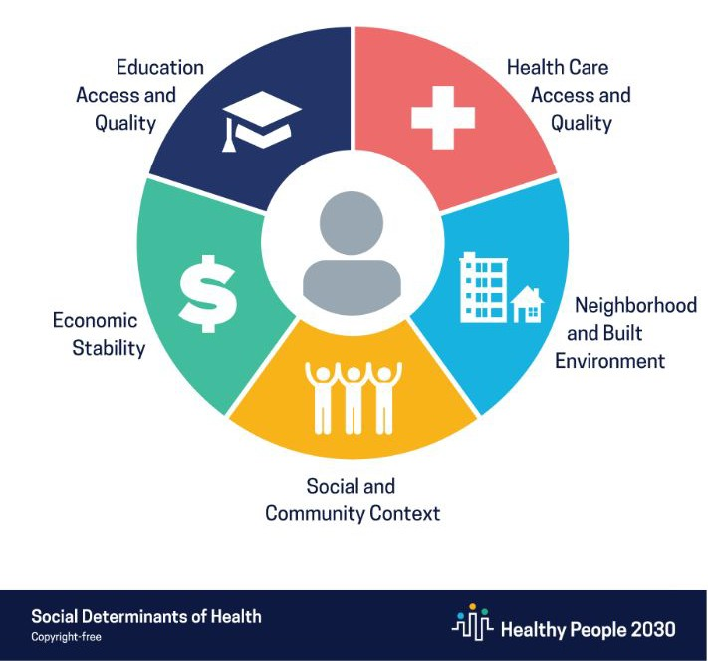
Opportunity: Social Determinants of Health (SDoH) can account for 40% of a person’s health
But the U.S. healthcare system doesn’t currently focus on SDoH
Source: CMS Roadmap for States, American College of Healthcare Executives
4

Slide 5
Opportunity: Health disparities linked with social, economic, and/or environmental disadvantages adversely affect groups of people who have systematically experienced greater obstacles to health
People of color
Older adults, 65+ years
Children
People with chronic conditions
Low-income/Medicaid
People experiencing homelessness
Rural and Frontier
Photo by Brooke Lark on Unsplash
People with disabilities

Slide 6
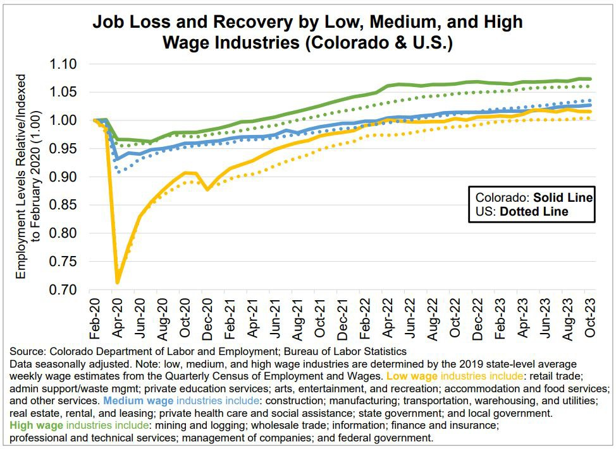
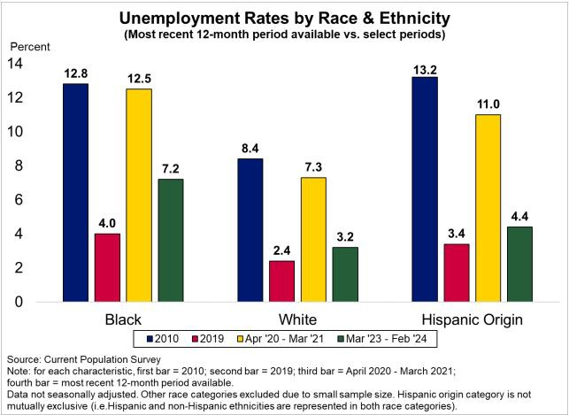
Wage & Unemployment Disparities
Source: Colorado Department of Labor and Employment, Press Release: Colorado Employment Situation – October 2023 and February 2024
Also, inflation has disproportionately affected lower-income Coloradans (Source: CU Denver report www.bellpolicy.org/2022/12/15/inflation-and-colorados-middle-class)

Slide 7
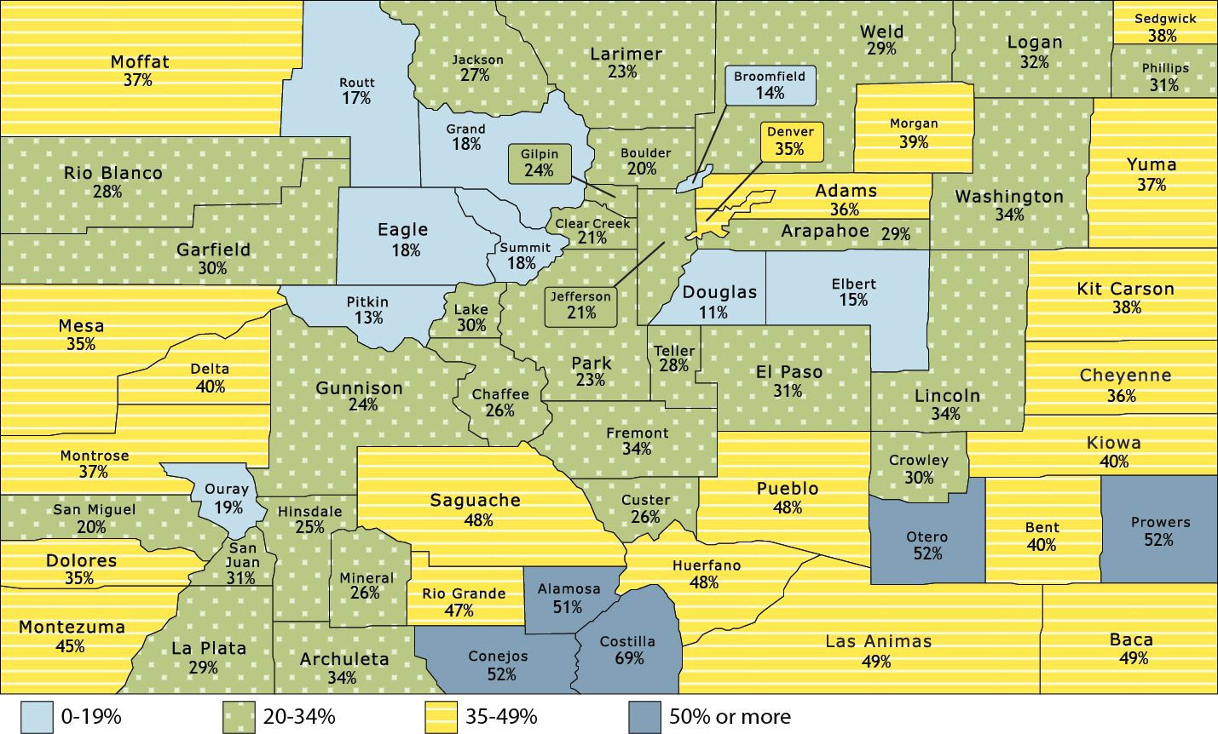
Percentage of Total Population Enrolled in Medicaid and CHP+
Source Medicaid Management Information System (MMIS) from CY 2022
Population data from State Demographer.

Slide 8
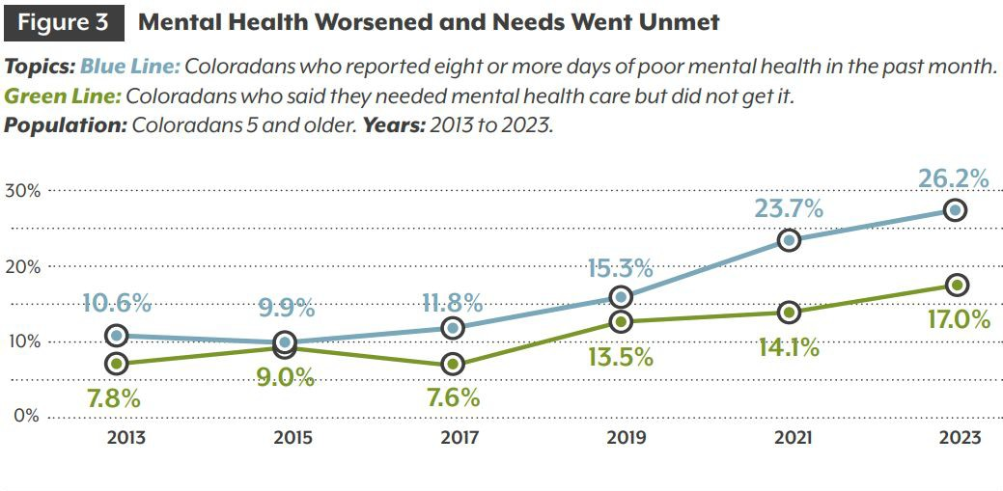
Behavioral Health Opportunity
Healthy Kids CO Survey 2021:
26% of youth felt their stress was unmanageable
40% of youth experienced persistent feelings of sadness or hopelessness
17% of youth seriously considered suicide in the past year, which has not changed since 2015
Source: 2023 Colorado Health Access Survey

Slide 9
Challenge: An Increasing CO Older Adult Population 1-in-5 CO’s >60 years old. 1-in-4 in Mesa County*
Pressure on demand for health care workers Lower reimbursements under Medicare
Costs: Dec. 2022 to Nov. 2023
Total Medicaid PMPM Cost: $600
Non-LTSS Cost PMPM:
LTSS cost PMPM:
$408
$5,968
LTSS = Long Term Services & Supports for People with Disabilities
*per Board of Mesa County Commissioners

Slide 10
Challenge: U.S. spending & the cost of healthcare
2022: U.S. health care spending grew 4.1%, accounting for 17.3% of GDP. Top 2 drivers: Rx and hospital prices
2023 Colorado Health Foundation Pulse Poll:
2/3 respondents: Cost of healthcare is a “very serious” problem
Cost of living is the top issue, disproportionately affecting people of color and lower-income
40%: “Just getting by financially”
2022 National Health Expenditure Accounts (NHEA): cms.gov
2023 Colorado Health Foundation Pulse Poll: copulsepoll.org/results
10

Slide 11
Emerging Financial Impact of Specialty Rx
Threat: <2% of drugs are so expensive, they are driving
50% of Rx costs
Emerging Prices:
$4.25M Lenmeldy - treatment to preserve cognitive and motor function in metachromatic leukodystrophy
$3.5M Hemgenix - potentially curative treatment option for patients with severe hemophilia B
$3.2M Elevidys - one time gene therapy for select patients with Duchenne Muscular Dystrophy
$3M Skysona - treats degenerative neurological condition in children
$2.9M Roctavian - one infusion treatment option for patients with severe hemophilia A
(#1 driver of rising Rx costs, nationally)
11

Slide 12
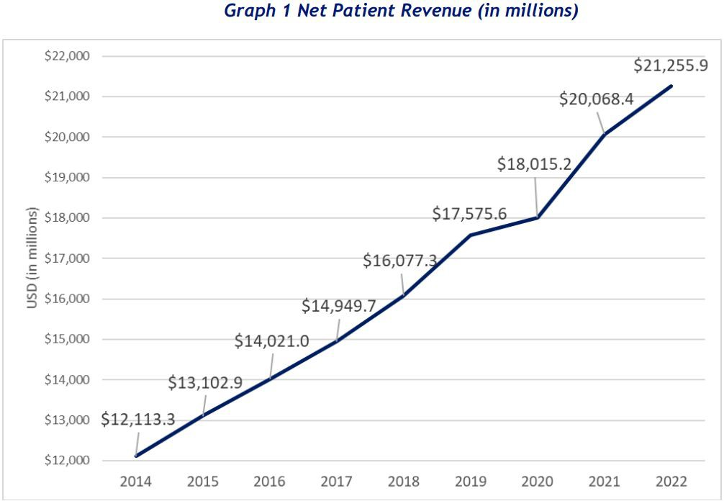
Colorado hospital revenues continue to increase
The biggest part of the health care dollar: hospital costs
Net patient revenues have continued to rise at an annual rate of 7%+, up $9B (75%)
btw 2014 and 2022
The CO population grew by 9.2% during the same period
More at: CO.gov/HCPF/hospital-reports-hub
12

Slide 13
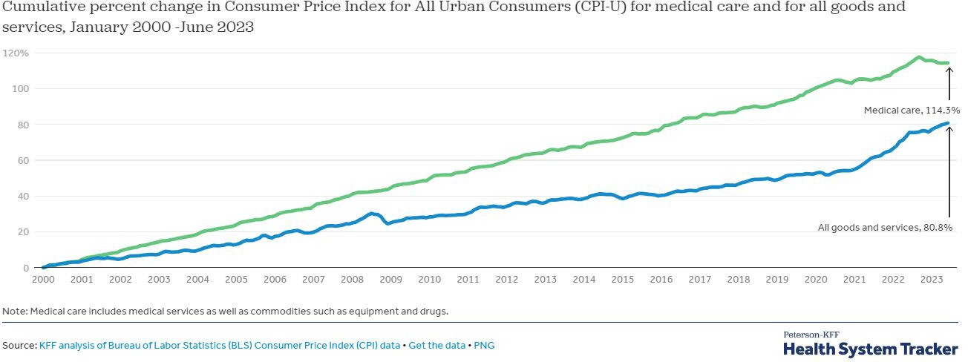
Challenge: Medical vs overall inflation growth
13

Slide 14
CO 2023 uninsured rate decreased (<5% from 6.5% from 15.8%) as Medicaid coverage increased through PHE…Now what is it??
More at: coloradohealthinstitute.org/research/2023-chas-insurance-coverage
14

Slide 15
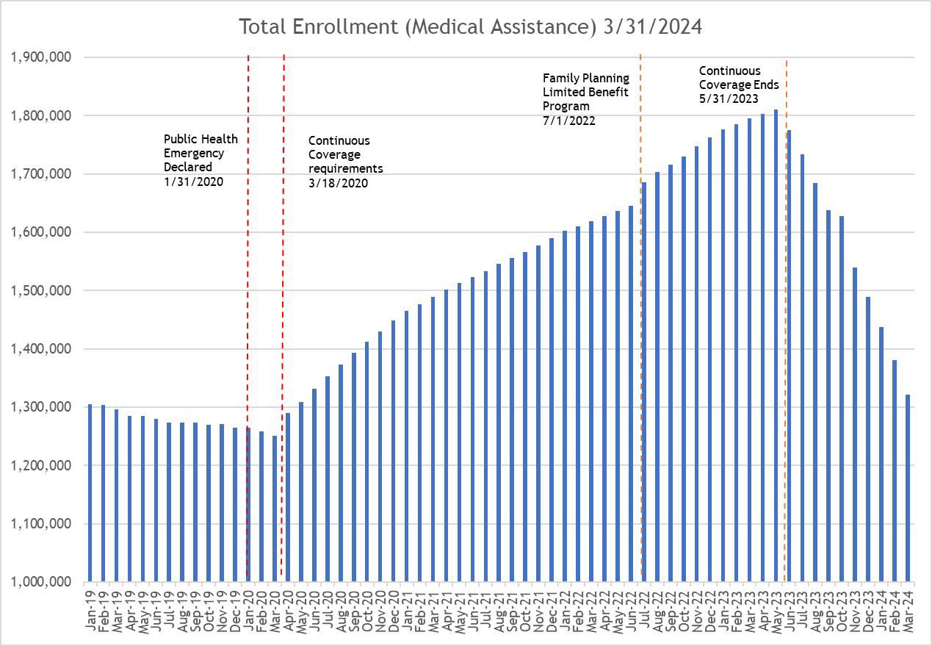
Medicaid Change
45%+ growth Q2
2020 thru May 2023 PHE continuous coverage
Projected disenrollment of 519k during PHE Unwind
Pre-PHE
uninsured rate: 6.5%.
During PHE, down to <5%. Now?
More at: CO.gov/hcpf/ccu
15

Slide 16
Solutions
16

Slide 17
Solution: SDoH & Affordability-Colorado Prescriber Tools
Phase I: OpiSafe (Jan. 2021)
Phase I: Affordability (June 2021)
Phase II (SHIE): Patient Health Supports for Providers, Care Managers and Community Workers - In Process
Helps prescribers prevent misuse/ abuse of opioids, benzos, controlled substances
5,250+ allocated licenses
+16% reduction in inappropriate use just in Year 1!
Shares real-time Rx benefit info (RBTI), affordability hierarchy empowering prescribers to be part of solution
Automates prior authorizations and prescriptions
Improved patient and provider service experience
State programs like WIC (CDPHE), SNAP and TANF (CDHS), Housing Vouchers (DOLA)
Medicaid and Commercial payer programs like: prenatal support, diabetes/case management
Community supports to address social determinants of health, like food banks, homeless shelters
Build in development
Thank you for supporting single sign on to and from OpiSafe, enabling quick, secure access! Thanks for making connections to make the SHIE robust and impactful for providers on the Western Slope!
CO.gov/HCPF/prescriber-tool-project

Slide 18
Health Equity Transformation
Executing Health Equity Plan to address disparities, improve outcomes for members
Maternity and perinatal health: 1 year of postpartum coverage (SB21-194); expanded population coverage for family planning services; Cover All Coloradans 2025
Behavioral health: increase in-network providers; expand behavioral health mobile crisis benefit and develop secure transportation benefit
Prevention: address social determinants of health through Phase II of the Prescriber Tools; whole-person care and integrated services; ACC Phase III
SB 21-181, in partnership with the Governor’s Office and CDPHE, created a shared health equity strategic plan across the social determinants of health framework
Each RAE and CHP+ MCO has a Health Equity Plan (contract requirement)
13 health equity plans from RAEs/CHP+
Reducing health disparities with targeted interventions - drive quality care and access
Cultural responsiveness and member experience
More at: CO.gov/HCPF/health-equity

Slide 19
Solution: VBP - Pay providers to achieve shared goals: improve quality and affordability, close disparities
Value Based Payments - 50%+ of Medicaid Payments by 2025
Hospital Transformation Program: quality, equity, affordability - 100% of hospitals
Primary Care Physicians: 54% of Medicaid members cared for by PCPs under advanced primary care payment model
Physicians Controlling Rx Costs: 50% of Medicaid prescribers for Prescriber Tool affordability real-time benefit check results
Maternity Care: 30% of Medicaid births paid through Maternity bundle VBP
Behavioral Health safety net (CMHCs) in development
More at: CO.gov/HCPF/value-based-payments

Slide 20
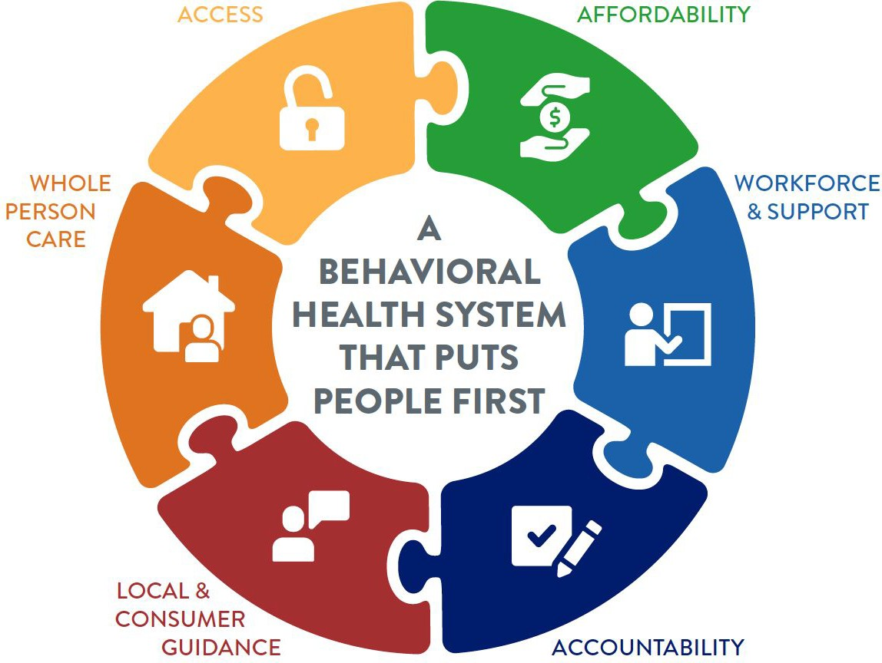
Solution: CO Behavioral Health Blueprint for Reform
6 pillars & 19 priority actions to support creating a BH system that will meet people where they are and help them navigate resources available to support the whole person
More at: bha.colorado.gov/about-us/behavioral-health-taskforce
20

Slide 21
Priorities of BH Transformational Task Force
Prioritizing Gaps in Care
Increasing high-intensity outpatient and
transition services
Children and youth, schools
Serious Mental Illness, folks with complex needs
People who are unhoused
Adding beds; youth residential, tribal substance use disorder facility
Co-occurring intellectual or developmental disabilities
Criminal justice diversion, Continuous coverage
People who have been incarcerated

Slide 22
Solution: Improving Behavioral Health in Medicaid
New Providers
New Services
New Payment Models
New Accountability Standards
Helping providers adjust
BHASO and RAE
alignment in policy and practice
New provider types, service provisions, associated funding
Integrating primary care, mental health, SUD/MAT services
Improving crisis continuum
Focus on community delivered services
Reducing reliance on law enforcement
Reducing reliance on ERs

Slide 23
Solution: April 2024 1115 Waiver Elements
Continuous Eligibility Coverage for Children 0-3 Years
Extends continuous eligibility coverage for children >3 years of age. Includes eligible children who face barriers due to immigration status.
Eff. Jan 2026
Continuous Eligibility Coverage for Adults Released from DOC
Criminal Justice Reentry Services
Coverage will include case management services, medication- assisted treatment for SUD, a 30-day supply of meds upon release from DOC and Division of Youth Services facilities.
Eff. July 2025
Serious Mental Illness and Serious Emotional Disturbance (SMI & SED) Inpatient Care
Allows HCPF to pay for up to 15 days per month for each member staying in an Institute of Mental Disease (IMD) regardless of the number of days in each episode of care.
Eff. July 2025
Extends eligibility coverage for 12 mo.s to adults released from a Colorado Department of Corrections facility
Eff. Jan 2026

Slide 24
Solution: Addressing social determinants of health
HB24-1322 conducting study using Medicaid dollars to support SDoH, incl food security, housing
Section 1115 Waivers can be used to address food and nutrition access as well as housing supports, including:
Medically-tailored meals
Fruit and vegetables prescriptions and/or protein boxes
Nutrition counseling and education
Meals or pantry stocking
Rent/temporary housing
Housing transition navigation services
Tenancy sustaining services
Thank you for connecting providers while coordinating care and services to improve people’s health across western Colorado!

Slide 25
Solution: Supporting shared workforce goals
96% of HCPF budget goes to pay our health care providers
The Long Bill as of late March included the below (subject to change):
Across-the-board rate increases 2% (FY24-25), 3%, 2% and 2.5% last several years
Targeted Rate Increases: Approved at or above most all HCPF requests. Surgery rate increase slightly lower than requested. Rejected co-surgery rate increase.
Direct care workers wage increase $12.41 to $15 (1/1/22) to $15.75/hr (7/1/23) to
$17/hr and Denver $17.29/hr to $18.29/hr eff 7/1/24
Building the pipeline for tomorrow’s workforce:
Care Forward Colorado: free, short-term health care training
Career Advance: credentials in other high-demand industries
Colorado Healthcare Corps: 150 AmericCorps serve in facilities statewide
Opportunity Now: industry and education collaboration
HB24-1231: state funding for 4 medical professions at specific higher ed institutions

Slide 26
Solution: eConsults
Live and operational Feb. 2024
Provides PCPs with specialist support
Enable expanded care in PCP office, improving access
More convenient for members
Reduces unnecessary specialist visits and no-shows
Supported by value based payments that reward results
Flexibility to use hospital’s own, HCPF-approved tool
Drives improvements in access, outcomes, equity and affordability to the betterment of members and providers
Thank you for partnering with RMHP to launch with Safety Net Connect: ensuring primary care providers and specialists have access to longitudinal health records!
More at: ColoradoMedicaideConsult.com
26

Slide 27
Solution Cost/Quality: Providers of Distinction
Driving affordability while improving care access, quality, health equity
Hired KPMG to collaborate to build the model, payment, rewards, etc.
Reward providers with value based incentives for cost and quality performance and referrals
Provide members with information about which facilities have a distinction label so they can make informed decisions on where to access care
Unique advantages for rural providers and communities: access, jobs, revenues, and closing disparities
Focus on maternity, cholecystectomy (gallbladder), and knee replacements initially
Providers of Distinction Tentative Timeline:
Design Program and Pick Draft Measures
Now - May 2025
Engage Stakeholders
May 2024 -
Dec 2024
Test Model
Target Implementation
Dec 2024 -
June 2025
Mid 2025
27

Slide 28
Solution: ARPA HCBS By the Numbers
10% Enhanced FMAP from April 1, 2021 - March 31, 2025
resulting in:
61 Projects
$551.7 Million
reinvestment
10,400+
5 Projects have been completed
1,340 Grantee Recipients
90% Directly Beneﬁting the Community 3.5% Admin
total attendance at ARPA Stakeholder Engagement Opportunities
11 months to close
98,001
page views on the ARPA webpage
Through March 2024

Slide 29
Solution: Nursing Home Transformation
Need to reimagine Nursing Facilities: Consider what Coloradans want, need, safety. Sustainability. Consider NH and hospital rural collaboration.
Challenge | Approach | Results
Staffing | Increased reimbursements State Funding towards Career Development (CareForward Colorado) Licensing requirement for Staffing Agencies | Full time CNA wages in nursing homes increased 25% YoY Staffing agency usage is decelerating
Evolving Consumer Preference and Needs | In collaboration with stakeholders, develop a state-wide long-term sustainability plan Increased reimbursement tied to outcomes, quality, and behavioral health supports | Record high pay for performance participation in 2023 Increasing # of facilities adopting behavioral supports programs
29

Slide 30
Investing in Rural Hospitals
Hospital Transformation Program Rural Support Fund - $60M over 5 years to help 23 critical access and rural hospitals modernize ($30M out)
Improving Rural Access and Affordability - $10.6M rural access and affordability
We celebrate SB23-298 enabling rural hospitals to collaborate and cooperate without merging or violating anti-competitive federal or state laws
CHASE prepayments to help cover payroll for 2 rural hospitals, as they implemented parallel sustainability solutions
More at: CO.gov/HCPF/rural-provider-access-and-affordability-stimulus-grant-program
30

Slide 31
Investing in Rural Hospitals
$17.4M in federal matching fund in Health Information Exchange (HIE) over 4 years connectivity
100% of identified rural safety net providers connected to HIE, in support of rural member access to care and to keep care local
Sustainability payments to keep participating — first payments went out March 1 $3.74M with $2.5M payments to CAHs; next payment Aug. 1, then annually ($100k per hospital, $20k per provider)
31

Slide 32
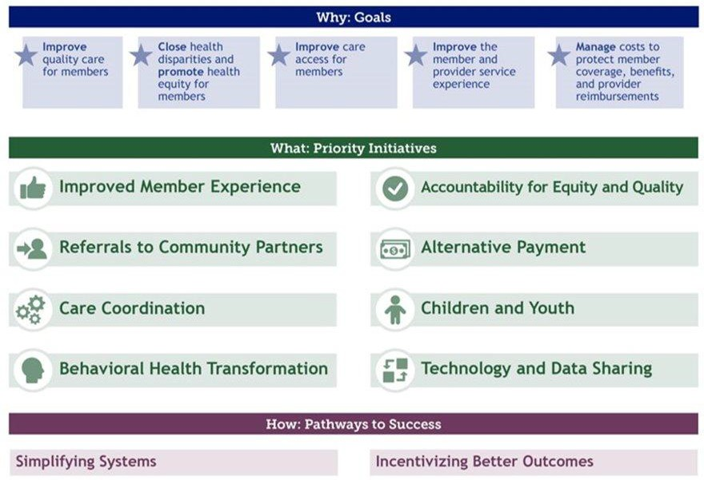
Investing in Western CO Providers Going Forward Accountable Care Collaborative Phase III
Vision for July 2025 - RHC
massive support
To engage or get more info: CO.gov/HCPF/accphase3

Slide 33
Solution: Saving People Money on Rx
7 recommendations | Progress made on all recommendations
Value-based arrangements for specialty drugs | 5 Medicaid value-based contracts hold drug manufacturers accountable for clinical outcomes while sharing 100% of savings on the prescriber tool
Canadian Drug importation | Submitted an updated Canadian drug importation program plan in Feb. 2024 to bring savings to consumers and employers
Rebate Pass Through, Pricing Transparency and Contract Pass Through (eliminate spread pricing) | HB22-1370: Effective Jan. 2024, health insurers required to use all rebates to lower employers and consumers Rx costs HB23-1201: Effective Jan. 2025, eliminates “spread pricing,” or up-charging of Rx drugs carriers/pharmacy benefit managers on insured policies and Medicaid
Prescription Drug Affordability Board (PDAB) | Sets upper payment limits on certain drugs - max 18 per year
Prescriber Tools: Opioid Response. Affordability Modules. Social Health Information Exchange. | OpiSafe: >5k allocated licenses. Affordability: ~50% Medicaid prescribers while improving member and provider experience. Social Health Information Exchange: Awarded bid to enable providers to prescribe health improvement programs and social determinants of health supports
Reducing Prescription Drug Costs in Colorado, 2nd ed., 2021, CO.gov/HCPF/publications

Slide 34
Solution: Saving People Money on Hospital Care
Payer mix continues to shift from private insurance to government payers
Medicaid and Medicare payer mix increased from ~43% in 2009 to ~61% in 2022
Since 2009, Health First Colorado reimbursements have increased from 54% to 81% of hospital cost
More at: CO.gov/HCPF/hospital-reports-hub

Slide 35
Questions?
Thank you!

