Slide 1
Evolution of the HIE Platform
Contexture Update at QHN Hot Topics
Deanna Towne
Chief Information Officer
deanna.towne@contexture.org
Marc Lassaux
Chief Solutions Officer – Contexture
Former CEO and Executive Director – QHN
marc.lassaux@contexture.org

Slide 2
Presenters
Sherri Corey
Marc Lassaux
Deanna Towne
Director, Development & Engagement
Chief Solutions Officer
Chief Information Officer

Slide 3
Agenda
Welcome & Introductions
Agenda
About Contexture
Affiliation Information
New Platform Benefits
New Platform Features and Functions
Improved Identity Matching
Data Quality Standards on new Platform
New HIE Solutions
Patient Care 360 Portal
Questions

Slide 4
About Contexture
Who We Are Contexture provides health information exchange (HIE) services for Arizona and Colorado. We are the largest health information organization in the Western region
What We Do Contexture is a nonprofit regional organization that provides strategic, technical and administrative support to communities committed to advancing health through information sharing
Our Mission Advancing individual and community health and wellness through the delivery of actionable information and analysis

Slide 5
Contexture by the Numbers
(Contexture + QHN)
688
16.5K
1105
DATA SENDERS
AZ
USERS
PER
MONTH
DATA SENDERS
CO
13.2M
14.3M
PATIENTS
AZ
PATIENTS
CO
11.7M
56+M
17.5M
ALERTS
PER MONTH
AZ
CCD/HL7
TRANSACTIONS
PER MONTH
ALERTS
PER MONTH
CO

Slide 6
Contexture Solutions
Health
Information
Exchange
Quality Improvement
Data
Analytics
Social Determinants of Health
Public
Health
Connecting digital health records to give providers the patient information they need at their fingertips.
Helping healthcare providers meet various federal reporting and compliance requirements.
Providing the information necessary to improve individual and community health.
Connecting healthcare and community service providers to streamline referrals and foster easier access to vital services.
Working with public health agencies to improve emergency response, access to vital patient data and reporting.

Slide 7
QHN & Contexture Affiliation
Why Affiliate?
Contexture & QHN have a long partnership in Colorado
Our future strategies and vision align
Contexture has a strong national presence
HIE is evolving rapidly and requires strong partners
Participants will:
benefit from unified data systems
have access
to more
services
have access
to larger
data sets

Slide 8
QHN & Contexture Affiliation Timeline
AUG 2023
Letter of Intent (LOI) to Affiliate
APRIL 2024
Board votes for affiliation
OCT 2024
Staff begin integration
STAFF
FULLY
MERGE
DUE
DIL.
GO
PUBLIC
APRIL-SEPT 2024
Due Diligence
MAY 2024
Publicly
Announce
Affiliation
JAN 2025
QHN staff are now Contexture staff
LETTER
OF
INTENT
STAFF
BEGIN
MERGE
BOARD
VOTE

Slide 9
Scope & Contracting
Implementation & Data Receivers & Senders
Go-live
QHN & Contexture Technical Timeline
Planning
Q4
2025
Communications

Slide 10
Contexture HIE Platform

Slide 11
New HIE Platform Benefits to QHN Participants
Data will be connected statewide!
Improved Data Exchange Capabilities
Greater EHR interoperability & data management
Faster, more reliable data exchange
Easier to access patient information & coordinate care
Enhanced Security & Protection
Commitment to patient information and privacy
Stronger safeguards against unauthorized access & breaches
Greater Flexibility
Improved system performance
Better adaptation to healthcare needs & technologies
Better User Experience
Upgraded portal in 2025
Simplified user experience
Easier searching & patient matching
BENEFITS

Slide 12
New Features & Functionality
Integration of new data types into Portal
Behavioral Health
Physical Health
42 CFR Part 2 Protected Data
New Pharmacy Interfaces
Ability to indicate 'Patient Favorites'
Save specific frequent patients
Reduced time searching
Data Analytics within Portal
Trending over time for specific values
Visual representation of data

Slide 13
Revolutionary Data Access Across All Sources
Integrated Data Ecosystem Patient Comprehend harnesses the full spectrum of healthcare data from diverse, agnostic sources:
HL7 & FHIR: Delivering real-time clinical data with cutting-edge API capabilities.
CCD & Claims Capabilities (Future): Seamless integration of clinical documents and administrative claims for a 360° patient view.
Flat Files & APIs: Unlocking previously siloed data for immediate use and action.

Slide 14
Identity Management
= Best of breed EMPI
All data is identity managed at point of ingestion
Leverages a referential matching approach in addition to traditional probabilistic matching

Slide 15
Data Quality Standards
Focus on inbound data quality and integrity.
Leverage standard interface specifications across all senders.
Improved monitoring for quality/quantity expectations. Value Set Monitoring expansion.

Slide 16
HIE Solutions
in the New Platform

Slide 17
PatientCare 360 Portal
Web-based platform that provides a comprehensive view of a patient's physical and behavioral health records.
Seamless Access
User-friendly Dashboard
Cost Efficiency
Comprehensive Connectivity
Enhanced Identity Matching
SSO Available

Slide 18
Data Senders
Hospitals or healthcare providers that send patient information to HIE.
Interoperability
Real-time Data Exchange
Complete Patient Record
Secure Data Sharing
Improved Data Repository
Increased Efficiency
Better Data Quality
Data Standardization

Slide 19
Notifications
Receive alerts in real-time or on a set cadence when a patient has new lab results, visits the ER, or is admitted/discharged from a hospital.
Event Notifications
Clinical Notifications
Care Management Improvements
Customization Options
Outcome Enhancements

Slide 20
Direct Secure Message
A secure method for healthcare providers to exchange patient information with other providers and the HIE.
Enhances communication and care coordination
Allows the exchange of various data types
Helps meet bidirectional HIE exchange requirements

Slide 21
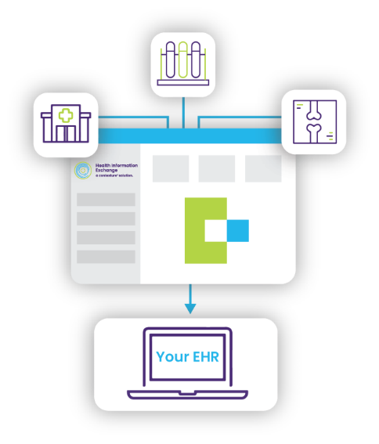
Results Delivery
A system that transmits patient results directly into a provider’s EHR, allowing for faster decision-making and improved care coordination.
Provider-Based Routing
Real-Time Results Access
Collaborative Care
Streamlined Workflow

Slide 22
Quick Results
Delivers face sheets, lab results and radiology reports within minutes of the data being available, ensuring providers have real-time, accurate information.
Optimized Workflow
Solution Differentiation
Unique Deployment Characteristics

Slide 23
Reports
Provides up-to-date information for care coordination, population health management, quality reporting and data analytics.
Standard Reports Offered
Demographic Report
Contact Report
Encounter Report
ADT Notification Compliance Report (Hospital Only)
HTP Summary Report (CO Hospitals Only)
Vital Report
Laboratory Report

Slide 24
Smart Summary
A complete view of a patient’s medical history to help healthcare providers gain a full understanding of a patient’s health over time.
Member Lookback
Real-Time
Query
High Utilization
Individual Authorization (Managed or Self Directed)

Slide 25
History
Robust historical patient data to support decision-making and reporting.
One-Time Delivery of Historical Patient Data
Raw Data Format
Flexible Look-Back Periods
Enrich Your Systems

Slide 26
PatientCare 360 Portal
Powered by KPI Ninja Health Catalyst

Slide 27
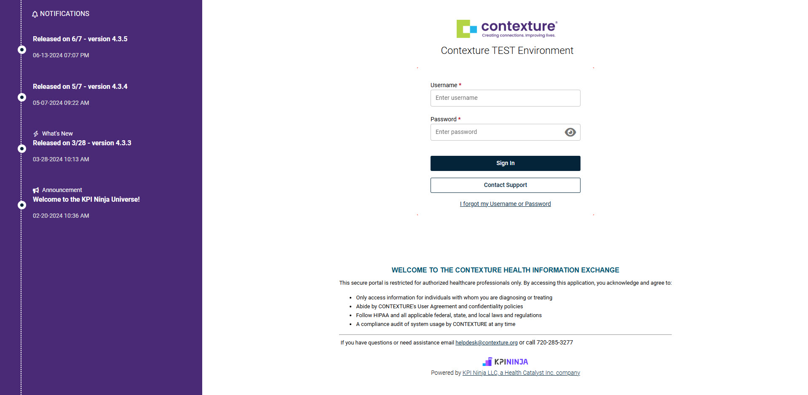
A Quick Look at PatientCare 360 Portal

Slide 28
Easy Navigation

Slide 29
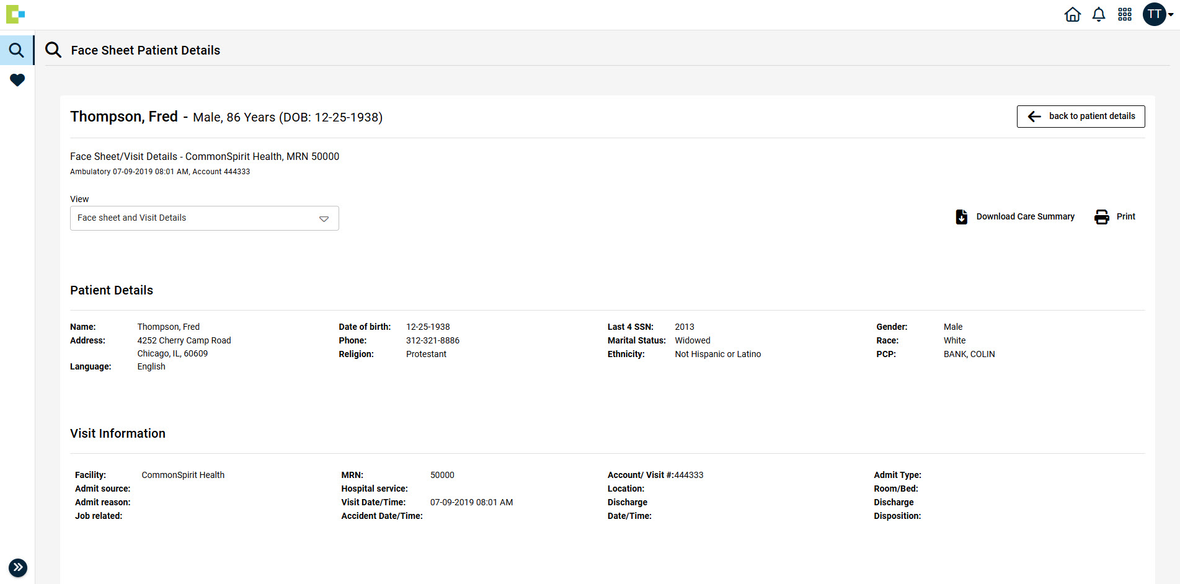
Face Sheet

Slide 30
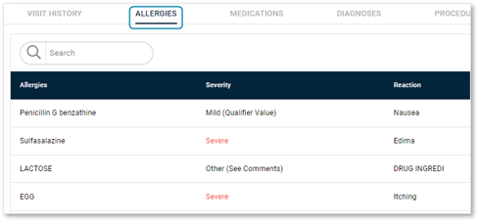
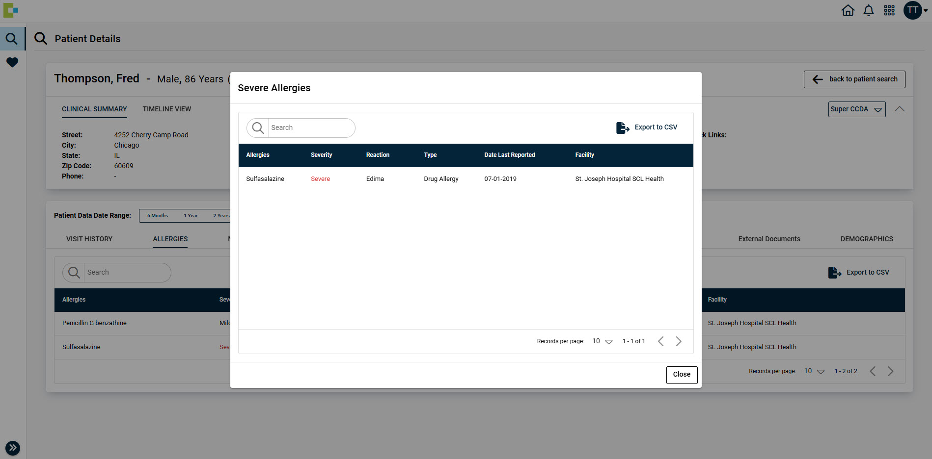
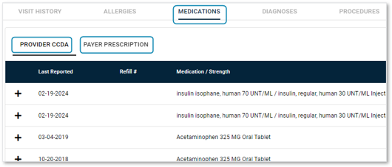
Allergies and Medications Overview
Allergies​
Flagged if Severe ​
Severe Allergies Quick Link & Alerts​
Medications​
Parsed from CCD​
Payer files can be included: such as MedicaidRx​

Slide 31
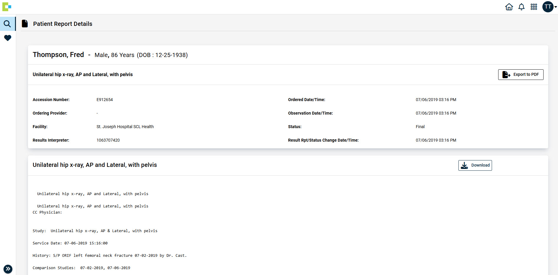
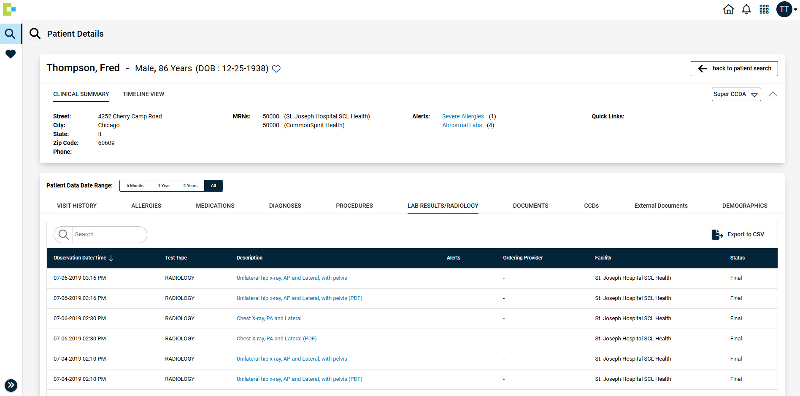
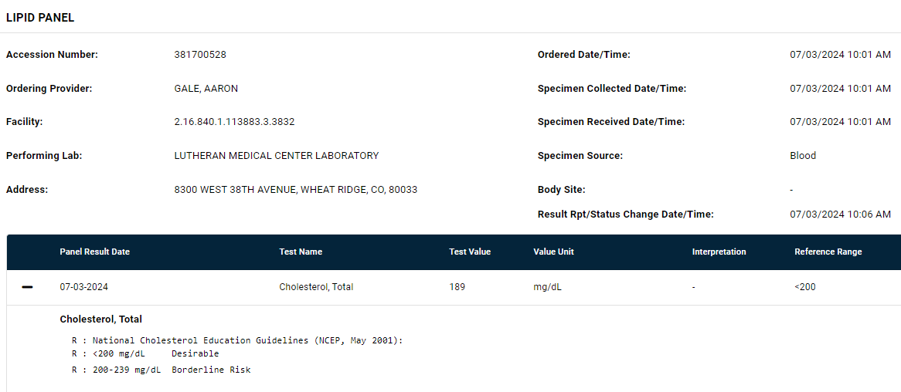
Lab/Rad & Imaging Reports
Lab/Rath/Lab/Rath/Path/Micro Results​
Flagged if abnormal​
Flagged if abnormal​
Abnormal labs Quick Link ​
Result details can be downloaded

Slide 32
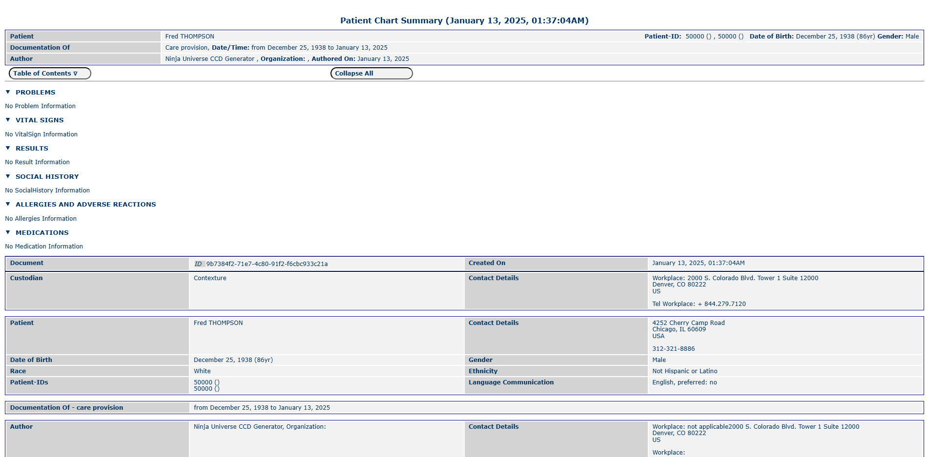
Transcriptions and Downloadable CCDs
Click to view entire document​
Super CCD-A- Download to PDF, XML, HTML or JSON format

Slide 33
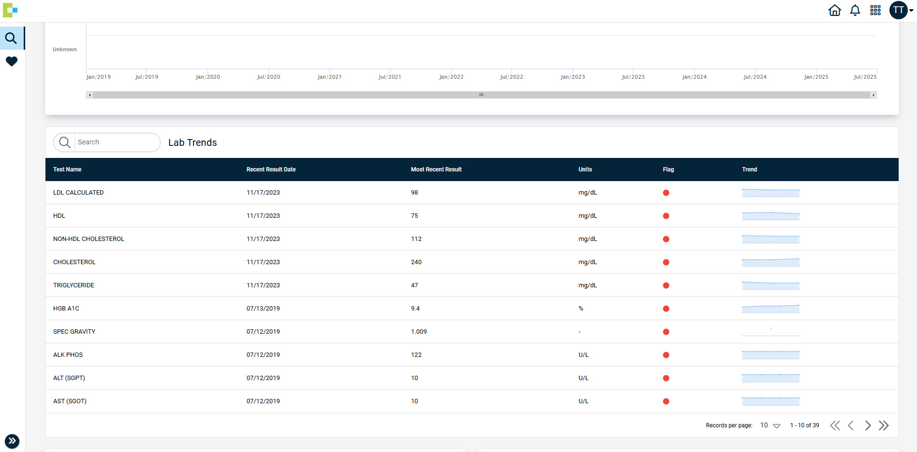
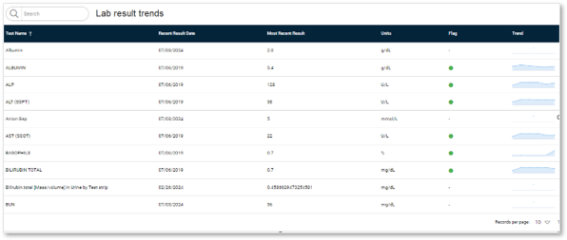
Trends and Timelines
Timeline Views provide lab trending to offer visual insight into results over time

Slide 34
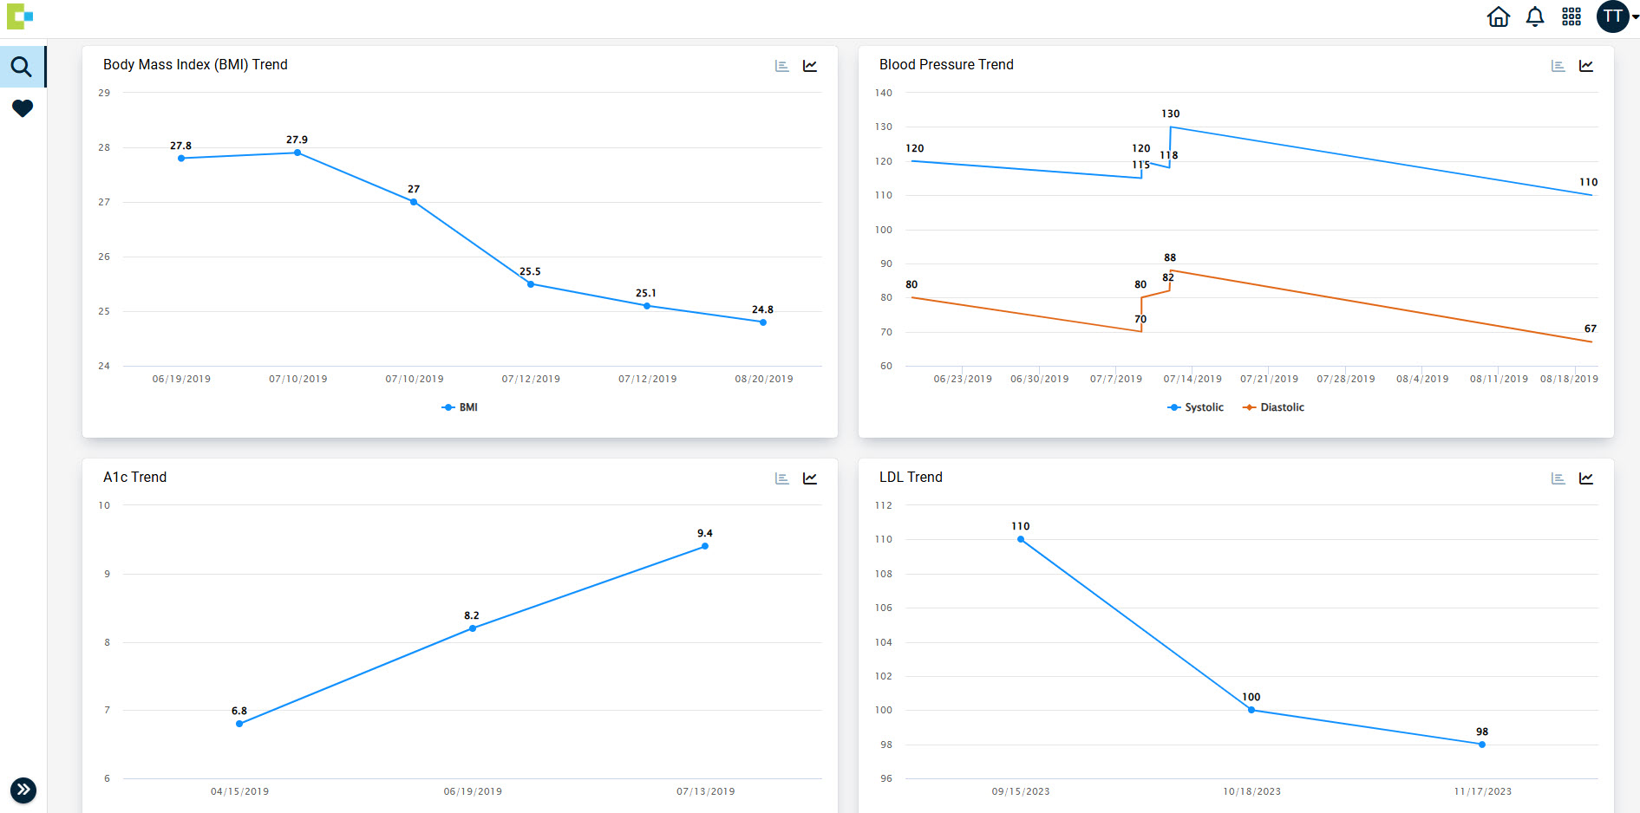
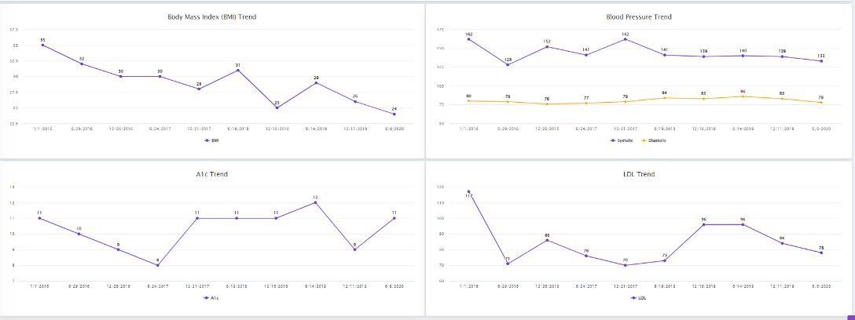
Key Indicators

Slide 35
Watch a quick demo of the new PatientCare 360 Portal
https://youtu.be/JMG_e_ZT3p8?si=XyRaL4gApk4ybL6A

Slide 36
Questions?

